Slide 1
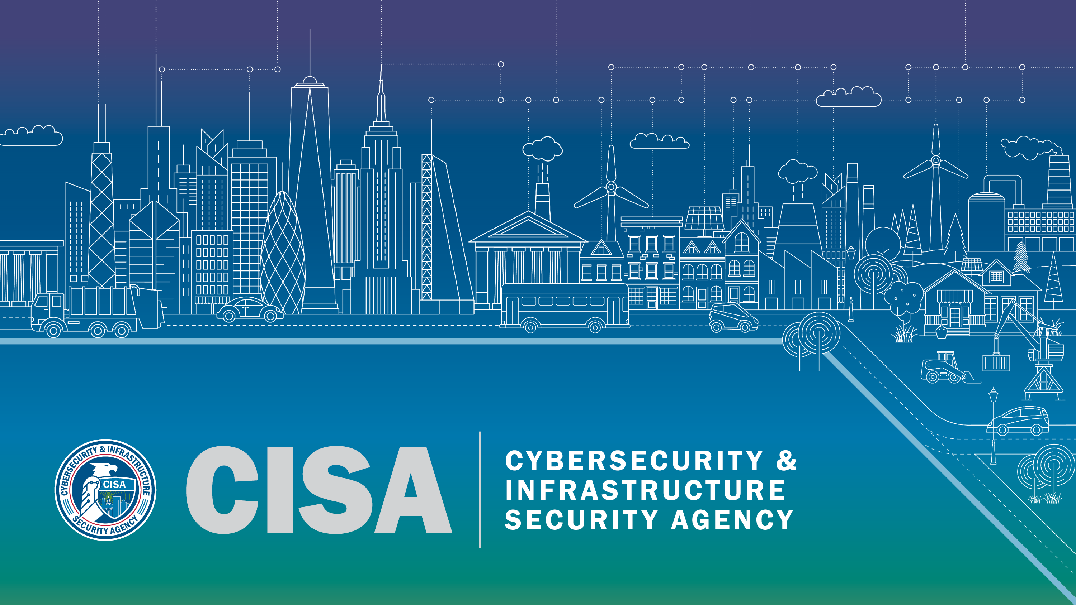
Notes:
[Provide introductory remarks, set the tone/introduce yourself and your relation to the audience.]
“Next Slide”

Slide 2
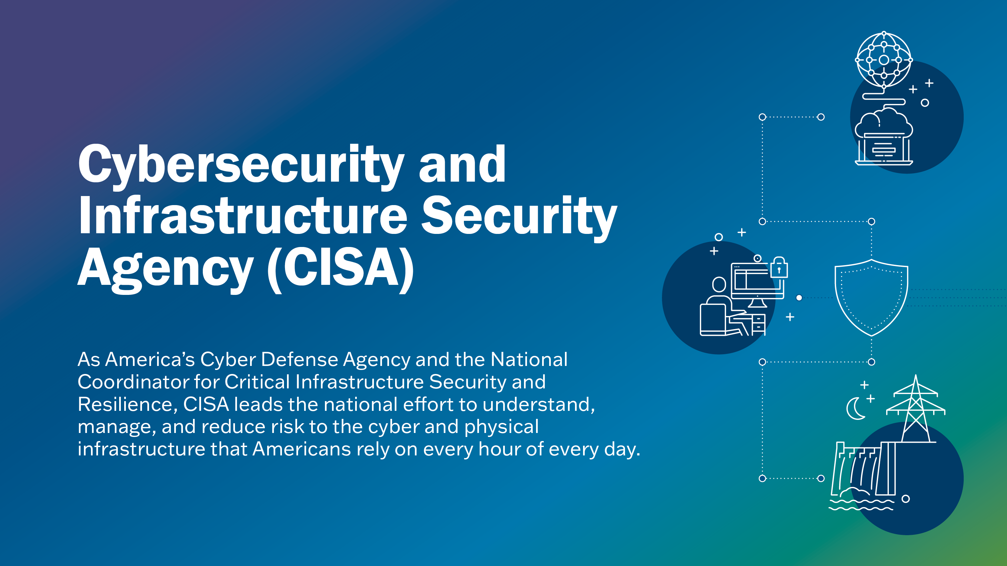
Notes:
As America’s Cyber Defense Agency and the National Coordinator for Critical Infrastructure Security and Resilience, CISA leads the national effort to understand, manage, and reduce risk to the cyber and physical infrastructure that Americans rely on every hour of every day.
“Next Slide”

Slide 3
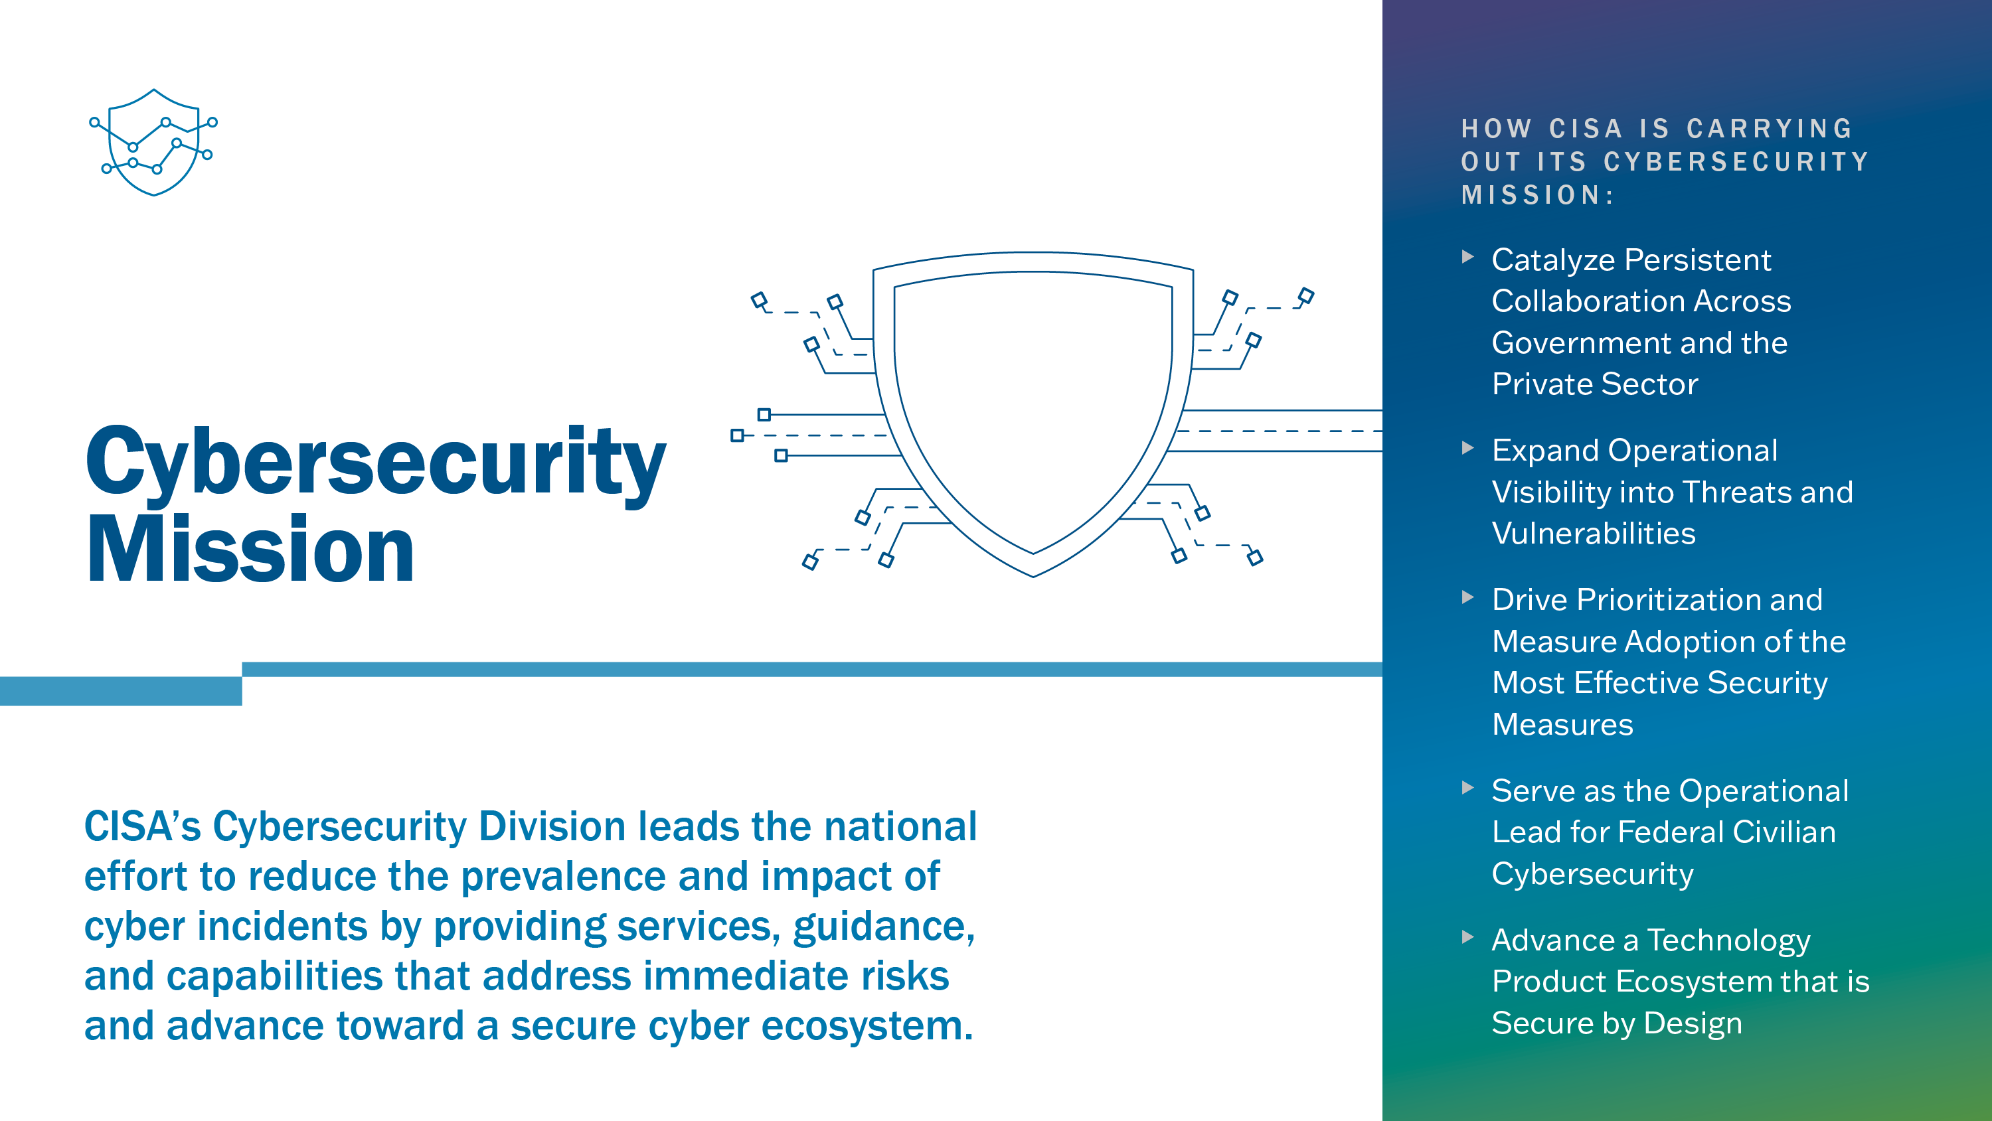
Notes:
“CISA’s cybersecurity mission is to defend and secure cyberspace by coordinating the collective national cyber defense of critical infrastructure, enhancing the resilience of national critical functions against cyber risks, and helping to build a defensible technology ecosystem.
We provide stakeholders with tools and capabilities to prevent, mitigate, and respond to cyber incidents.
CISA executes this mission by working with the cybersecurity community and engaging in operational collaboration to actively reduce the risk of cyberattacks, with a dominant focus on defending against and minimizing the impact of attacks intended to infiltrate, exploit, disrupt, or destroy critical infrastructure and the National Critical Functions (NCFs) it enables.
CISA established the Joint Cyber Defense Collaborative (JCDC) to unify cyber defenders from organizations worldwide. This diverse team proactively gathers, analyzes, and shares actionable cyber risk information to enable synchronized, holistic cybersecurity planning, cyber defense, and response.
Fully realizing its role as the operational lead for federal civilian executive branch cybersecurity, we leverage our directive authorities to transform how agencies prioritize their cybersecurity activities and by providing increasing levels of direct support to agencies that require major improvements.
By bringing together all levels of government, the private sector, international partners, and the public, we are taking action to protect against cybersecurity risks and strengthen the resilience of our nation’s networks.
While many preventative resources are available online, we understand during cyber incidents, swift and personalized assistance may be needed, and stakeholders are encouraged to, and should feel empowered to reach out to us at any stage if they need assistance.
“Next Slide”

Slide 4
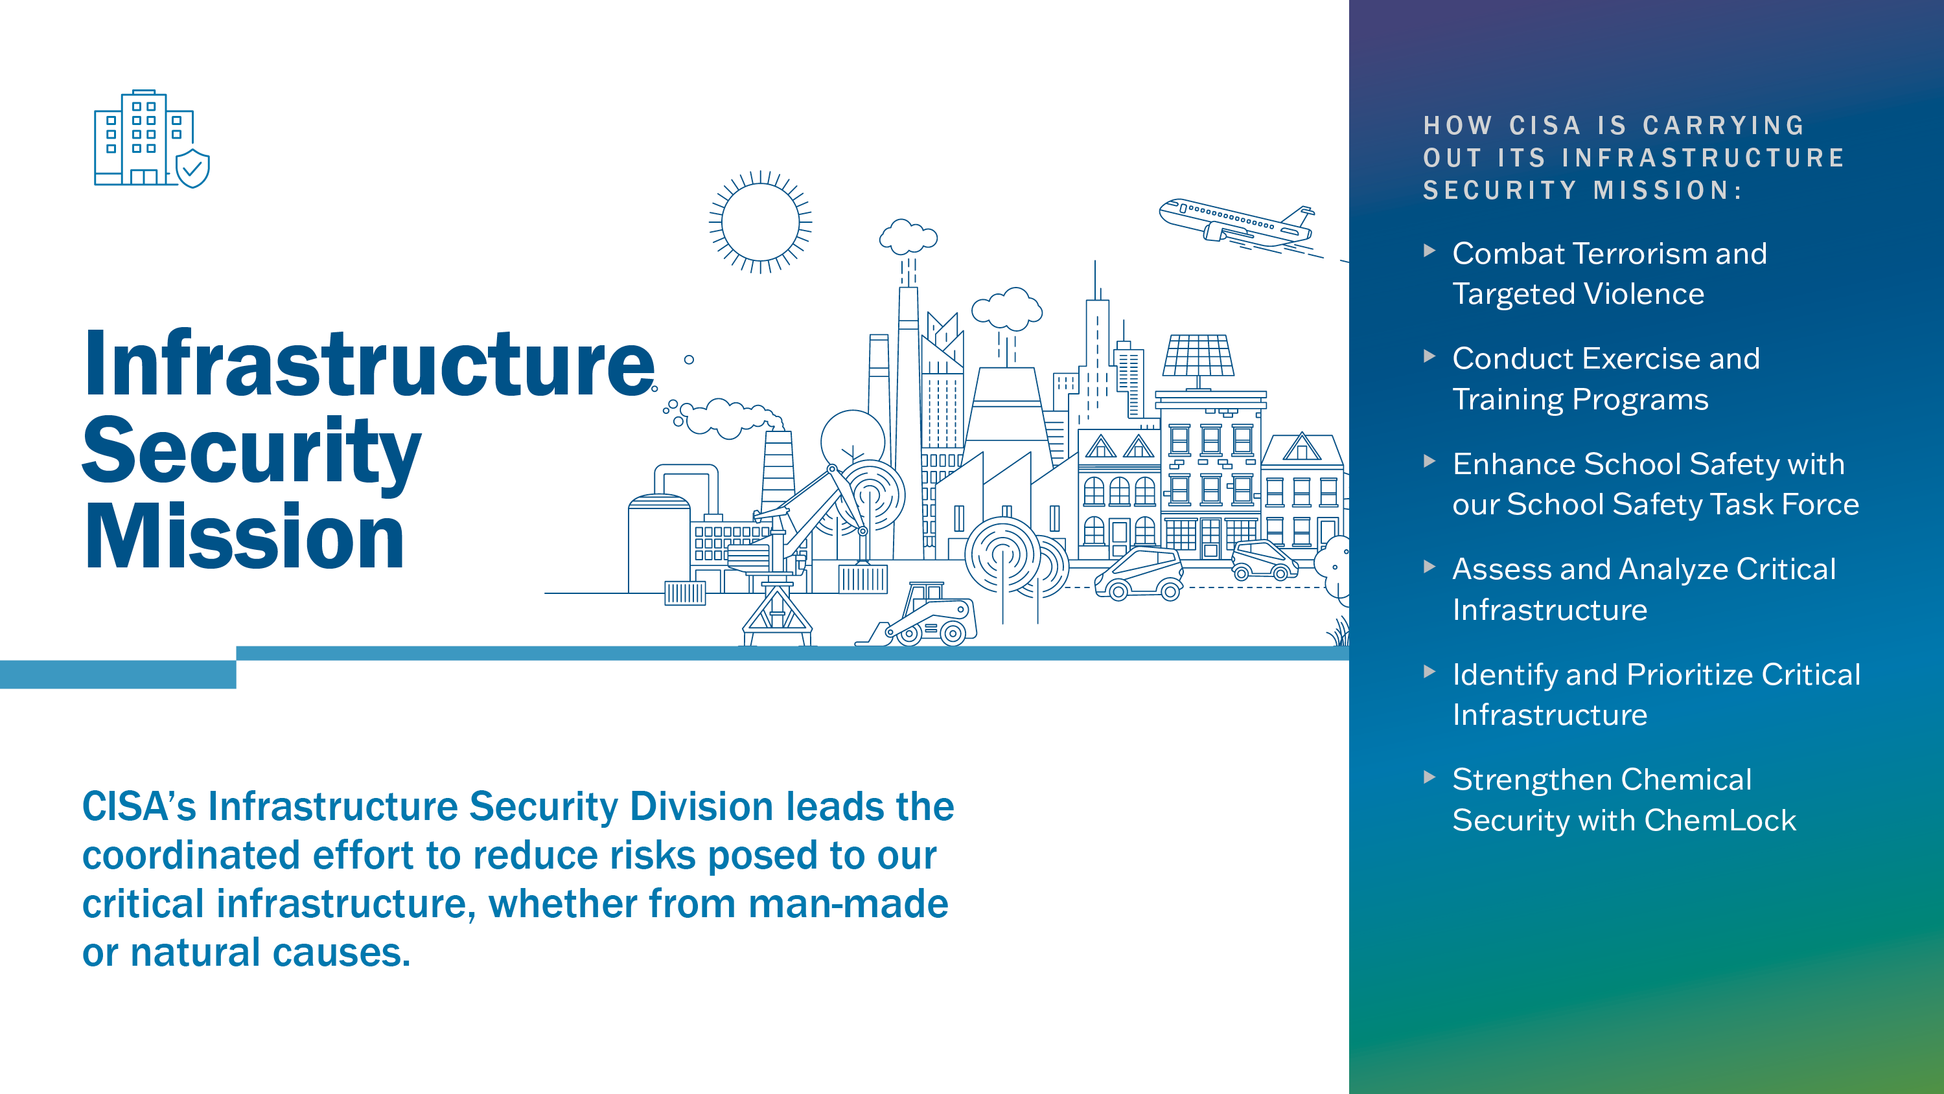
Notes:
CISA leads the national effort to secure critical infrastructure by managing risk and enhancing resilience through collaboration with the critical infrastructure community.
Through its core function and programs, CISA delivers unique and timely information, expertise, services, and tools in collaboration with infrastructure security stakeholders.
We provide access to tools and resources to support community security and resilience. These resources cover the numerous threat vectors in CISA’s portfolio, including unauthorized access to facilities, cybersecurity, election security, active shooters, bombings, and small unmanned aircraft systems (sUAS).
Through a multitude of resources, trainings, and exercises, we support stakeholders in building security capacity to mitigate domestic violent extremism, like a bomb attack on a House of Worship, as well as and targeted violence, like an active shooter in a school.
CISA also has an exercise and training program where the agency conducts cyber and physical exercises with government, sector, and international partners to enhance security and resilience of critical infrastructure.
CISA’s School Safety Task Force works to strengthen the safety and security of our nation’s kindergarten through grade (K-12) schools.
The task force develops and deploys resources and training specific to helping schools and districts prevent and mitigate physical security threats and risks.
The program also manages and administers the interagency Federal School Safety Clearinghouse and its website SchoolSafety.gov, and regularly conducts outreach and engagement campaigns and activities to educate the K-12 community on school safety issues.
Lastly, the task force supports CISA’s coordination with the K-12 community by raising awareness of cyber-related risks and CISA’s resources to combat them.
Lastly, I would like to touch on chemical security. CISA Chemical Security manages the ChemLock program, a completely voluntary program that provides facilities that possess dangerous chemicals with no-cost services and tools to improve their chemical security posture in a way that works for their business model. Additionally, despite strong support from industry and overwhelming bipartisan support in both the House and Senate, Congress has allowed the statutory authority for CISA’s Chemical Facility Anti-Terrorism Standards (CFATS) regulations to expire. For more than 15 years, CISA’s CFATS program has ensured that the more than 3,200 high-risk chemical facilities located in communities across all 50 states are protecting their chemicals from cyber threats and physical exploitation by terrorists. The implementation of CFATS directly helps to protect the homeland—and the agency continues to urge Congress to act soon to re-authorize this critical program.
“Next Slide”

Slide 5
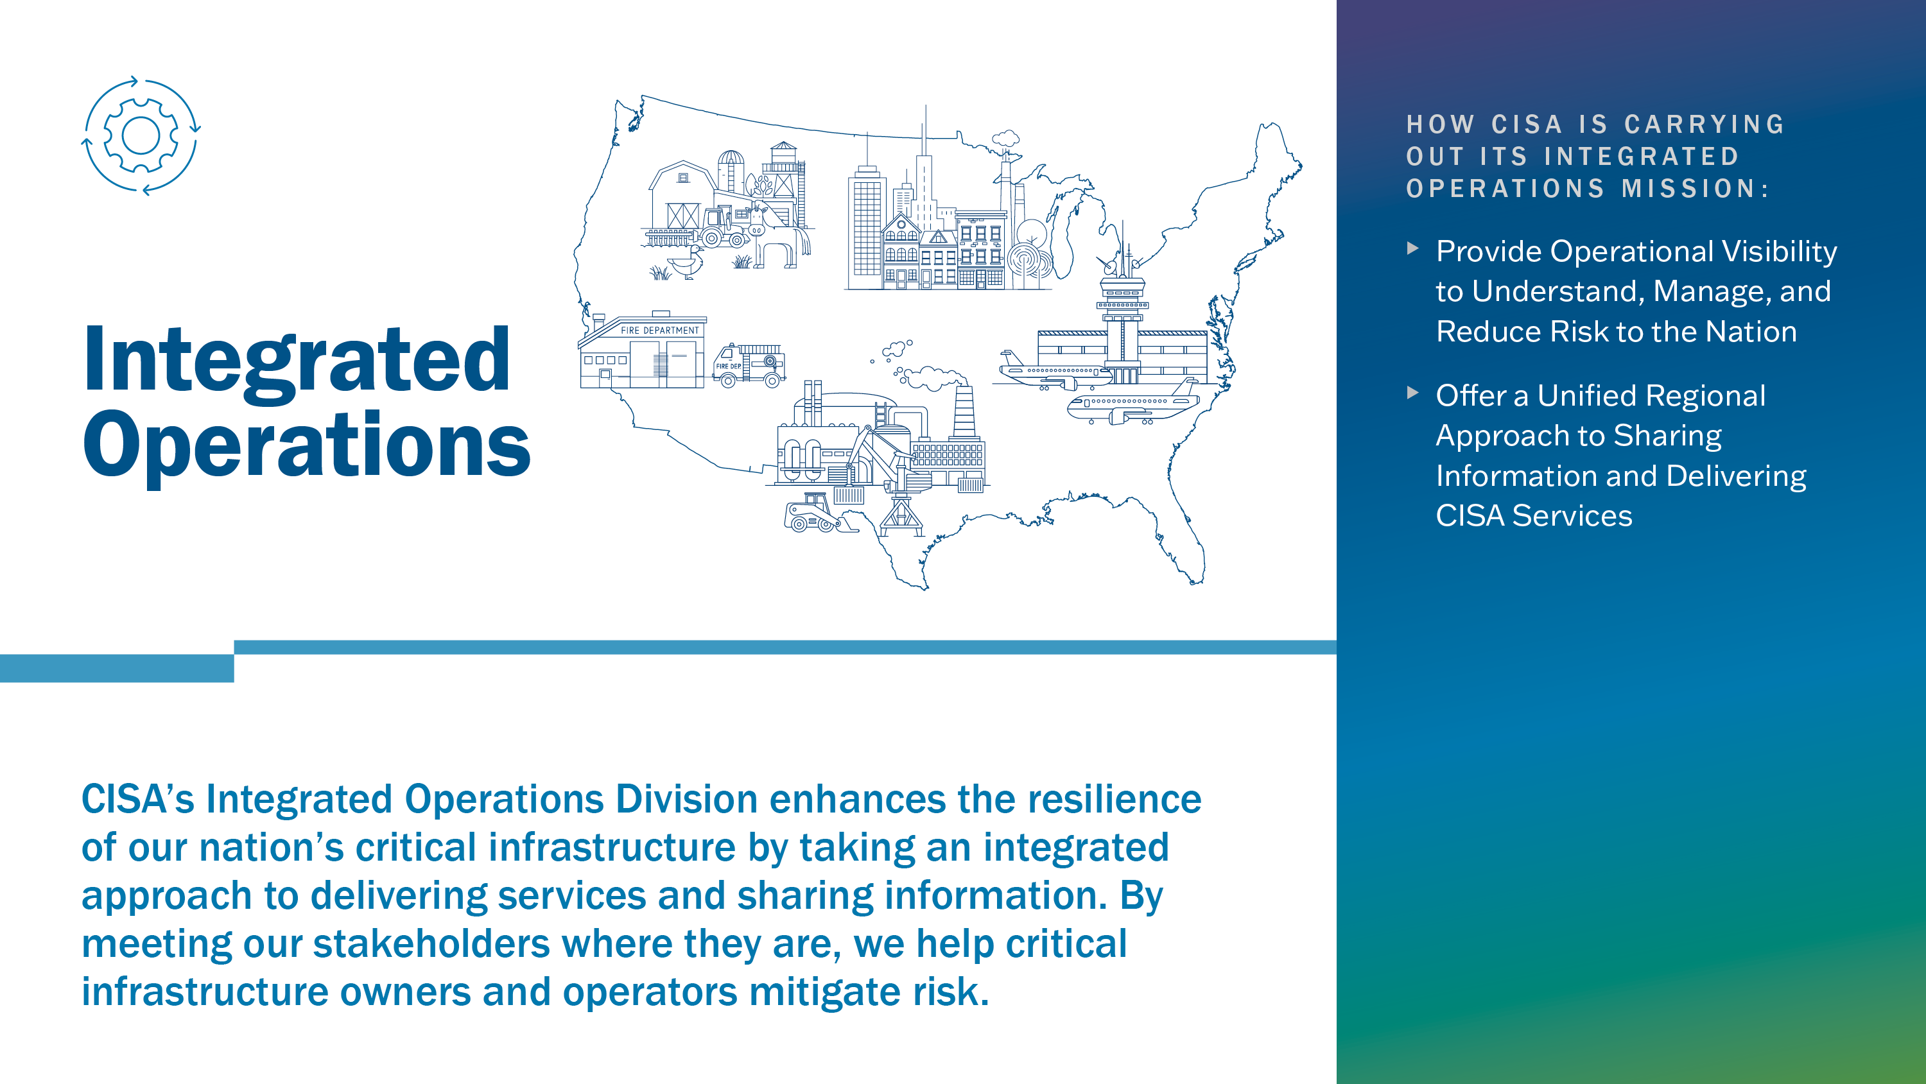
Notes:
Because our nation’s critical infrastructure exists in every state, city, and territory, CISA’s Integrated Operations Division (IOD) was created to prepare, plan and manage operations nationwide.
Here are a few ways IOD operates:
Via CISA Central, IOD provides 24x7x365 situational awareness and near-real time operational reporting.
IOD conducts all-source intelligence analysis, oversees CISA’s Reports Officers, and partners with the Intelligence Community to ensure support across CISA’s missions.
Lastly, through Operational Planning, Readiness, and Continuity, IOD supports CISA-wide operational priorities such as Elections Security, COVID, and CENSUS 2020. This includes developing operational plans and Concepts of Operations (CONOPS) and overseeing CISA’s continuity and readiness programs.
CISA provides a national capability to deliver its services to our stakeholders and partners across state and local governments and the critical infrastructure community. Via CISA Regions, IOD delivers:
Cyber and physical vulnerability assessments
Architecture review and design subject matter expertise
Incident response support
Exercise planning and support
National Special Security Event planning and support
Chemical facility inspections and site security planning to implement Chemical Facility Anti-Terrorism Standards
“Next Slide”

Slide 6
Essential Cybersecurity Concepts
  NIST CSF: Governance, Identify, Protect, Detect, Respond, Recover
  Resilience is an emergent property. You can not buy resilience
  The Goal: Increase Resilience and Reduce Risk
  C-I-A: Confidentiality, Integrity, and Availability
  People-Process-Technology (each is important to understand)
Notes:
Replace these examples.

Slide 7
Essential Cybersecurity Concepts
  Owner and Custodians: (both internal or external)
  Sustainment and Protection: Requirements (for the critical service)
  Assets: People, Information, Technology, Facilities
  Risk: Threats, Vulnerabilities, Likelihood, and Impact
  Risk Dispositions: Mitigate, Transfer, Avoid, Monitor, Accept
  Recovery: Recovery Point Objectives and Recovery Time Objectives
Notes:
Replace these examples.

Slide 8
Working Toward Cyber Resilience
Follow a framework or general approach to cyber resilience.
One successful approach includes:
Identify
Services
Create Asset Inventory
Protect &
Sustain
Assets
Disruption Management
Cyber
Exercise
Identify and prioritize services
Identify assets and align assets to services and inventory assets
Establish risk management, resilience requirements, control objectives, and controls
Establish continuity requirements for assets and develop service continuity plans
Define objectives for cyber exercises, perform exercises, and evaluate results
Process Management and Improvement

Slide 9
Range of Cybersecurity Assessments
STRATEGIC
(C-Suite Level)
Cyber Resilience Review (Strategic)
External Dependencies Management (Strategic)
Cyber Infrastructure Survey (Strategic)
Cybersecurity Evaluations Tool (Strategic/Technical)
Phishing Campaign Assessment (EVERYONE)
Vulnerability Scanning / Hygiene (Technical)
Validated Architecture Design Review (Technical)
Risk and Vulnerability Assessment (Technical)
Cyber Resilience Review (Strategic)
External Dependencies Management (Strategic)
Cyber Infrastructure Survey (Strategic)
Cybersecurity Evaluations Tool (Strategic/Technical)
Phishing Campaign Assessment (EVERYONE)
Vulnerability Scanning / Hygiene (Technical)
Validated Architecture Design Review (Technical)
Risk and Vulnerability Assessment (Technical)
TECHNICAL
(Network-Administrator Level)
TECHNICAL
(Network-Administrator Level)

Slide 10
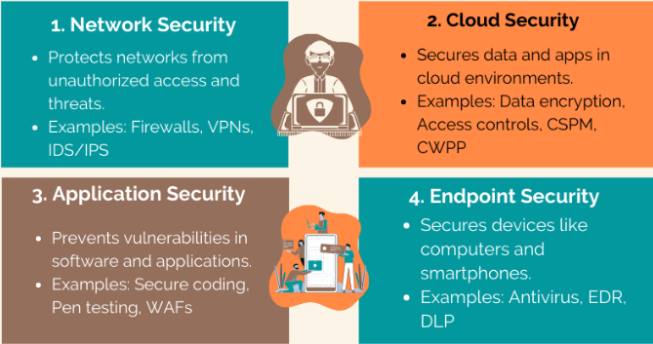
16 Types of Cybersecurity
Notes:
Replace these examples.

Slide 11
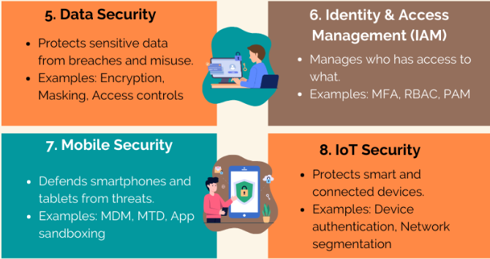
16 Types of Cybersecurity
Notes:
Replace these examples.

Slide 12
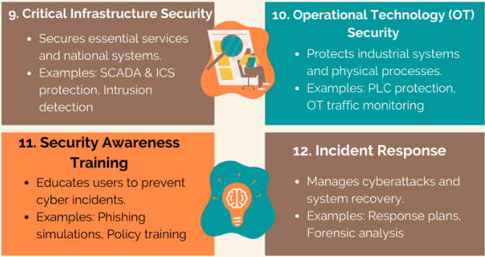
16 Types of Cybersecurity
Notes:
Replace these examples.

Slide 13
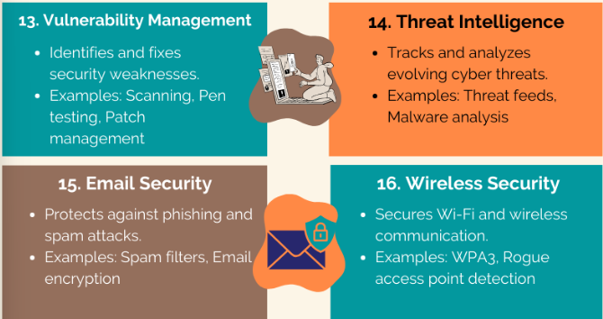
16 Types of Cybersecurity
Notes:
Replace these examples.

Slide 14
12 Cybersecurity Career Paths (and growing)
  Network Security: Securing corporate networks.
  Application Security: Enhancing the security of mobile & web applications.
  Information Security (InfoSec): Protecting data integrity.
  Operational Security: Ensuring procedural safety.
  Disaster Recovery & Business Continuity: Planning for worst-case.
  End-user Education: Addressing the human factor in cybersecurity.
Notes:
Replace these examples.

Slide 15
12 Cybersecurity Career Paths (and growing)
  Mobile Security: Protecting on-the-go information.
  Cloud Security: Data, apps and infrastructure that are off premises.
  Endpoint Security: Securing individual devices on a connected network.
  Identity & Access management: Rights access to authorized users.
  Critical Infrastructure Security: protecting assets for society/economy.
  IoT Security (OT): Protecting any device that is network capable/enabled.
Notes:
Replace these examples.

Slide 16
Cybersecurity Certifying Organizations
  (ISC)2: Securing corporate networks.
  EC-Council: Enhancing the security of mobile & web applications.
  CompTIA: Protecting data integrity.
  GIAC: Ensuring procedural safety.
  ISACA: Planning for worst-case.
  End-user Education: Addressing the human factor in cybersecurity.
Notes:
Replace these examples.

Slide 17
Top 12 Cybersecurity Certifications
  Entry Level
  CEH-Council Certified Ethical Hacker
  CompTIA Security+, Network +, A+
  GIAC Security Essential Certification (GSEC)
  Offensive Security Certified Professional
Notes:
Replace these examples.

Slide 18
Top 12 Cybersecurity Certifications
  Mid Level
  CompTIA PenTest+
  Certified Information Security Manager (CISM)
  Advanced Level
  Certified Information Systems Auditor (CISA)
  Certified Information Systems Security Professional (CISSP)
  CompTIA Advanced Security Practitioner (CASP+)
  GIAC Certified Incident Handler (GCIH)
Notes:
Replace these examples.

Slide 19
Final points to take away
Cyberspace and Cyberattacks are here to stay!!!!
Defending against cyber attacks is a team effort at a local, national and international level in both public and private sectors
A solid defense must look at people, processes, and technology. It is no just the job of the IT security team!!
Organizations must think about their information assets from the dimensions of confidentiality, integrity and systems availability
The are numerous careers in cybersecurity. Find out what interests you and gain the knowledge, develop the skills, acquire the Certs!

Slide 20

For more information:
StopRansomware.gov
Contact:
Mike Tetreault, CSA for RI &
Chief of Cyber for New England
roland.tetreault@cisa.gov
Cell: 202-941-1288
Notes:
Thank you for having me present today. Please contact us if you would like to request any of our ransomware campaign material or would be interested in hosting in future events or sharing information on ransomware. We appreciate your time and your continued support protecting critical assets in our regions!

Slide 21
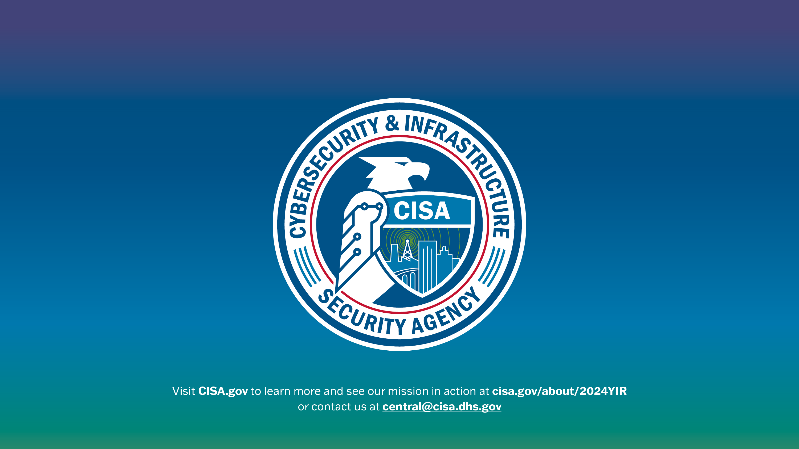
Notes:
[Thank the audience and open the floor for questions, if applicable]
[Refer audience to more information on all topics on CISA.gov and to put them in touch with appropriate CISA personnel]

