Slide 1

How to construct an effective Cover Letter
Presented by CCRI Career Services
careerservices@ccri.edu
(401) 825-2322

Slide 2
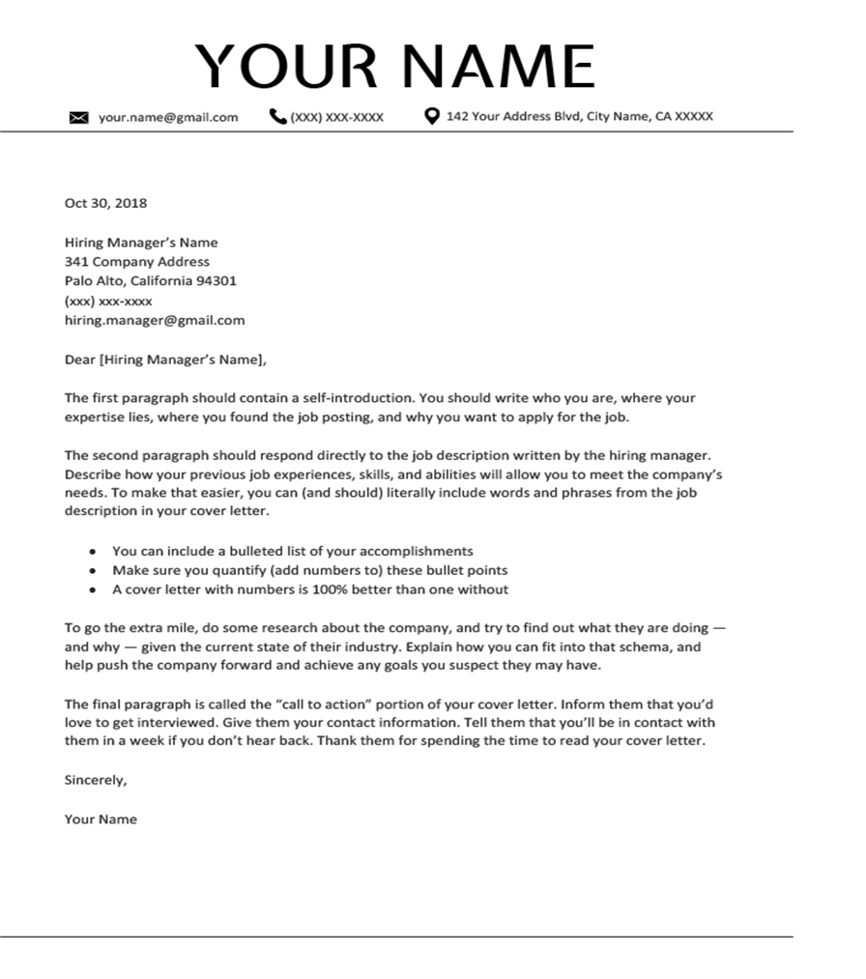

Slide 3


Purpose of a Cover Letter
The cover letter is the employer’s first glimpse at you and what skills and experience you can offer to the company.
Goal is to grab their attention and make them want to review your resume and call you in for an interview.

Slide 4
Structure of a Cover Letter: Heading
The Heading should look professional, it is good to use the same heading on your cover letter, resume, and reference page.
Include the following information:
  Name
  City, State
  Phone number
  Email (make sure this is hyperlinked)
  LinkedIn profile link (make sure this is hyperlinked too)

Slide 5
Examples of Headings
Jane Smith
Providence, RI ▪ (401)123-4567 ▪ jsmith@ccri.edu
Jane Smith
Providence, RI ▪ (401)123-4567 ▪ jsmith@ccri.edu

Slide 6
Structure of a Cover Letter: Greeting
The Greeting is located under your heading, and it contains the employer’s contact information.​
If you do not have the contact information of who the application is going to then address it as “Dear Hiring Manager”​
The contact information is usually on the job posting.​
Do your research and gather the company address.​
Good to put the position title you are applying to.​

Slide 7
Greeting Example​
Community College of Rhode Island​
Department of Human Resources​
1 Hilton Street​
Providence, RI 02905​
​RE: Human Resource Assistant position​
Dear Hiring Manager,​

Slide 8
Structure of a Cover Letter: First paragraph​
The first paragraph is the space where you introduce yourself, the job you want to apply for, and why you are the best candidate for this job.​
Example:​
My name is Jane Smith, and I am excited to apply for the Human Resources Assistant position at the Community College of Rhode Island. My 4 years of experience at Department of Human Services has allowed me to gain skills that make me the best candidate for this position.

Slide 9
Structure of a Cover Letter: Second paragraph
The second (possible third) paragraph is your chance to highlight your most relevant skills, abilities, and experience.​
Look at the job description and pull-out different keywords that match the skills you have to offer.​
Example:​
For the past 4 years I have been working as a Human Resources Assistant for the Department of Human Services. I have hired and trained 15 new staff as well as fired personnel and oversaw 3 union grievances. I have excellent active listening skills, organizational skills, as well as time management skills.​
​

Slide 10
Structure of a Cover Letter: Closing paragraph​
This paragraph is to thank the employer for their time and reiterate why you are the best fit for this job.​
Make sure to include your contact information in this paragraph as well.​
Example:​
Thank you for taking the time to review my application, please see my attached resume. I know that if you give me the chance to interview, I can show you how my skills and experience make me the best candidate for this position. I look forward to hearing from you, please contact me via phone (401)123-4567 or by email: jsmith@ccri.edu. ​

Slide 11
Cover Letter tips
Use keywords that are included in the job posting, make sure you only use the ones that match your skills.​
Promote yourself, don’t be humble! This is a chance for you to showcase your skills and abilities.​
Proofread!!! Read it aloud, to make sure the sentences flow and are clear.​
Make sure you have the right contact information for the company and hiring contact.​

Slide 12
Questions?
Career Services
careerservices@ccri.edu
401-825-2322

