Slide 1

Kappa Beta Delta International Honor Society
Induction Ceremony
May 6, 2024
Business & Professional Studies Department
Community College of Rhode Island
Notes:
Hello and welcome to your Kappa Beta Delta induction ceremony!

Slide 2


Membership in the prestigious Kappa Beta Delta is the highest international recognition a business student can receive at a two-year ACBSP institution.
We honor your high academic accomplishments in CCRI’s Business Programs!
Notes:
Kappa Beta Delta is an international honor society which was established in 1997. Membership in this Society:
recognizes students for their high academic achievement in business programs,
promotes personal and professional improvement, and encourages a life distinguished by honorable service to humankind.

Slide 3

Our new Inductees….
Notes:
As a KBD member, you will receive a certificate, a pin, and a KBD stole.
You should wear this stole at your CCRI commencement; and as a lifetime KBD member you should wear these stoles at all of your future commencement ceremonies!
Here are this year’s new inductees …

Slide 4

Junayd F. Ali
Junayd earned an Associate’s Degree in General Studies through the JAA program
He is currently pursuing a Bachelor’s Degree in Computer Information Systems at Rhode Island College.
“I hope to either become a cybersecurity or business analyst. I enjoy learning how business applications and technology connect”

Slide 5
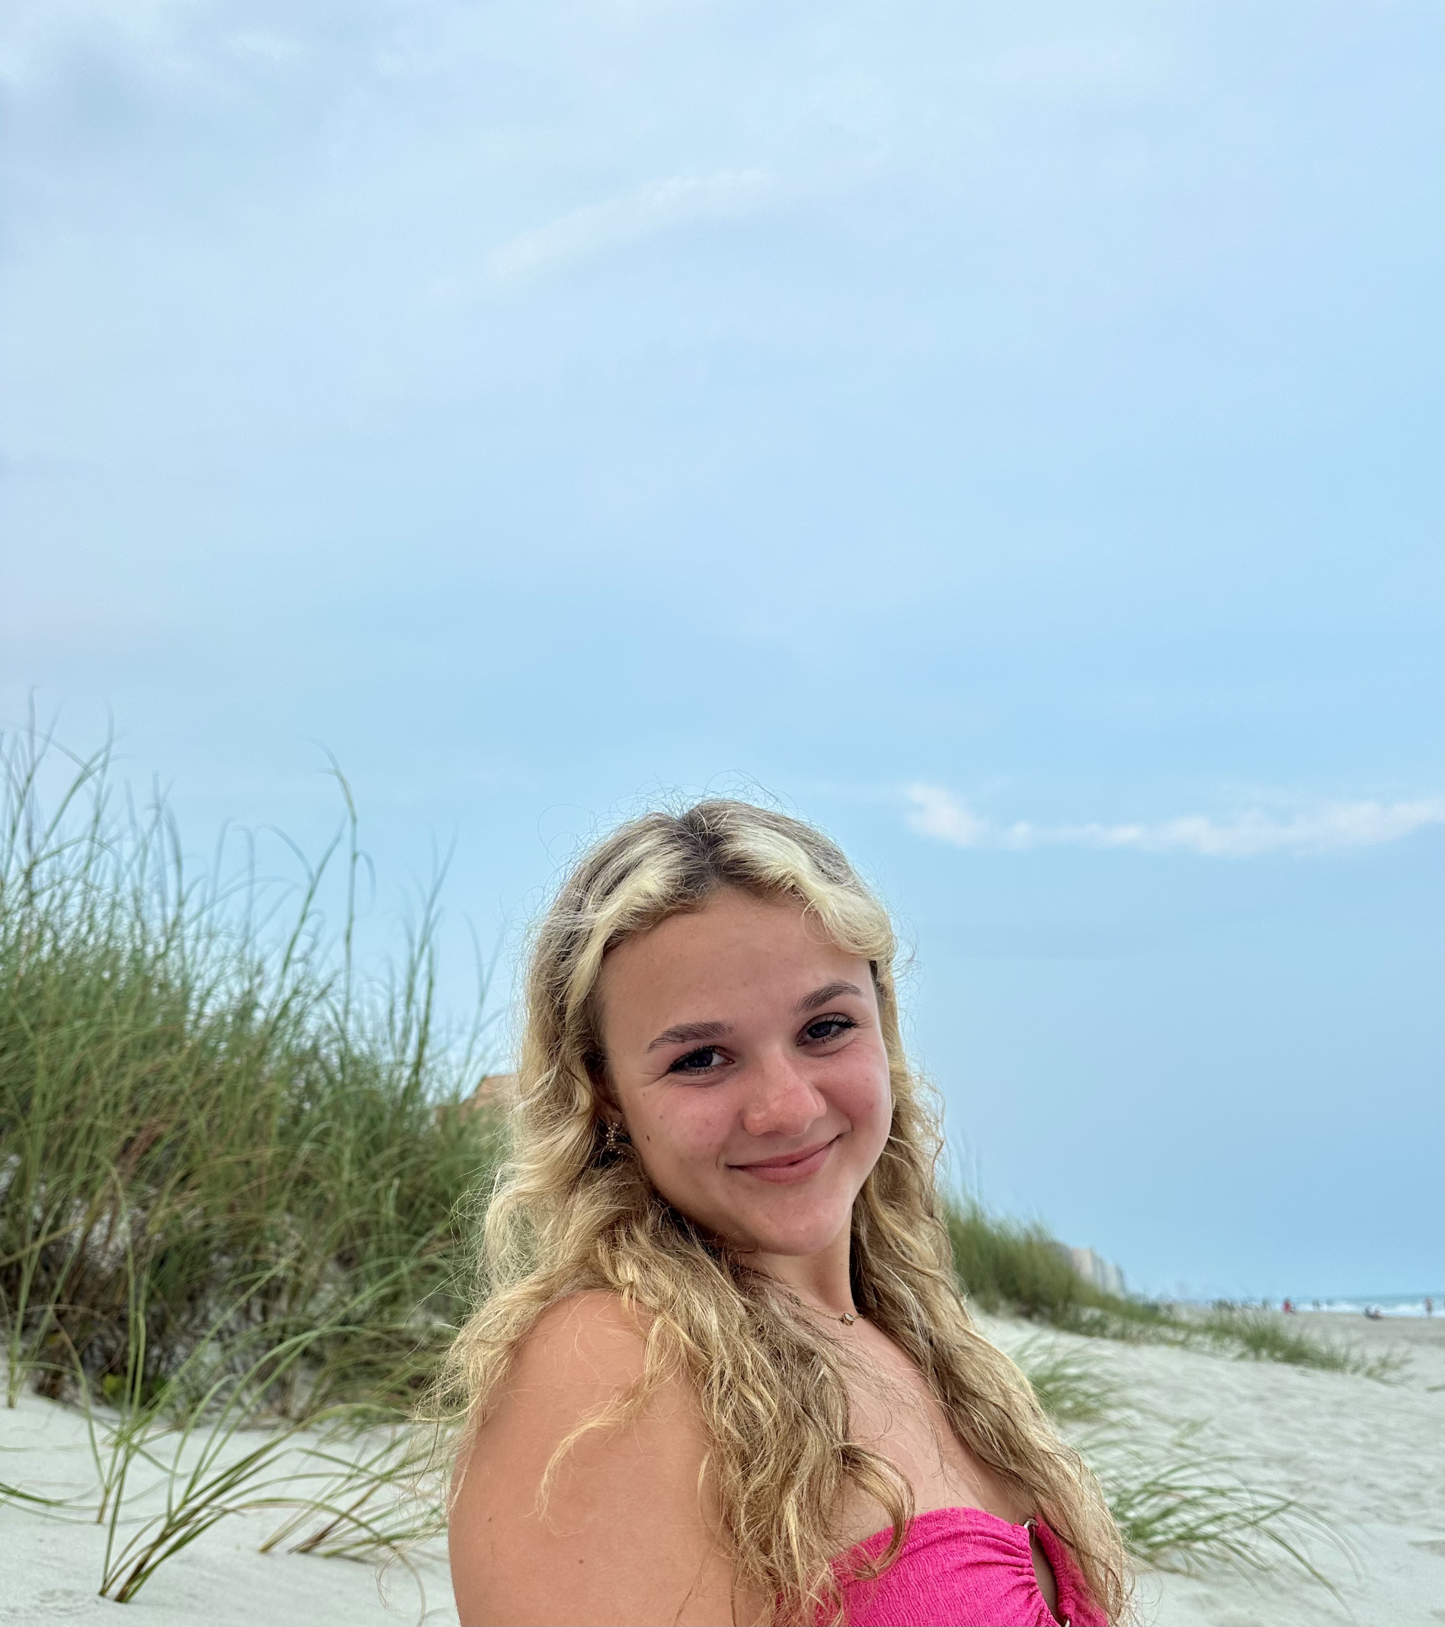
Corinne Bucklin
Corinne has earned a degree in General Studies, with a concentration in Business.
She plans to continue her education at the University of Rhode Island.
Her goal is to open a business as a wedding/event planner

Slide 6

Madison Cabral
Madison will earn an Associate of Arts Degree in General Studies, with a concentration in the Business, Economics, and Data Pathway.
She plans to transfer to a four-year university to earn a Bachelor’s Degree in Finance, in hopes of becoming a Financial Advisor or Analyst.

Slide 7
Monica S. Ciannavei
Monica earned a Bachelor of Arts Degree in Medical Assisting from Bay State College in 2013 and is pursuing her second Associate’s Degree in Business Administration at CCRI.
She plans to transfer to Rhode Island College to earn a Bachelor’s Degree in Substance Abuse and Mental Health, and become a counselor.

Slide 8
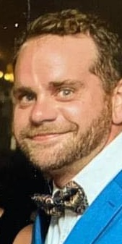
Patrick Ferrer Connerton
Patrick is graduating the Spring of 2025 with an Associate’s Degree in Business Administration, with a concentration in Accounting
He plans to transfer to Rhode Island College to earn a Bachelor’s Degree in Business Administration, with a concentration in Accounting
“I hope to become a CPA and continue to work towards my Master’s Degree..”.

Slide 9
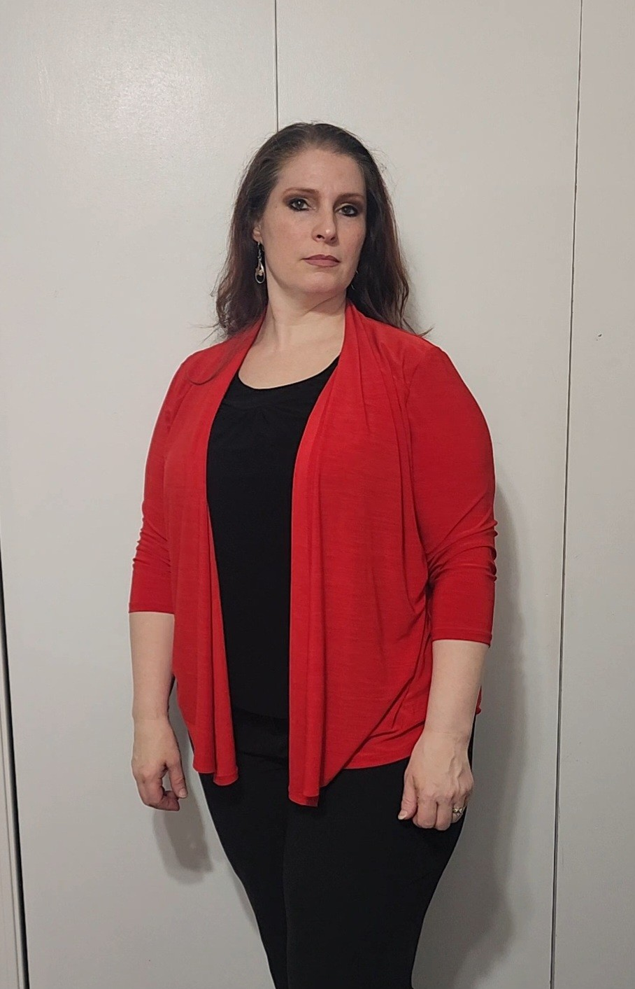
Mary E. Drescher
Mary is earning an Associate’s Degree in Business Administration.
She hopes to focus on a concentration in Accounting.

Slide 10

Estevan F. Escobar
Estevan is part of the JAA program and is graduating with an Associate’s Degree in General Studies with a concentration in Business.
He plans to plans to transfer to the University of Rhode Island, to earn a Bachelor’s Degree in Business Administration, with a concentration in Accounting.
“I plan to become a CPA”.

Slide 11

Sharon Pipeloluwa Fasina
Sharon has earned an Associates in Business Administration, with a concentration in Accounting.
She is transferring to the University of Rhode Island to earn a Bachelor’s Degree in Accounting.
“I plan to work as a tax professional at H & R Block next year and one day become a CPA”.

Slide 12

Stephen C. Forcino
Stephen is a Management and Training professional who is working in the banking industry.
He is currently pursuing CCRI’s online Associate’s Degree in Business.
Stephen plans to earn a Bachelor’s Degree and continue his career in Banking.

Slide 13
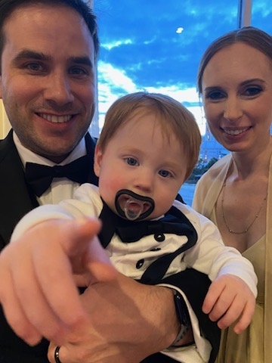
Lee B. Grossguth
Lee is currently pursuing an Associate’s Degree in Business Management.
His plan is to transfer to Rhode Island College to earn a Bachelor’s degree in either Data Analytics or Operations Management, and ultimately an MBA.
“I hope to use my education to further my career in Quality and Operations”

Slide 14
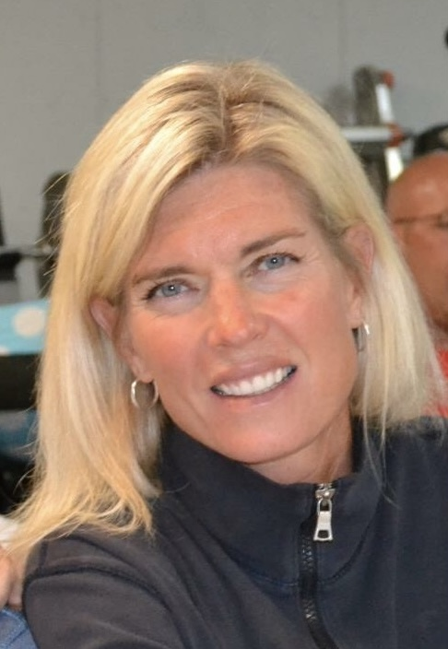
Katherine Hellendrung
Katie holds a Bachelor of Arts Degree in Communication Studies and is earning a certificate in Business Entrepreneurship at CCRI.
She has been accepted into a joint initiative between CCRI and URI's Cooperative Extension, the Agriculture and Food Sustainability Fellowship Program. I will be working with a local non-profit food organization, Farm Fresh Rhode Island, to educate RI communities about food sustainability and address the issue of food insecurity.
“I hope to open a brick-and-mortar catering business that will focus on the creation of homemade, organic soups made with locally sourced ingredients”.

Slide 15
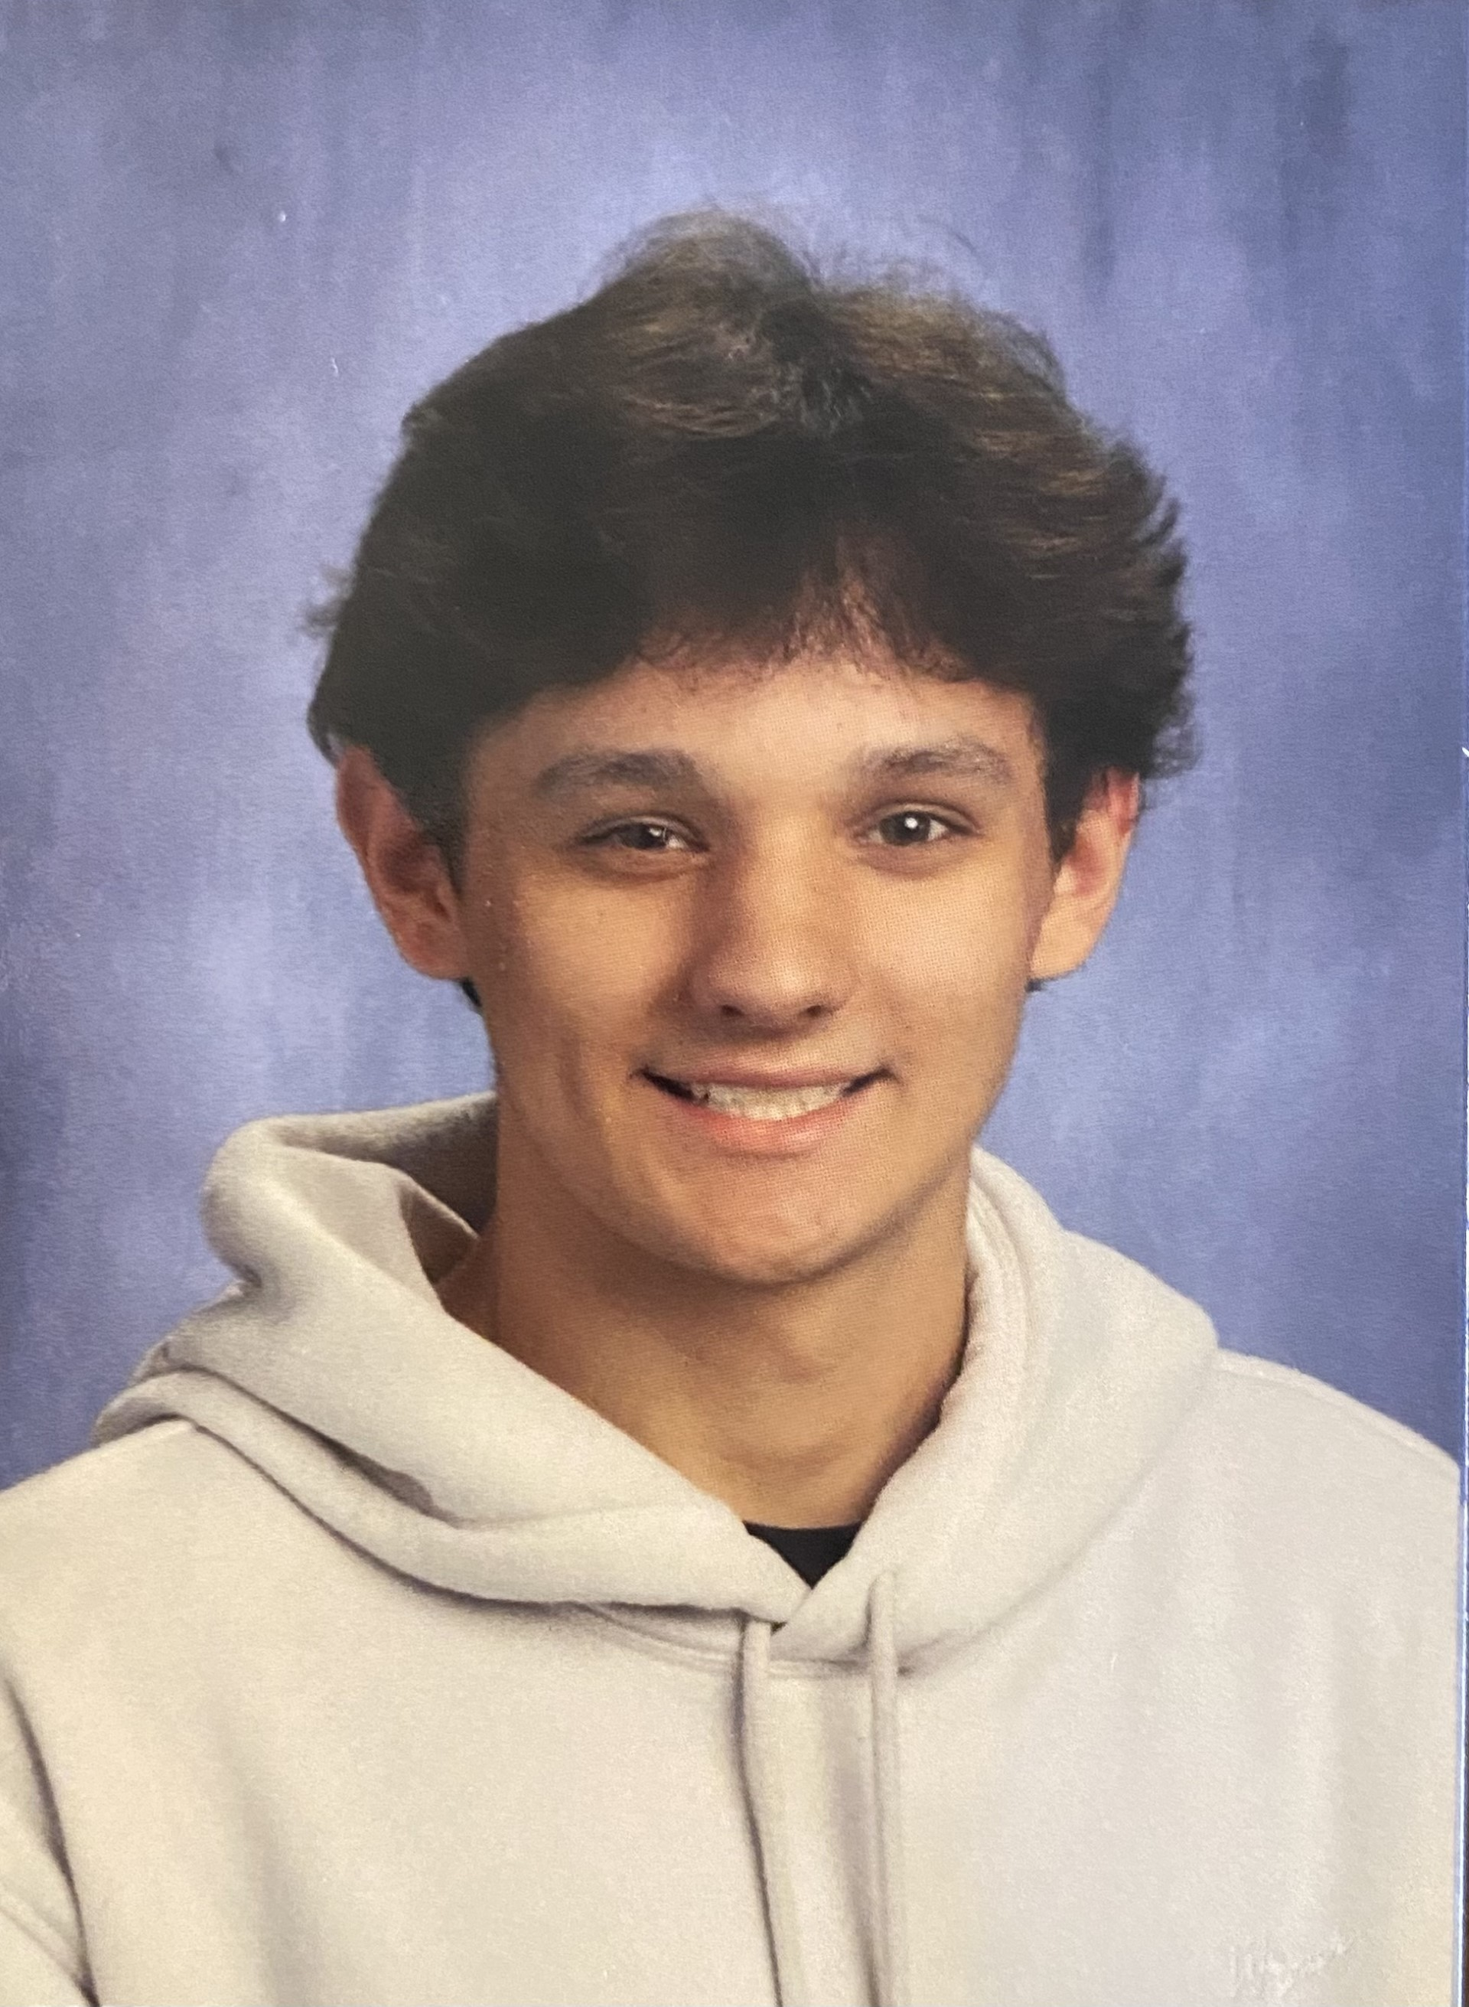
Nathan A. Hunt
Nathan is currently earning an
Associate’s Degree in Business Administration with a concentration in Marketing.
He plans to transfer to the University of Rhode Island to earn a Bachelor's Degree.

Slide 16
Beyan Livingstone
Beyan is currently pursuing an
Associate’s Degree in General Studies with a concentration in Business.
He plans to transfer to Rhode Island College to earn a Bachelor’s Degree in Accounting.

Slide 17

Isabella R. Lombardi
Isabella is currently pursuing an
Associate’s Degree in Business with a concentration in Marketing.
She plans to transfer to the Johnson & Wales to continue her studies.
“I would like a career in marketing for small businesses or fashion brands, or social media marketing for brands and companies”.

Slide 18
Juliana Lopes
Juliana is currently pursuing an
Associate’s Degree in General Studies with a concentration in Business.
She plans to continue her studies at Rhode Island College to earn a Bachelor’s Degree.

Slide 19
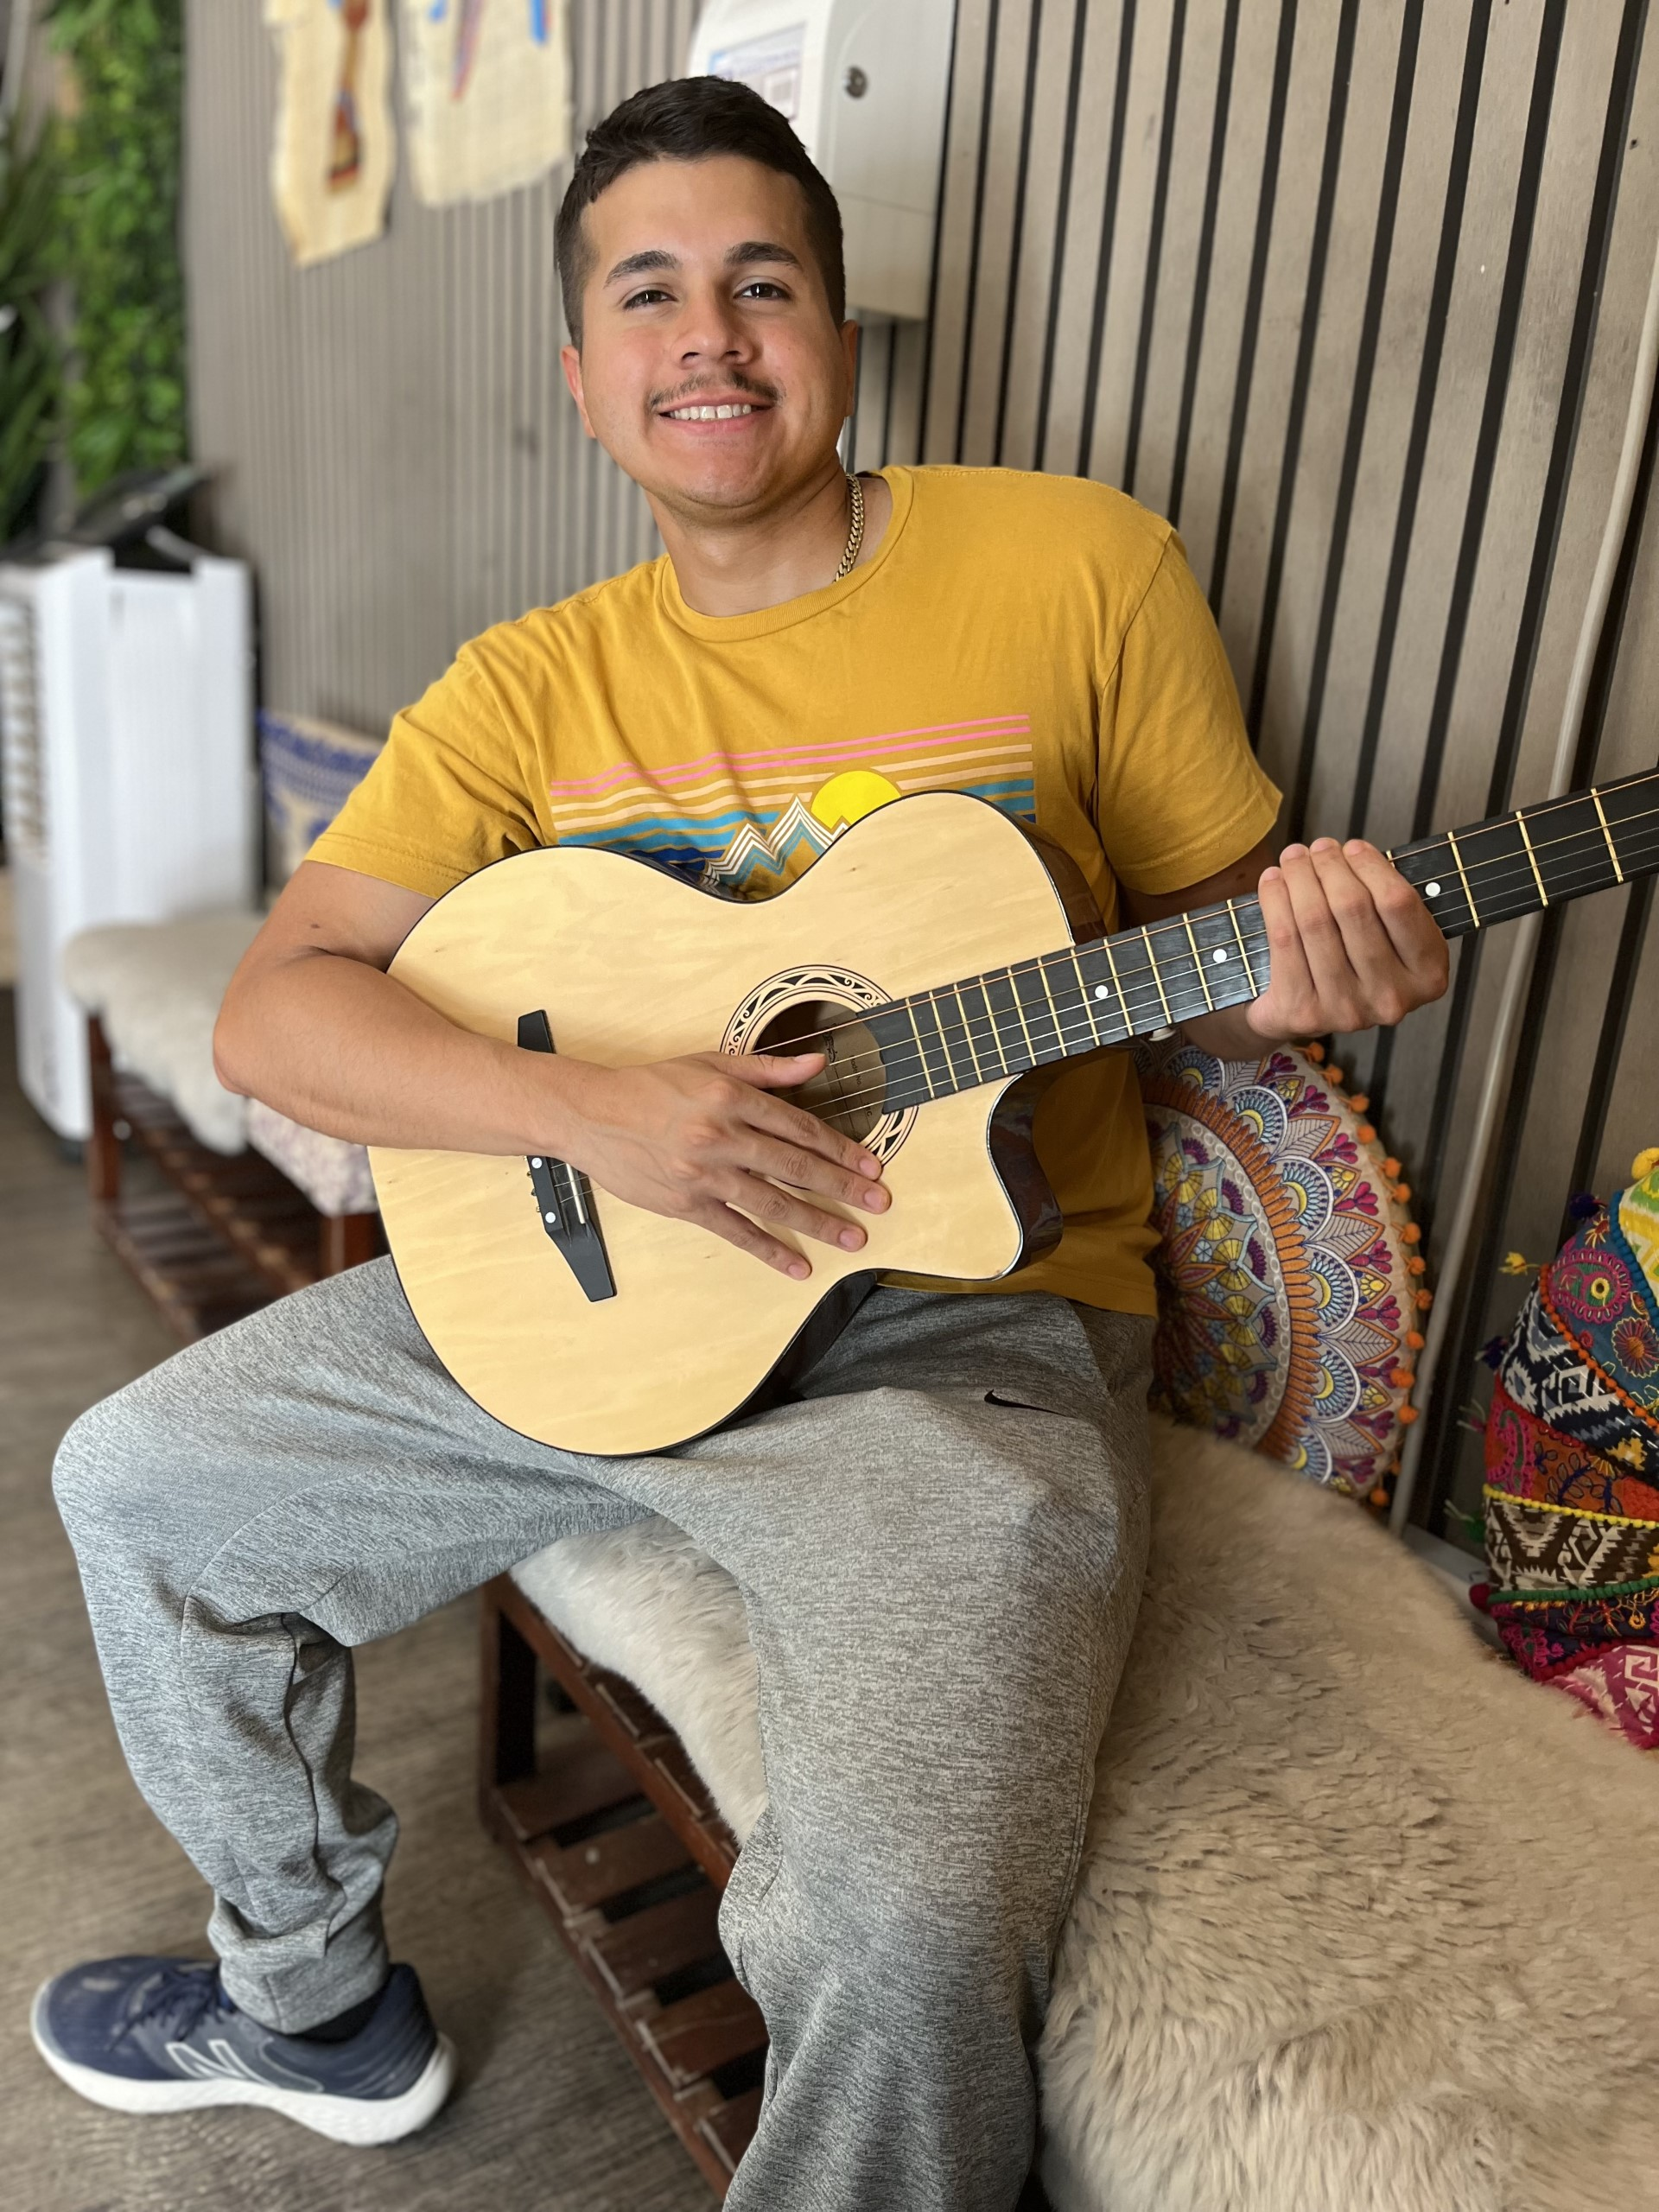
Crystian J. Marroquin
Crystian has earned an
Associate’s Degree in Business Administration, with a concentration in General Studies.
He plans to continue his studies at the University of Rhode Island, ultimately earning his Master’s Degree.

Slide 20
Jana Masri
Jana is currently pursuing an
Associate’s Degree in Business Administration, with a concentration
in General Studies.

Slide 21

Nicole McPherson
Nicole has earned an Associate’s Degree in Business Administration with a concentration in Accounting.
She plans to transfer to Bryant University to earn one Bachelor’s Degree in Accounting, and another in Business Management.
“ I plan to get my CPA license and become an auditor. “

Slide 22

Brooke Menard
Brooke has earned an Associate’s in General Business.
She plans to continue at CCRI to pursue an Associate’s in Business Administration, with a concentration in Accounting.

Slide 23

Michaela C. Naum
Michaela is currently pursuing an
Associate’s Degree in Business Administration with a concentration in Accounting.
“I would like to pursue a career as a Tax Accountant”.

Slide 24
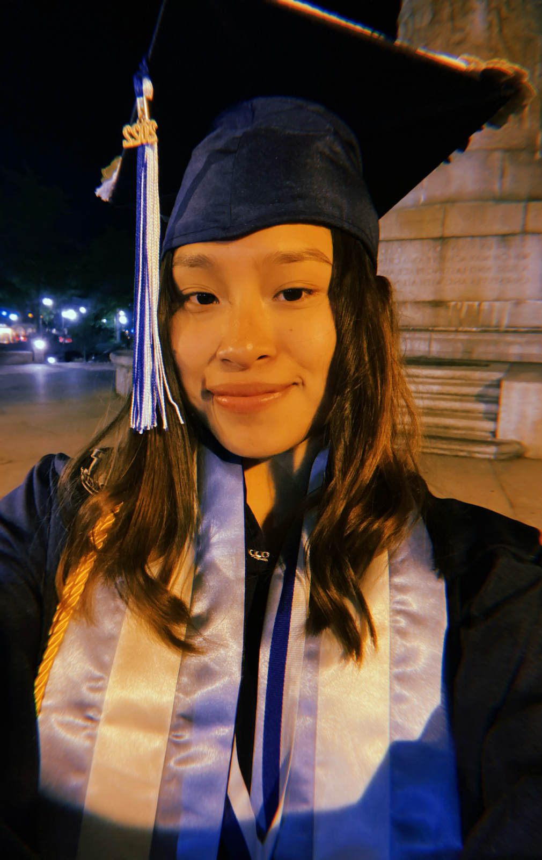
Cesia M. Pangan
Cesia is currently pursuing an
Associate’s Degree in Business Administration.
She plans to transfer to the University of Rhode Island to pursue a degree in Business Administration.
“My plan is to take a cosmetology course and then offer beauty services from home, building a strong customer base, and then open my own beauty salon”.

Slide 25
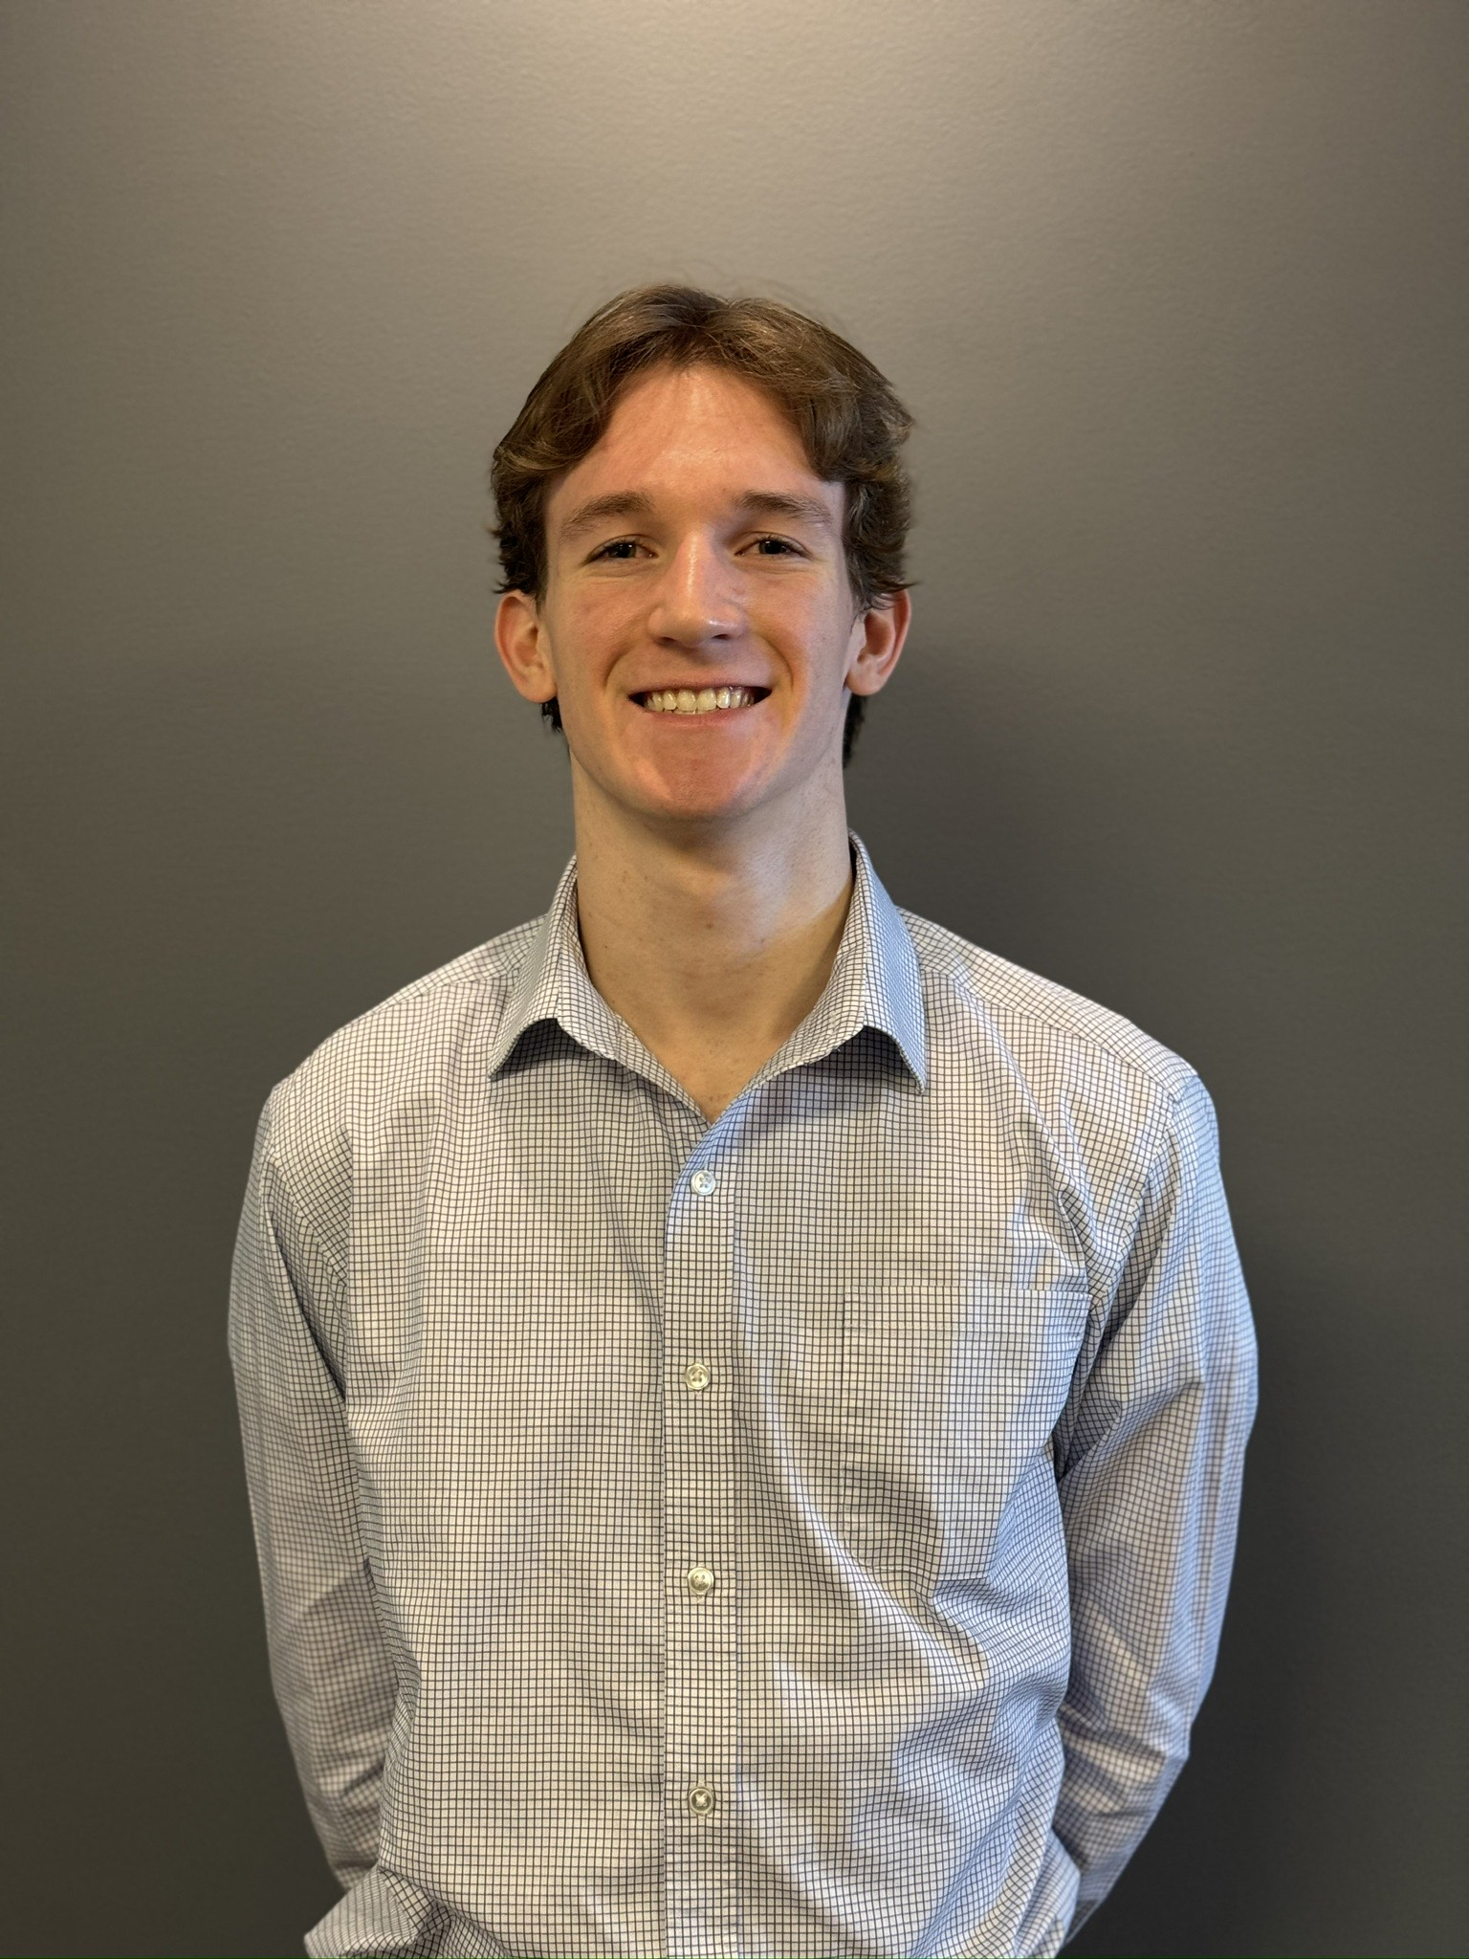
Christian Polofsky
Christian has earned an Associate’s Degree in Business Administration with a concentration in General Business.
He is transferring to Johnson & Wales University to obtain his Bachelor’s and Master’s Degrees in Business Administration.

Slide 26

Courtney Pouliot
Courtney has earned an Associate’s Degree
in Business Administration.
Her career goals advancing in the sales department of her current job, and earning a Bachelor’s Degree in the future.

Slide 27

Samantha Quattrucci
Samantha is currently pursuing an
Associate’s Degree in Business Administration.
She plans to continue her studies at Rhode Island College to earn her Bachelor’s Degree in Management.

Slide 28
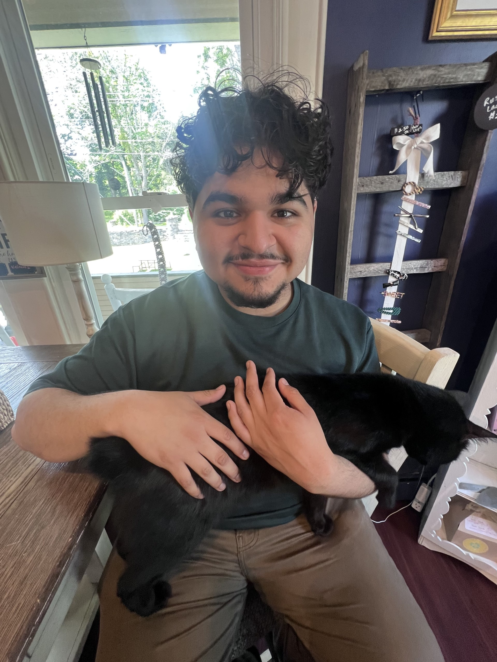
Angel G. Ramiez
Angel is currently pursuing an
Associate’s Degree in Business Administration.
He plans to transfer to the University of Rhode Island to earn a Bachelor’s Degree in Business Administration.

Slide 29

Steven E. Santangini
Steven is currently pursuing an
Associate’s Degree in General Studies with a concentration in Business.
He plans to transfer to Rhode Island College to earn a Bachelor’s Degree in Business Marketing.
“I hope to become either a Market Research Analyst, or a SEO Specialist”.

Slide 30

Rashawn Vaughan
Rashawn is currently pursuing an
Associate’s Degree in Business Management and Marketing, as he balances the joys of parenting with a new career in sales.
He plans to transfer to Rhode Island College to earn a Bachelor’s Degree.
“My goal is to become a Marketing Director for a fortune 500 company.

Slide 31
Natalie Villegas
Natalie is graduating with an
Associate’s Degree in Arts with a concentration in Accounting.
As part of the JAA program, she will transfer to Rhode Island College this fall to earn a Bachelor's in Accounting.

Slide 32
Deborah Ann Wolley
Deborah is currently pursuing an
Associate’s Degree in Business Administration, with a concentration
in General Studies.

Slide 33
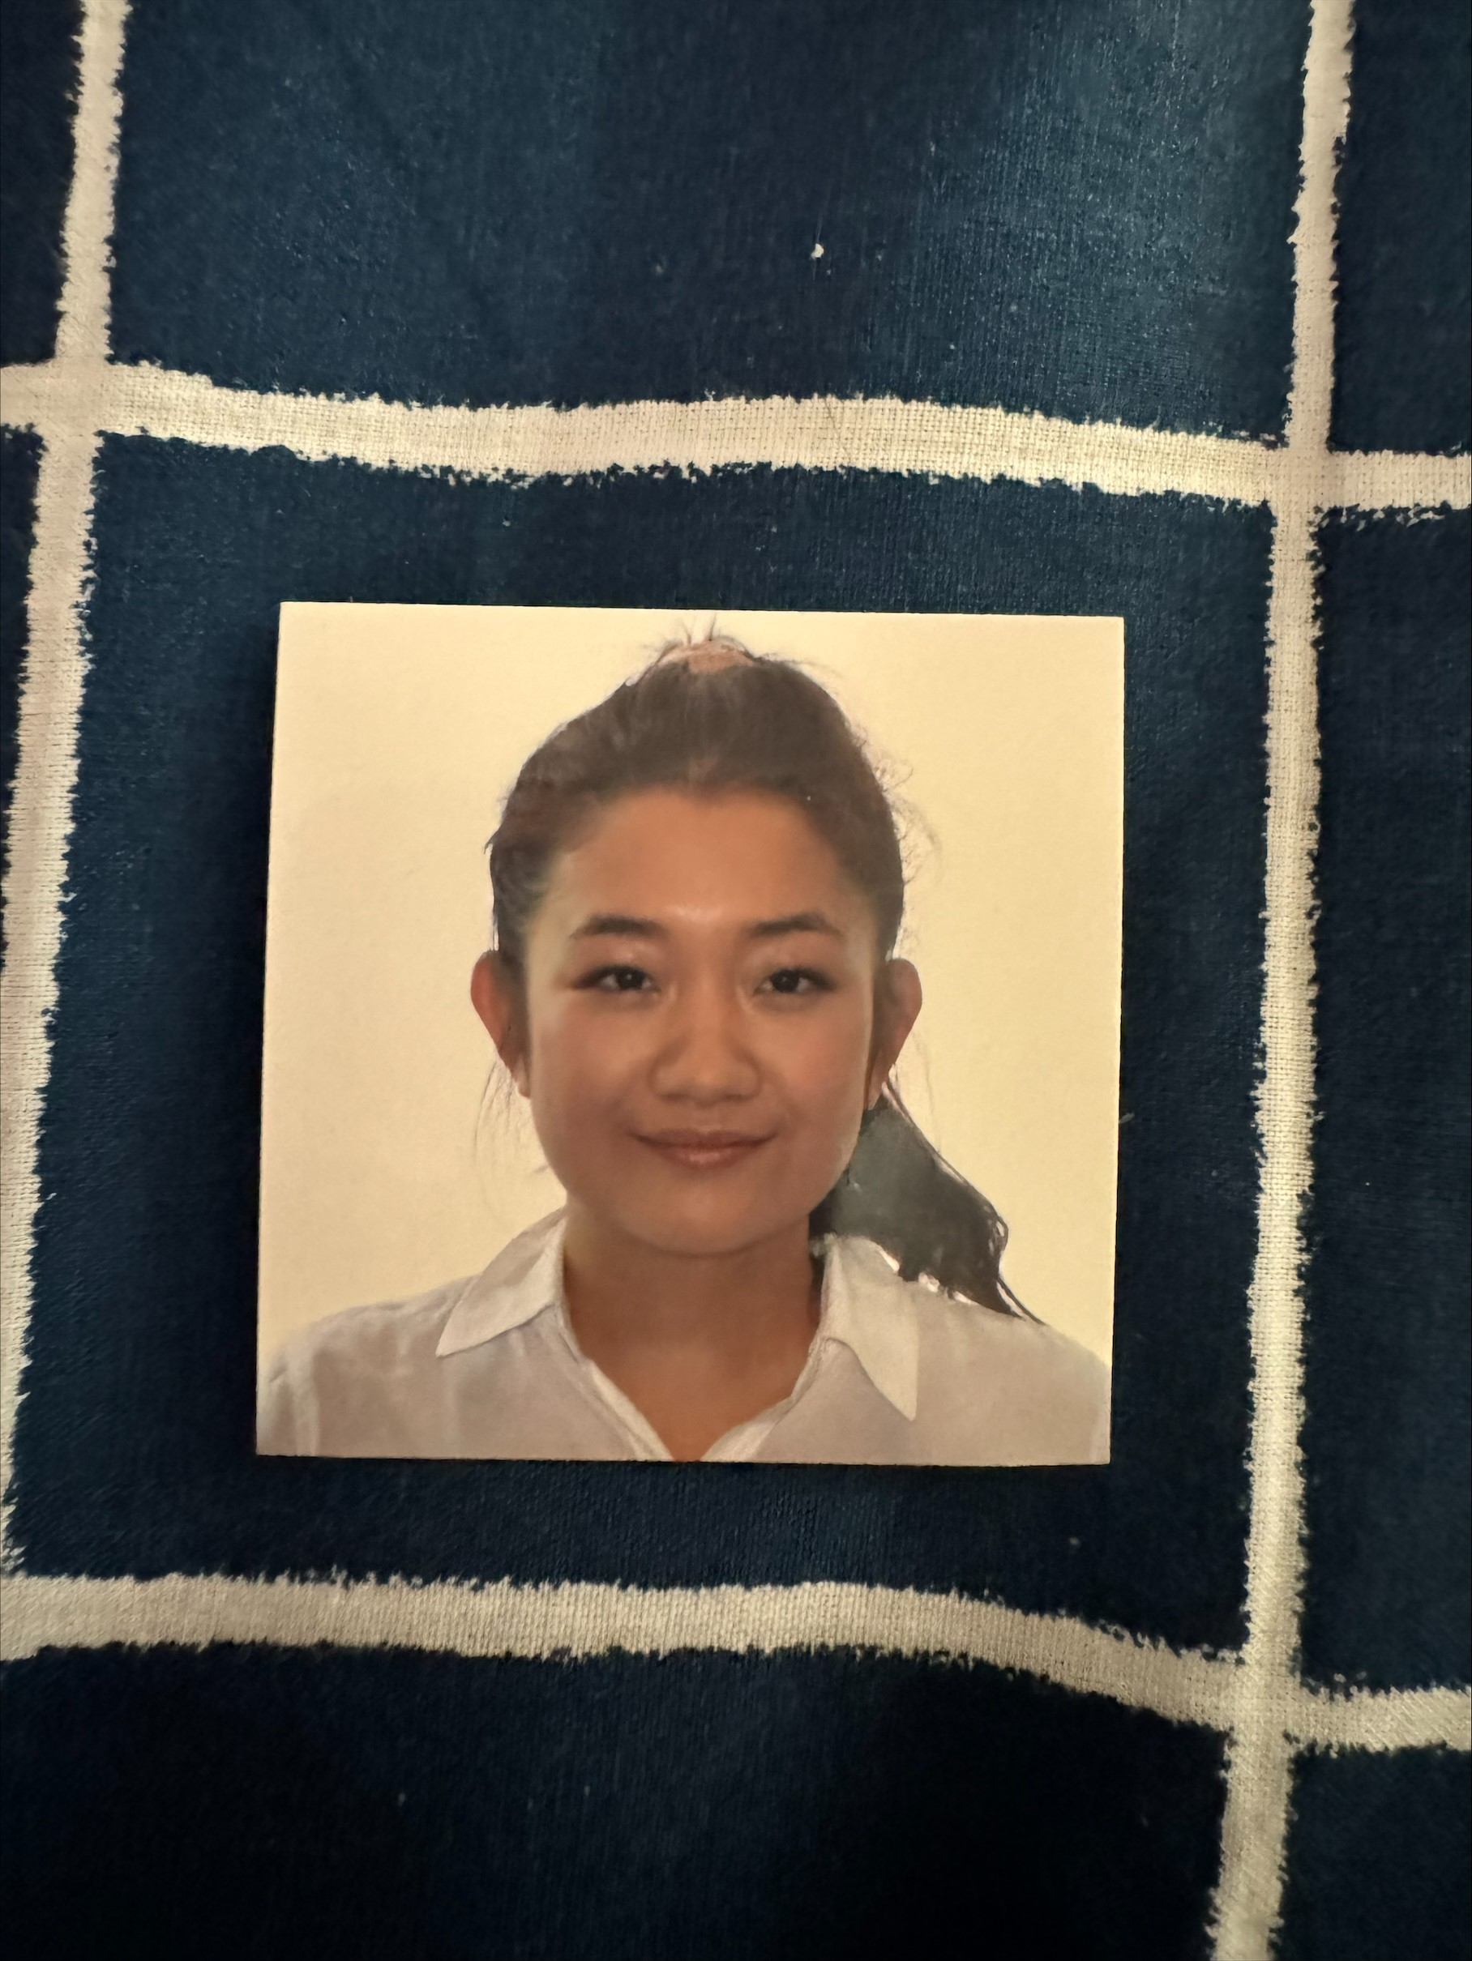
Molikar You
Molikar was born and raised in Cambodia, moving to the United States in 2013.
She is currently pursuing an
Associate’s Degree in General Studies with a concentration in Accounting.

Slide 34
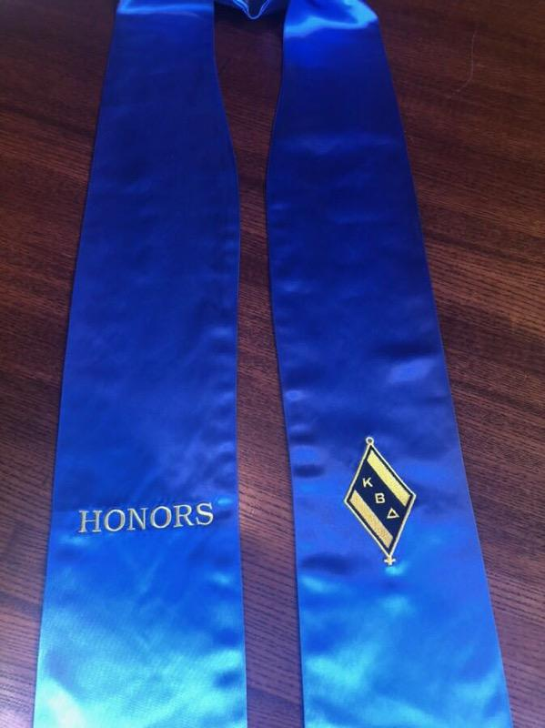
Kappa Beta Delta
Kappa is the initial letter of the word, Kratisteuo, which means to excel.
Beta is the initial letter of the word, Bebaous, which means trustworthy.
Delta is the initial letter of the word, Dokimos, which means genuine and esteemed.

Slide 35
Our Pledge
I promise to abide by the guidelines established by The Association of Collegiate Business Schools and Programs and Kappa Beta Delta.
I will uphold the ideals set forth by our name: excellence, trustworthiness, and genuineness.
I agree to uphold the standards set forth by the chapter of Kappa Beta Delta here at the Community College of Rhode Island.
Notes:
Please join me as we recite the KBD pledge :

Slide 36

Dr. Andrew V. Stevenson International Scholarship Award and the 2024 KBD Regional Scholarship Award
Bedros Kevorkian
Christian Polofsky

Slide 37
Congratulations!
Best wishes from the
faculty members in the
Business and Professional Studies
Department

Slide 38
Accreditation Council for Business Schools and Programs Student Leadership Award
This award recognizes a student in a Business and Professional Studies Degree Program for their:
academic excellence,
leadership,
involvement in student clubs/organizations, and
involvement in community service activities.
This year’s recipient is Katherine Hellendrung.

