Slide 1
Kappa Beta Delta International Honor Society
Induction Ceremony
May 8, 2023
Business & Professional Studies Department
Community College of Rhode Island
Notes:
Hello and welcome to your Kappa Beta Delta induction ceremony!

Slide 2
Membership in the prestigious Kappa Beta Delta is the highest international recognition a business student can receive at a two-year ACBSP institution.
We honor your high academic accomplishments in CCRI’s Business Programs!
Notes:
Kappa Beta Delta is an international honor society which was established in 1997. Membership in this Society:
recognizes students for their high academic achievement in business programs,
promotes personal and professional improvement, and encourages a life distinguished by honorable service to humankind.

Slide 3
Our new Inductees….
Notes:
As a KBD member, you will receive a certificate, a pin, and a KBD stole.
You should wear this stole at your CCRI commencement; and as a lifetime KBD member you should wear these stoles at all of your future commencement ceremonies!
Here are this year’s new inductees …

Slide 4
Lauren Blanchette
Lauren has served as President of DECA, while earning her Associates in Business Administration
She plans to transfer to the University of Rhode Island to earn a bachelor’s degree in Business Management.
“ I plan to have a career in either customer service or human resources.”

Slide 5
Gabriel Camara, Jr.
Gabriel has earned an Associates in Business Administration.
He plans to transfer to Providence College to earn a Bachelor’s degree in Business Administration.
“I plan to utilize my education to continue to rise in the ranks of the municipality where I currently work”.

Slide 6
Darleny D. Castillo
Darleny began taking classes at CCRI in 2011, but then took time off to get married and raise a family.
When her youngest child turned 2, she returned to CCRI to study Management.
She graduates this summer and transfers to Rhode Island College to earn a bachelor's degree in Management.
“I will take the SHRM CP Certification to pursue my career in Human Resource Management.”

Slide 7
Vincent A. Cotoia
Vincent has been studying Accounting at CCRI, as part of the RI Promise program.
He plans to continue his studies at Bryant University this fall, earning a Bachelor’s Degree.

Slide 8
Lineishka Figueroa
Lineishka is currently pursuing an
Associate’s Degree in General Studies with a concentration in Business.
She plans to transfer to the University of Rhode Island to continue her studies.

Slide 9
Brandy Josefson
Brandy has earned an Associate’s Degree in Business Administration, with a concentration in Marketing.
She has previously earned a Bachelor of Science degree in Marine Biology..
“I am currently working at an internship in Marketing for a RI tech company, but I am actively pursuing full time opportunities in a Marketing role”.

Slide 10
Sasha N. Juarez
Sasha is graduating this spring, having earned an associate’s degree in General Studies, with a concentration in General Business.
She plans to earn a bachelor’s degree at the University of Rhode Island, in International Studies, with a double major in French and Leadership Studies.
“ After completing my studies, I hope to become an entrepreneur.”

Slide 11
Bedros M. Kevorkian
Bedros is currently taking classes at CCRI as part of the Running Start Program.
“I plan to earn a bachelor's degree at Rhode Island College”.
Notes:
I'm in the Running Start Program
I plan to transfer to RIC

Slide 12
Corina Marchetti
Corina will graduate this summer, with an Associate’s Degree in Business Administration.
She plans to continue at CCRI to earn her certification and degree in Cisco, part of the Computer Network Engineering and Cyber Security Program.
“In the future, I plan to continue my studies in Business and Cisco at the University of Rhode Island”.
Notes:
Associates Degree in Science of Business Administration. I am graduating the summer of 2023 . Continuing my education at Ccri for my certification and degree in Cisco which is a Computer Network Engineering and Cyber Security etc Program. . In the future I will further my education in Business and Cisco at URI

Slide 13
Melissa A. Mizzoni
Melissa works as a virtual bookkeeper for AccountingDepartment.com and also as an Accounting tutor at CCRI.
She has earned an Associate in Business Administration degree with a concentration in Accounting, along with an Accounting certificate.
Melissa plans to continue at CCRI to earn her ASB in Management.
Notes:
I am a virtual bookkeeper for AccountingDepartment.com
I am a tutor at CCRI for Accounting
I have earned degrees in:
ASB Major: Business Administration - Accounting
Accounting Certificate
AA Major: General Studies
I will be going back to CCRI in the fall to get my associate degree in ASB: Business Administration - Management

Slide 14
Sophie Reitz
Sophie is pursuing an Associate degree in Business Administration, with a concentration in Accounting.
When she graduates from CCRI next Spring, she plans to transfer to a 4 year university in the state to earn a Bachelor’s Degree in Accounting.
“I hope to become a CPA and then finish my higher education through a Master’s program in France”.

Slide 15
Paola Sanchez
Paola has earned an Associate’s Degree in General Education.
She plans to transfer to Rhode island College to earn a degree in Computer Science.
“I hope to become a Software Developer.”.
Notes:
I earned an Associate in General Education
I am transferring to Rhode Island College to earn a degree in Computer Science and hope to become a Software Developer

Slide 16
Autumn Scaramuzzi
Autumn is currently studying Business, with a concentration in Accounting.

Slide 17
Joseph Tallman
Joseph is planning to graduate with an associate degree in Business Management in December, 2023.
“ Upon completion of my Associates Degree, my plan is to then transfer to either the University of Rhode Island or Bryant University to earn my bachelor’s degree either economics or finance. “
Notes:
My name is Joseph Tallman.
I am planning to graduate with my associate degree in business management in December, 2023
I, then plan on transferring to either URI or Bryant to complete my bachelor's degree with a concentration in either economics or finance.

Slide 18
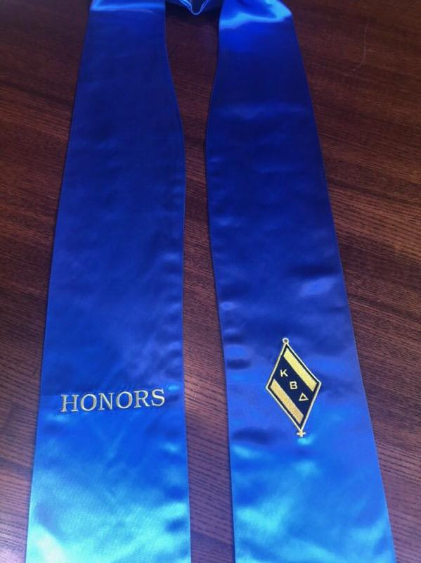
Kappa Beta Delta
Kappa is the initial letter of the word, Kratisteuo, which means to excel.
Beta is the initial letter of the word, Bebaous, which means trustworthy.
Delta is the initial letter of the word, Dokimos, which means genuine and esteemed.

Slide 19
Our Pledge
I promise to abide by the guidelines established by The Association of Collegiate Business Schools and Programs and Kappa Beta Delta.
I will uphold the ideals set forth by our name: excellence, trustworthiness, and genuineness.
I agree to uphold the standards set forth by the chapter of Kappa Beta Delta here at the Community College of Rhode Island.
Notes:
Please join me as we recite the KBD pledge :

Slide 20
Congratulations!
Best wishes from the
faculty members in the
Business and Professional Studies
Department

Slide 21
Accreditation Council for Business Schools and Programs Student Leadership Award
This award recognizes a student in a Business and Professional Studies Degree Program for their:
academic excellence,
leadership,
involvement in student clubs/organizations, and
involvement in community service activities.
This year’s recipient is Lauren Blanchette.

