Slide 1
Summer Intensive Institute for General Education Assessment
Standard 2b Critical Thinking, Information Literacy
Charles Morgan
Langdon Clough

Slide 2
Educated Person Outcomes: Critical Thinking
Develop information literacy by locating, evaluating, synthesizing, and using information to accomplish a specific purpose.
Key Indicators/Learning Outcomes:
1. Student provides evidence of research and information gathering processes
2. Student determines the extent of information needed
3. Student assesses needed information
4. Student evaluates information and its sources critically
5. Student communicates, organizes and synthesizes information from sources to fully achieve a specific purpose
6. Student accesses and uses information ethically and legally
We recommend reversing the order of outcomes one and two. Logic dictates an assessment of need should occur before the actual collecting of information.

Slide 3
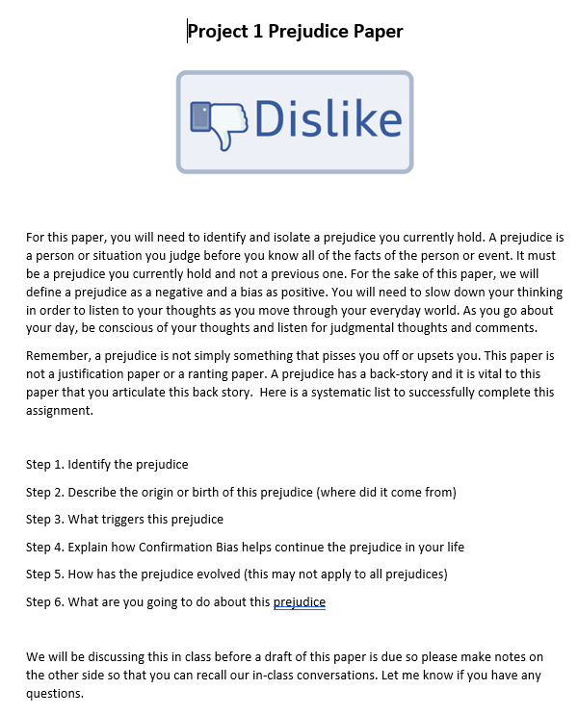
Original Assignments
Written Assignment #1 The Sociological Imagination
C. Wright Mills used the term ‘Sociological Imagination” to describe the ability to see the relationship between the experiences of an individual and the structure of the larger society.
In a three page paper, demonstrate your ability to understand how personal issues may be impacted by public issues.
Directions: Find a story about something that happened to an individual or group of people from a trustworthy news source and explain how their experience may have been shaped by events or circumstances in society.
Cite all of your sources of information in either MLA or APA format.

Slide 4
GOALS OF REVISIONS: Clear due dates Greater transparency for student understanding of what is expected and what they may gain from the task Assist students with working more efficiently Focused Instruction allowing the instructor to be more explicit in guiding students Alignment with grading rubric so that students will be better prepared to achieve learning goals.

Slide 5
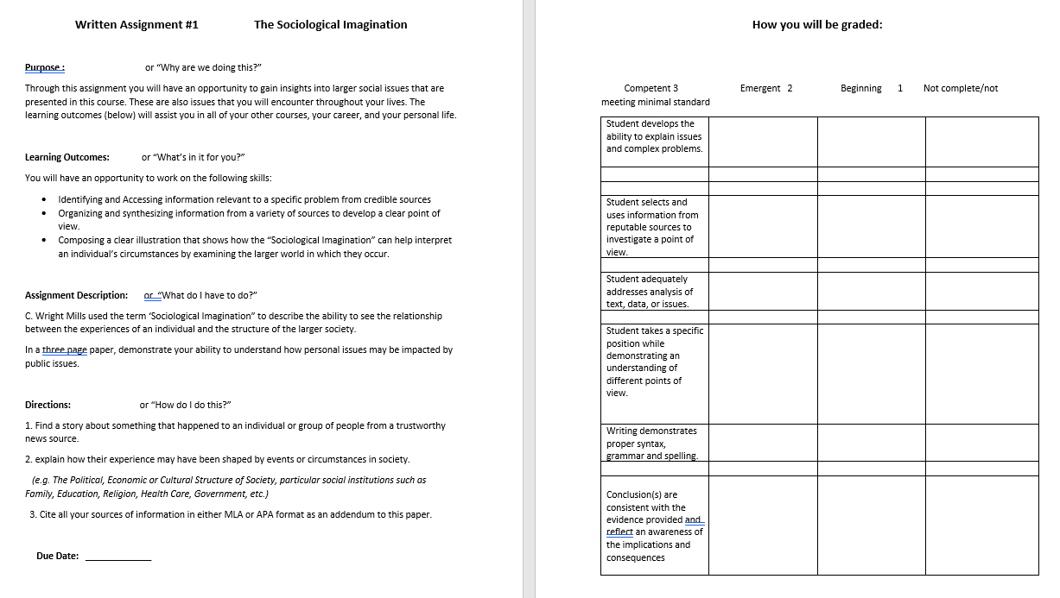
Revised Assignments

Slide 6
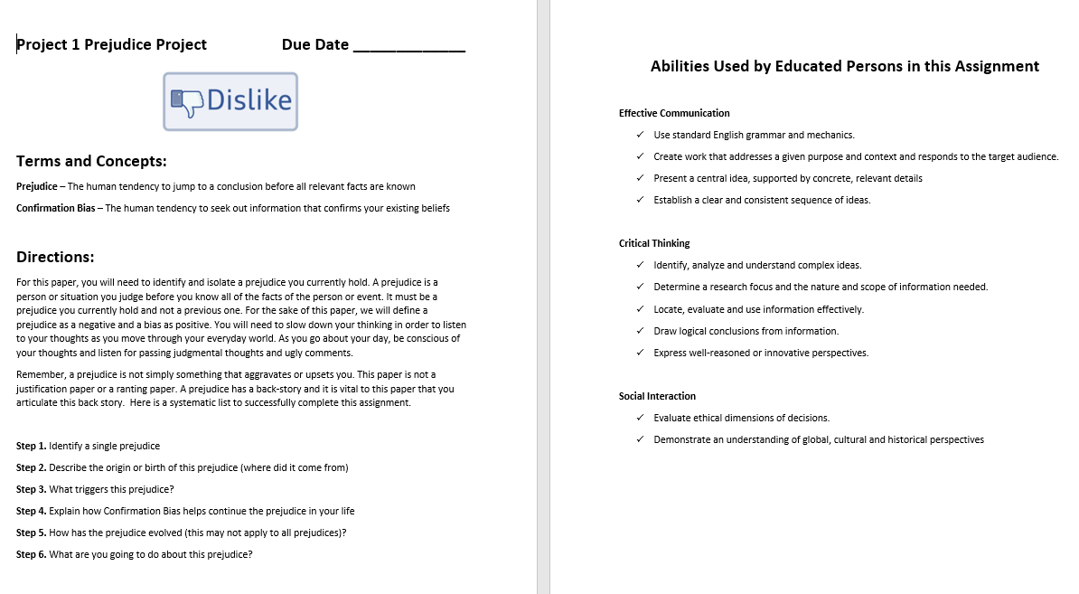
Revised Assignments

Slide 7
Questions for Additional Tasks
Track Changes in Student Performance
Track Changes in Student Completion Rate
Track Changes in Time Spent Clarifying Assignments to Students
Track Changes in Time Spent Grading

