Slide 1
Lessons Learned: A Sampling of Assignment Changes from 1b
Joyce L’heureux
Christopher Anderson
Christine Lima
Lydia Rogers

Slide 2
Showcase of Before and After of Assignment Design
Christopher Anderson

Slide 3
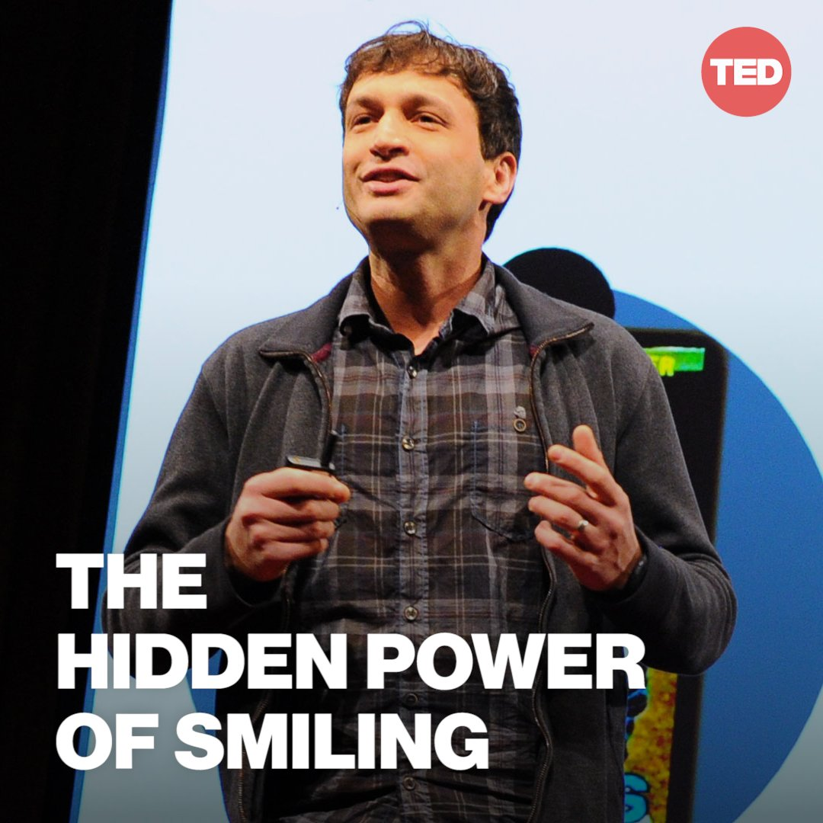
Before
Lecture
Watch Awesome Tedtalk
Group work with no consequences
Move on

Slide 4
After
Lecture
Watch Awesome Tedtalk
Group work with Grades
Move on

Slide 5
Showcase of Before and After of Assignment Design
Lydia Rogers

Slide 6
Assignment Design Change: Improve Visual Clarity
Notes:
Here are some before and after steps I'm taking for a course assignment re-design. The course is Communication Fundamentals, Comm 1010. The goal is to educate students to have effective oral communication skills.
Step One in my process is: update the visual.
Among the results for me as a result of these Summer Intensive sessions is a revamping of the "too much at one time" aspect of my assignments.

Slide 7
Before: Everything on One Page
Notes:
Here is a screenshot of one of my existing assignments. Too many words. Too little white space. Too little breathing room.
Up until now, I've included all elements needed for each assignment within the assignment itself.
For example, for a textbook chapter analysis, I would include within an assignment: the expected length of the analysis, the need to have correct spelling and grammar, and citations needed when quoting from the textbook.
Those elements were needed for every textbook chapter analysis.
Then, below that was the section, "Questions to Answer," which was different for each assignment.

Slide 8
Going Forward: Blackboard Assignment Questions & Links
Links
Questions
Notes:
Here's my new plan for assignment presentation. Standard elements to be presented as links, with the specifics for any one assignment spelled out.
As you see here, after ensuring that my instructions and rubric were accessible to those with sight-impairments, I uploaded them to the assignment as attachments, leaving only the questions showing.
Now, there is more white-space in the assignment, leading to a less visually stressful presentation. Although a student can refer to the guidelines within each assignment, those guidelines do not need to spelled out in every assignment, every week.
As needed, students can refresh their memory by clicking the links.

Slide 9
More Guided One-to-One Communication
Notes:
In Communication Fundamentals, I have students communicate via their own blog and PowerPoint. These sessions this summer have made me realize that while I teach both one-to-one communication and also presentations to a group, I should strengthen the instructions for one-on-one interactions. To that end, I'll give more guided instructions for the feedback students leave each other on blog posts. Up until now, I was more focused on making sure no student trash-talked another, with the result that comments are always polite, but also sometimes too vague to be truly constructive for each student.
I realize I need to go a step further and guide them in making strong, collaborative, and constructive comments to each other, in a way that respects, and does not diminish the other person. Not only is that communication skill needed in class, but also in the work world, and for that matter in the world in general.

Slide 10
Showcase of Before and After of Assignment Design
Joyce L’heureux

Slide 11
Assignments, What changed? Revised Assignment
Audience Analysis
Due Date: July 5th, 2023
Purpose: This assignment allows students to investigate audience interest and research through thoughtful inquiry by preparing open-ended questions.
Please review the Individual Presentation Assignment found in Week 1.
Skills: Research, audience analysis, speech preparation, preparing questions for research
Knowledge: Students acquire the importance of understanding their audience; how to create a research question or questions of inquiry to further independent research.
Path to success: Please see the rubric.
Create five (5) open-ended questions. What does an open-ended question look like? Open-ended questions are questions that provide us with the opportunity to gain an individual’s perspective. These questions are not yes and no answers or one word; they ask for thoughtful input. Instead of asking, would you be interested in learning about …..., ask what kind of information you would find exciting to learn about….? What areas of information apply to your life? For an explanation, use the link here to read more about Open ended versus closed questions for an explanation.
Post five open-ended questions to the discussion page by Sunday, July 2nd, 11:59.
Respond to at least four (4) of your classmates’ posts with your answer to their inquiry. Be sure to answer the questions with thoughtful inquiry to support their research. A supportive and thoughtful post means a substantive response. If there are four (4) answers, please toggle to the following discussion post to ensure all students have responses.
Once you have a minimum of four responses for each question from four classmates, you can complete the Audience and Speech Analysis and APA Research Assignment.

Slide 12
Design Transparency
Clarity in assignment
Student assessment
Student Feedback
Assignment Test
Components

Slide 13
Assignment Revisions
Assignment Assessment (Exam)
Student inquiry

Slide 14
Showcase of Before and After of Assignment Design
Christine LimA

Slide 15
Biol 1002 Introductory Biology: Cellular
Adding Transparency in Learning and Teaching (TILT) components to assignments
Much of the information and many of the directives added were historically verbally conveyed to students
Students who were not listening or came in late did not get the information
Students were unclear about what was required of them
Students were unprepared to meet the requirements of the assignment
Adding the information to the text of the handout increases clarity and recall for students
Supports students with neurodiversity
Increases student retention and completion rates
Students understand why the work is important and what they will get out of it

Slide 16
TILTing My Assignments
Before:
After:

Slide 17
TILTing My Assignments
Before:
After:
The approach used to update lab activities for Biol 1002 can be used for any assignment in any discipline

