Slide 1
Ability 1: Effective Communication
1a: Create written work that develops and expresses ideas and that addresses a given context and target audience.
Jessica Araujo
English
Mark England
Criminal Justice and Legal Studies
Kristen Swithers
Biology

Slide 2
1a: Create written work that develops and expresses ideas and that addresses a given context and target audience.
By the end of a 1A general education course, student will be able to:
Control syntax and mechanics to communicate clearly
Choose content, organization and structure to accomplish the purpose of the writing task(s)
Respond to considerations of audience, purpose, and the circumstances surrounding the writing task(s)
Engage with specific writing processes, strategies, and modes of textual production or publication related to disciplines or specialized contexts
Effectively use sources and evidence

Slide 3
1. Control syntax and mechanics to communicate clearly
Suggested Change(s)
This should be removed
This is only addressed in our developmental courses

Slide 4
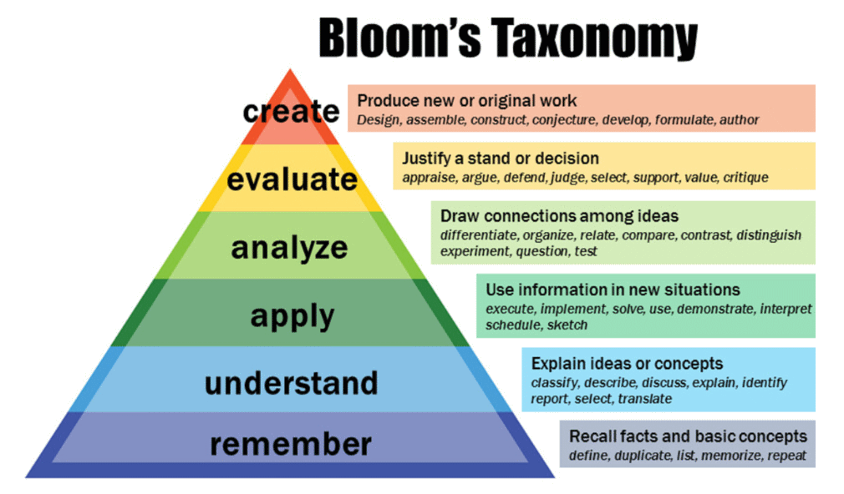
2. Choose content, organization and structure to accomplish the purpose of the writing task(s)
Suggested Change(s)
Organize and structure content clearly to accomplish the writing task(s)

Slide 5
3.Respond to considerations of audience, purpose, and the circumstances surrounding the writing task(s)
Suggested Change(s)
Evaluate how to write for specific audiences, purposes, or genres

Slide 6
4. Engage with specific writing processes, strategies, and modes of textual production or publication related to disciplines or specialized contexts
Suggested Change(s)
Demonstrate successful use of writing conventions of the specific discipline or specialized context(s)

Slide 7
5. Effectively use sources and evidence
Suggested Change(s)
Use evidence to support the objectives of the writing task and provide sources if needed

Slide 8
Revised 1A Student Learning Outcomes
Organize and structure content clearly to accomplish the writing task(s)
Evaluate how to write for specific audiences, purposes, or genres
Demonstrate successful use of writing conventions of the specific discipline or specialized context(s)
Uses evidence to support the objectives of the writing task and provide sources if needed
1
2
3
4

