Slide 1
Tour of the Vatican

Slide 2
Passeggiata in St. Peter’s Square

Slide 3
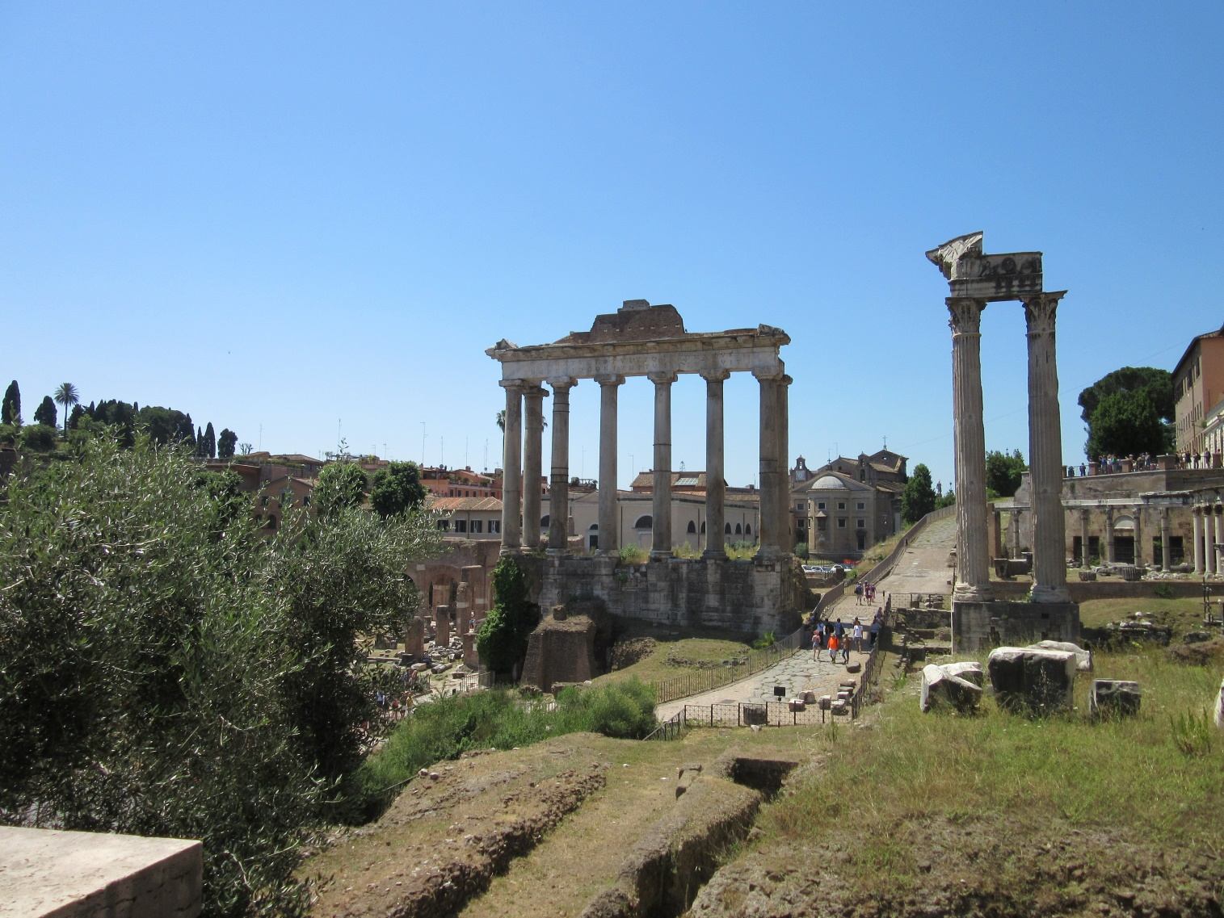
Colosseum and Roman Forum

Slide 4
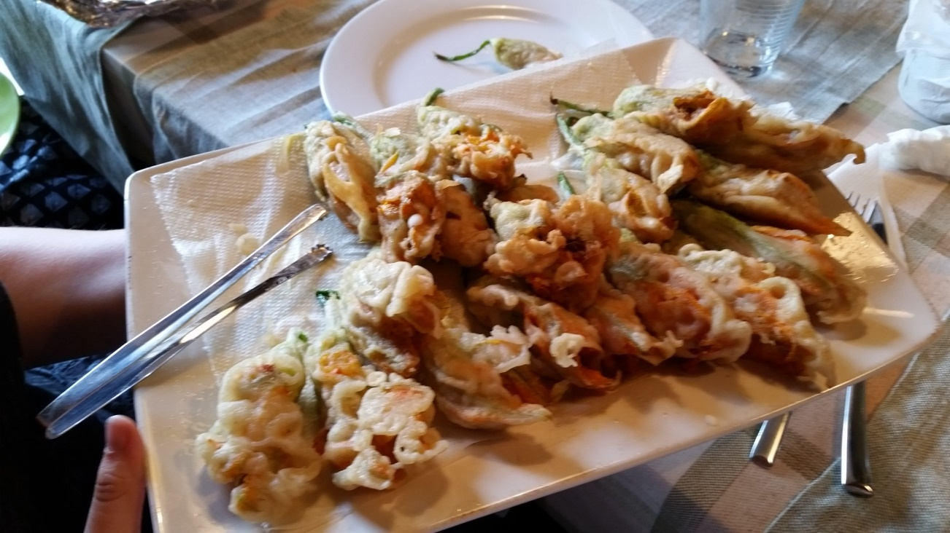
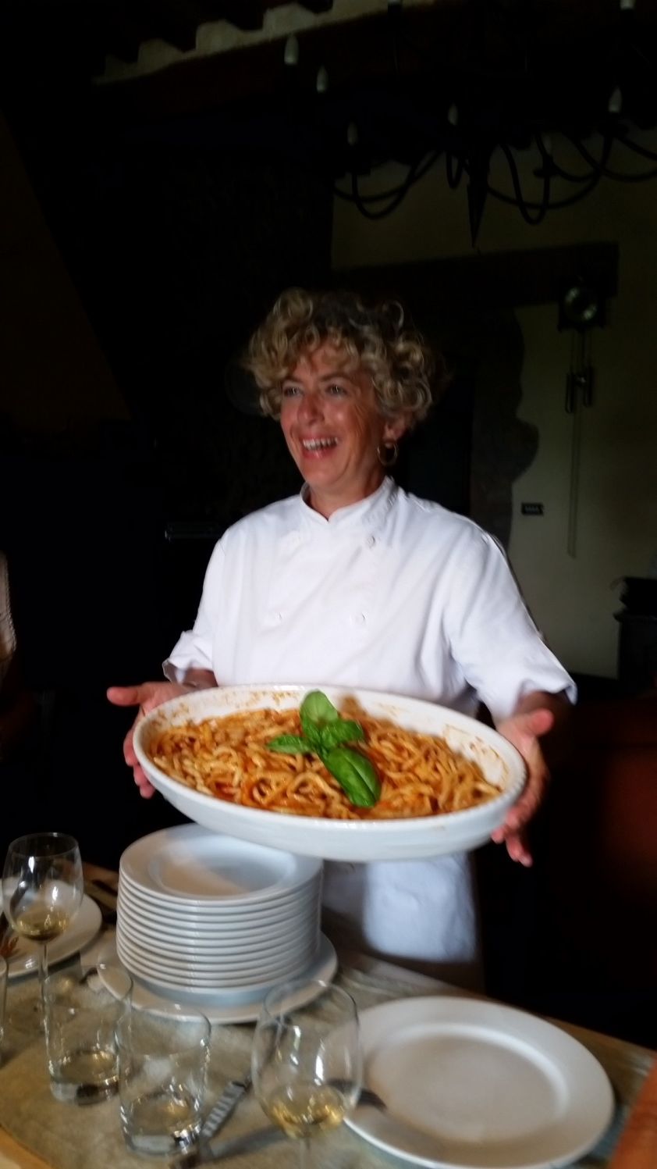
San Gemini - Cooking with Chef Lorena

Slide 5
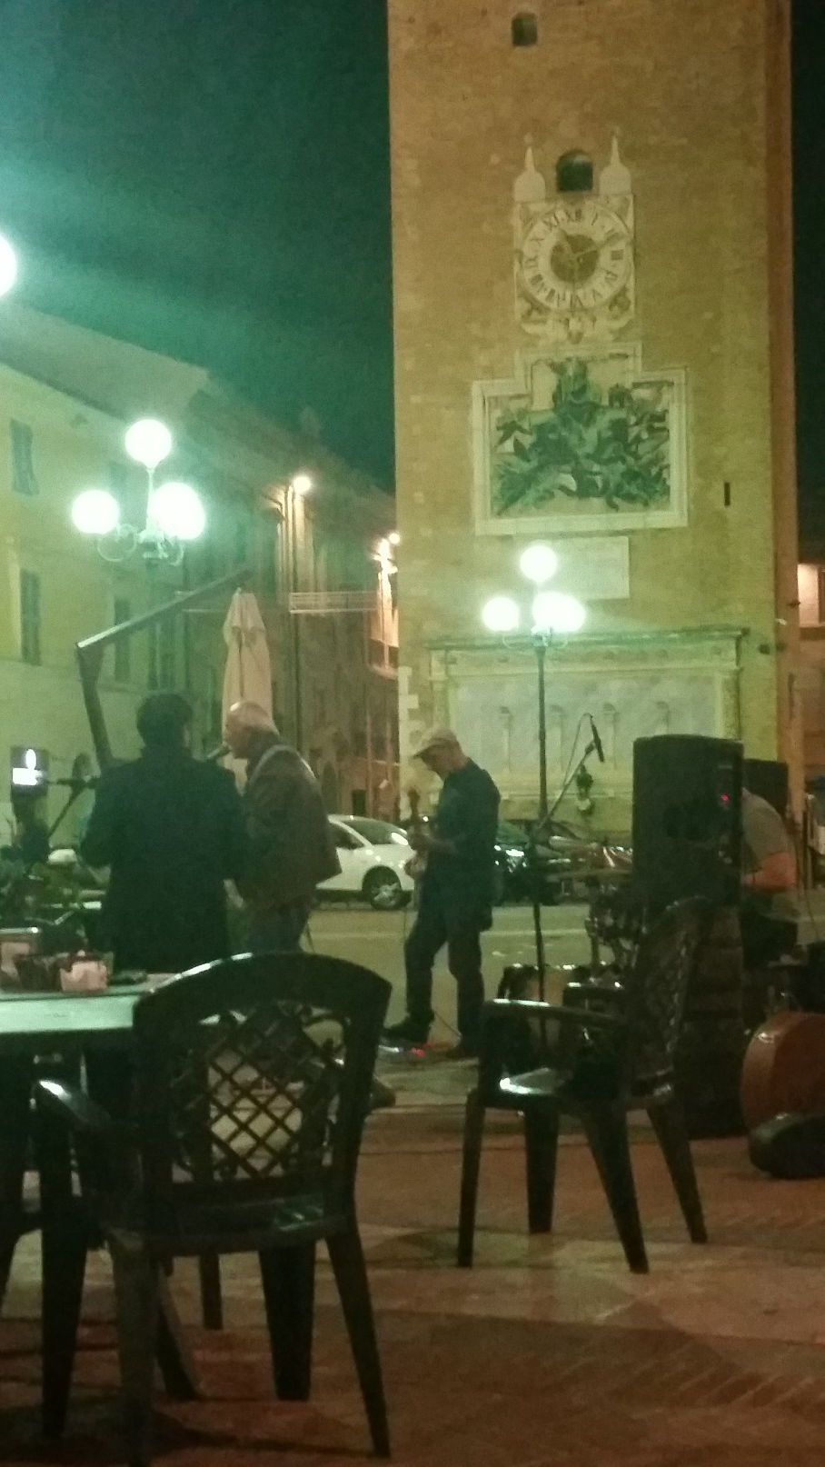
Recanati Town Square

Slide 6
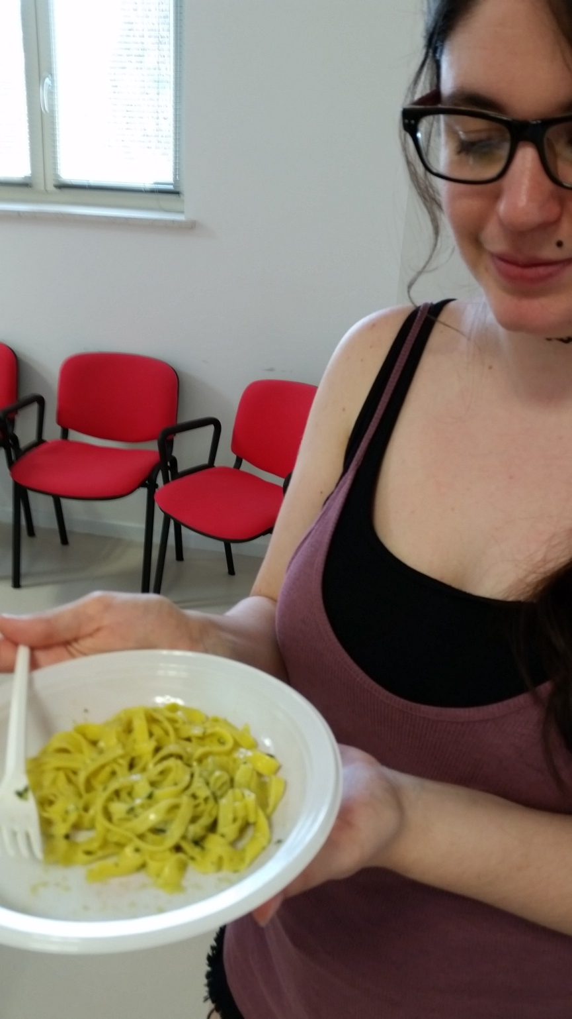
Cooking at Campus l’Infinito

Slide 7
Porto Recanati – Adriatic Sea

Slide 8
