Slide 1

Overview of History of Germany and
its Effect On Its Geographical Borders
(5th – 19th Centuries)
Diane Stadelbauer (aka Silke)
Elementary German 101
Frau Panaccione 1 December 2016
Notes:
Overview of Modern History of Germany and
its Effect On Its Geographical Borders
Diane Stadelbauer (aka Silke)
Elementary German 101
Frau Panaccione November 2016
Overview of Modern History of Germany and
its Effect On Its Geographical Borders
Diane Stadelbauer (aka Silke)
Elementary German 101
Frau Panaccione November 2016

Slide 2
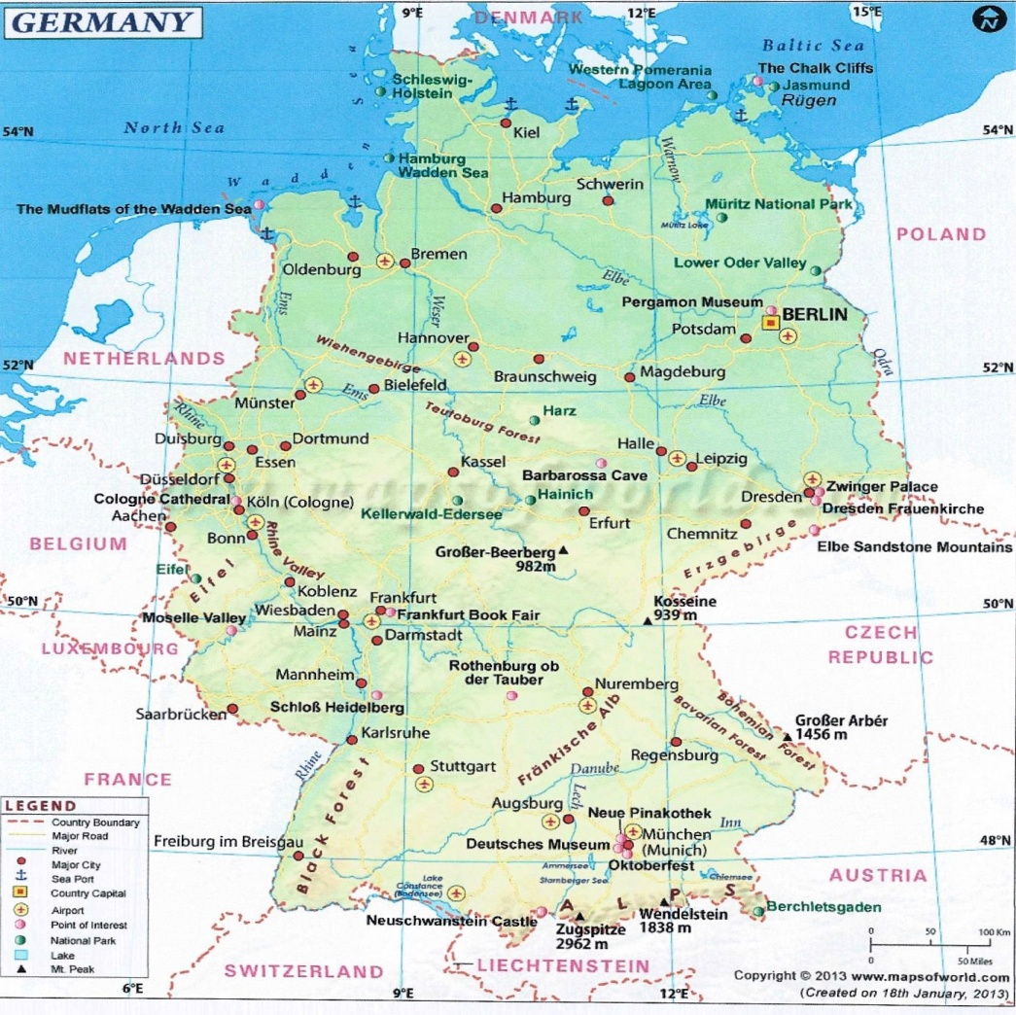
Photo Credit: www.mapsofworld.com/germany
Modern Germany as we know it

Slide 3
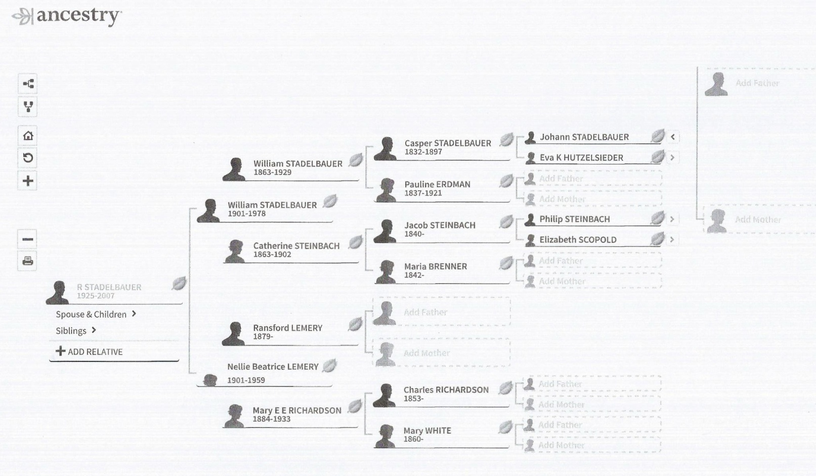
Overview of History of Germany and
its Effect On Its Geographical Borders
Hitting a wall in genealogy (impediments to finding your ancestors):

Slide 4
Until the 5th century, Rome was the leading power in Europe.
Internal struggles caused a weakening of this power. At that point, Germanic (Teutonic) tribes were living along the Rhine and Danube Rivers. By the time Roman power started to wane, the Germanic tribes were primarily divided into 4 major groups:
Franks: The Franks occupied land predominantly in the west (in the areas now known as France, Belgium, the Netherlands and some parts of Germany).
They replaced Rome as the dominant power in Europe.
Saxons: Many Saxons relocated, for various reasons, to Britain. Those that remained on the continent occupied land in central Europe, along the Baltic coast.
They fought against Frankish expansion until they were eventually subdued by Charlemagne who incorporated the into the Carolingian Empire (804 AD).
Allemandes or Swabians: These people occupied lands in central and southeast Europe (present day Alsace and northern Switzerland).
They were eventually conquered by the Frankish King Clovis I in 496 AD. In the 9th century, this area became known as Schwaben (Swabia).
Bavarians: These peoples were located in the south of Germany, north of the Alps. They were pagans until the 7th century.

Slide 5
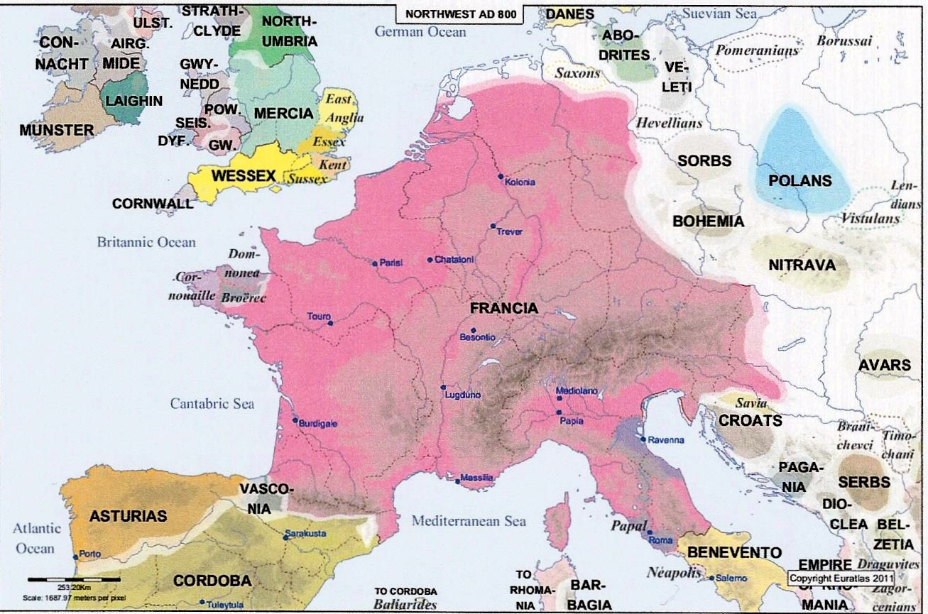
Photo Credit: Euratlas Periodis Guide Book, Euatlas-Nussli, Milieu 30, 1400 Yverdon-les-Bains, Switzerland, January 2015
Europe in the 9th century (800 AD)

Slide 6
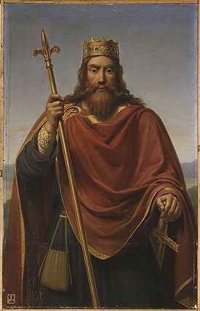
Clovis I (493 – 511 AD)
Merovingian King who won the Battle of Tolbiacum against the Allemani. He brought much of France and half of Germania (Germany) together.
He converted to Christianity in 496. He started laying the groundwork for the alliance between the Frankish kingdom and the church.
Merovingian Dynasty lasted about 300 years (457 – 752 AD), but after Clovis, the rulers became continuously weaker.

Slide 7
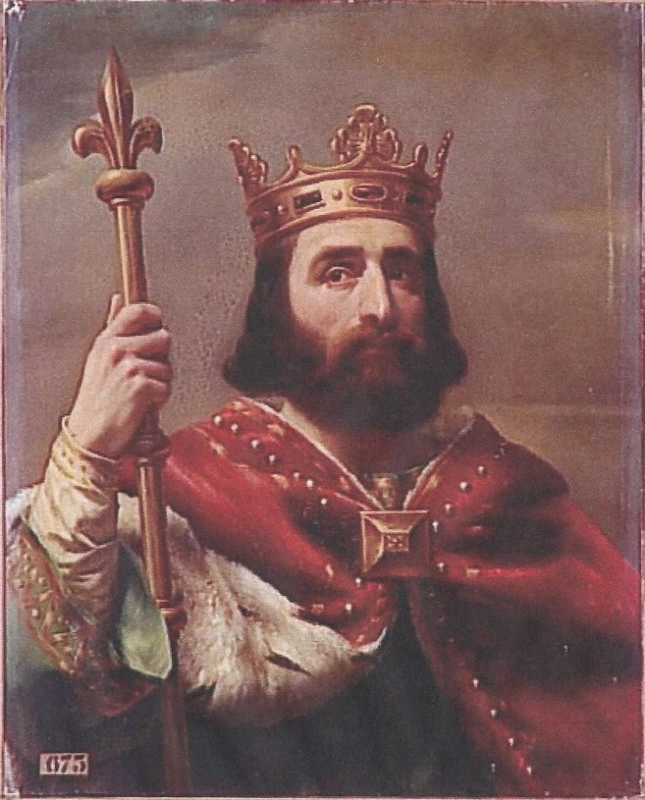
Early in the 8th century was a court councilor named Charles Martel. He never actually assumed the throne, but was definitely a leader and the power behind the throne.
732 AD - Defeated Arab (Islamic) invaders of Gaul at the Battle of Poitiers.
He restored centralized government to Francia (France). He took possession of large tracts of land and brought about the start of feudalism, which remained until the 19th century.
Pepin the Short, son of Charles Martel overthrew the Merovingian kings to become the first Carolingian King.

Slide 8
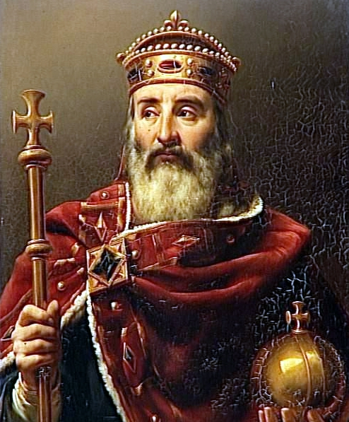
Charlemagne (c. 742 – 814 AD)
Son of Pepin the Short. Grandson of Charles Martel.
Became King in 768. His goal was to reunite all Germanic tribes.
He conquered France, then Italy. Having conquered Italy, he turned the land over to the Pope.
His turned his attention to Spain, where he fought the Arabs. He then moved east and fought Asian warriors, known as Avars. After fighting them for 8 years, he completely annihilated them.
Battled the Saxons - Charlemagne was Christian and the Saxons were heathens, Eventually had over 4000 Saxons put to death.
Charlemagne remained informed about all of his empire, creating schools, appointing judges, had laws written down, nominated Bishops.
Under Charlemagne, Germanic tribes no longer spoke Frankish or Bavarian. They spoke “thiudisk” meaning German.
On Christmas Eve 800 AD the Pope made Charlemagne Emperor of the Holy Roman Empire. Charlemagne died in 814 AD.

Slide 9
Within 100 years, the empire of Charlemagne was torn into pieces. His son, Louis the Pious was weak and ineffective. His sons not only fought against their father but also against each other over control of the empire. In 843 they finally signed the Treaty of Verdun, which divided the empire among them as follows:
Lothar received the middle kingdom (from the North Sea to Italy)
Charles received all that was west of Lothar’s land (southwest France)
Louis received Bavaria, bound on the west by the Rhine
By 884, all of the Frankish empire was reunited under Charles the Fat (last remaining of Louis’ grandsons). However, he was physically and mentally unfit to rule effectively, was deposed in 887 AD and died the following year.
Nobles elected their rulers following Charles, not always for the better of Germany, until in 911 Conrad I was elected. Conrad formed a firm alliance with the church and thus kept Germany from falling apart. Upon his death, he set up his chief rival Henry the Saxon to succeed him.
Henry forced the Magyars out of Germany and back into Hungary. He then moved into Italy, declared it a fiefdom of Germany, and turned over control to a Lombard (Italian) prince.

Slide 10
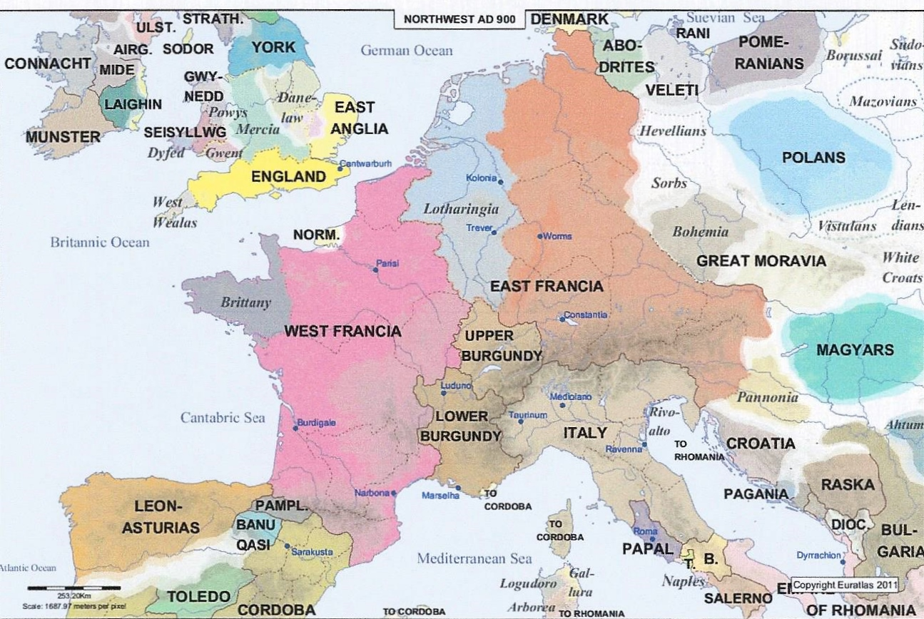
Photo Credit: Euratlas Periodis Guide Book, Euatlas-Nussli, Milieu 30, 1400 Yverdon-les-Bains, Switzerland, January 2015
Europe in the 10th century (900 AD) One hundred years after Charlemagne’s death, his empire was fractured under his 3 grandsons. However, by 884 AD it was reunited under Charles the Fat.

Slide 11
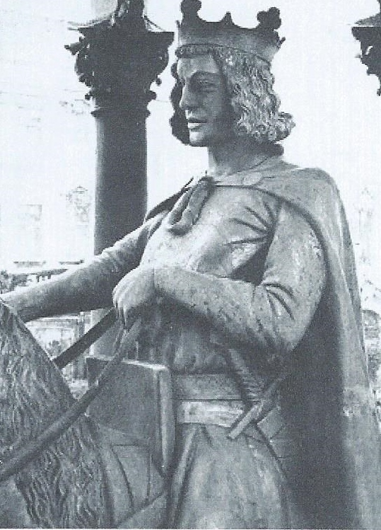
While Henry did not have much of a relationship with the church, his son Otto I (936 – 973 AD) relied on the church to help strengthen his empire and increase his power. To accomplish this, he chose the bishops and abbots. He then gave them land and power thus gaining their loyalty and support. He was a strong leader, much like Charlemagne
Otto’s reign was followed by less effective leaders, starting with his son, Otto II in 973 AD. He died in 983 AD and his 3 year old son Otto III assumed power with 2 female regents. He died at the age of 22, having ruled as an adult only a short time. Having no male heirs, he was succeeded by Henry II (1002 – 1024) of Saxony.
Otto I

Slide 12
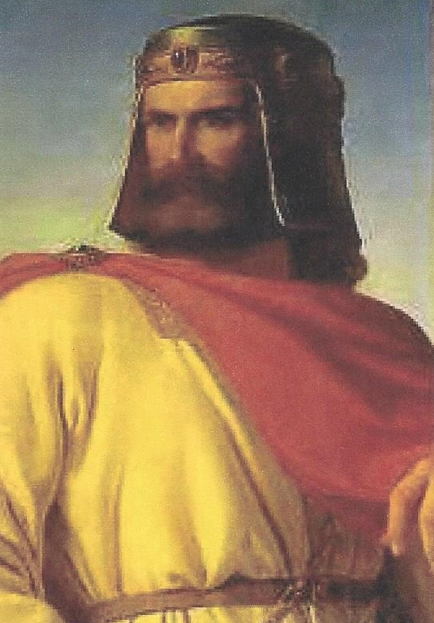
When Conrad II (1024 - 1039) assumed the throne upon Henry’s death in 1024 AD, Germany once again had a strong capable leader. He increased his lands and created a new social class called ministeriales. These were peasants from serf backgrounds. He trained them as knights or administrators, providing himself with a force with allegiance to no one but the king. His son Henry III continued this practice of using ministeriales. He too increased the lands of his kingdom.
Henry IV (1056 – 1106) succeeded his father at the age of 6 with his mother and the Archbishop of Cologne as regents. In 1065 AD, upon reaching the age of majority, he reacquired authority and following his father and grandfather’s leads, he too cultivated ministeriales.
Conrad II

Slide 13
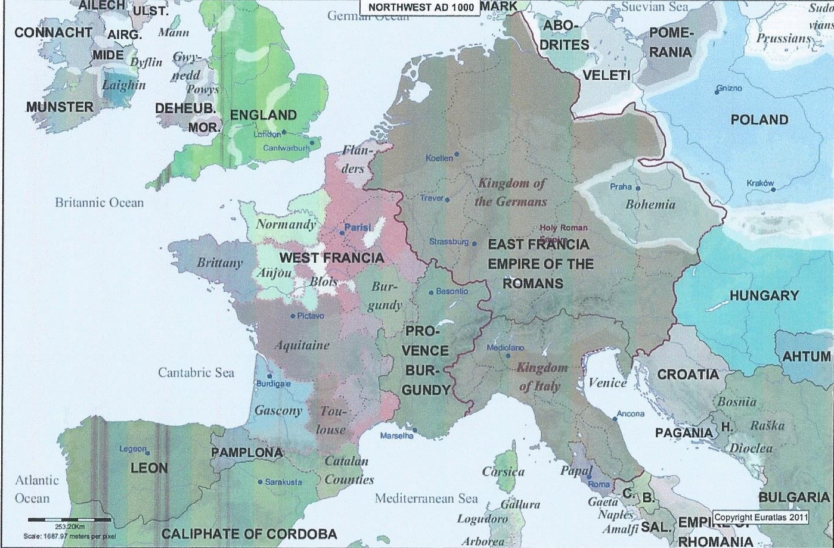
Photo Credit: Euratlas Periodis Guide Book, Euatlas-Nussli, Millieu 30, 1400 Yverdon-les-Bains, Switzerland, January 2015
Europe in the 11th Century (1000 AD)

Slide 14
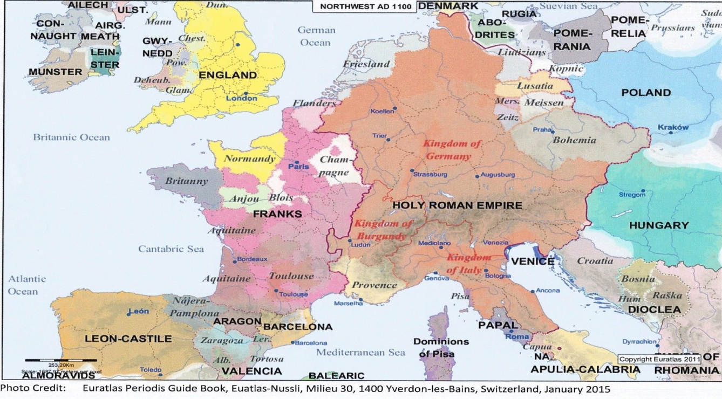
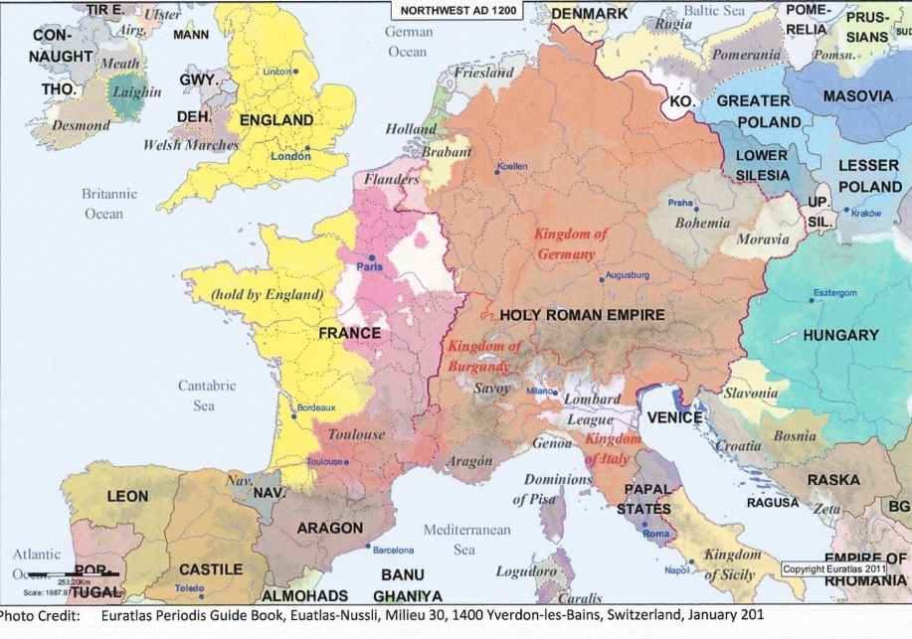
12th and 13th Century Europe (1100 – 1200 AD)

Slide 15
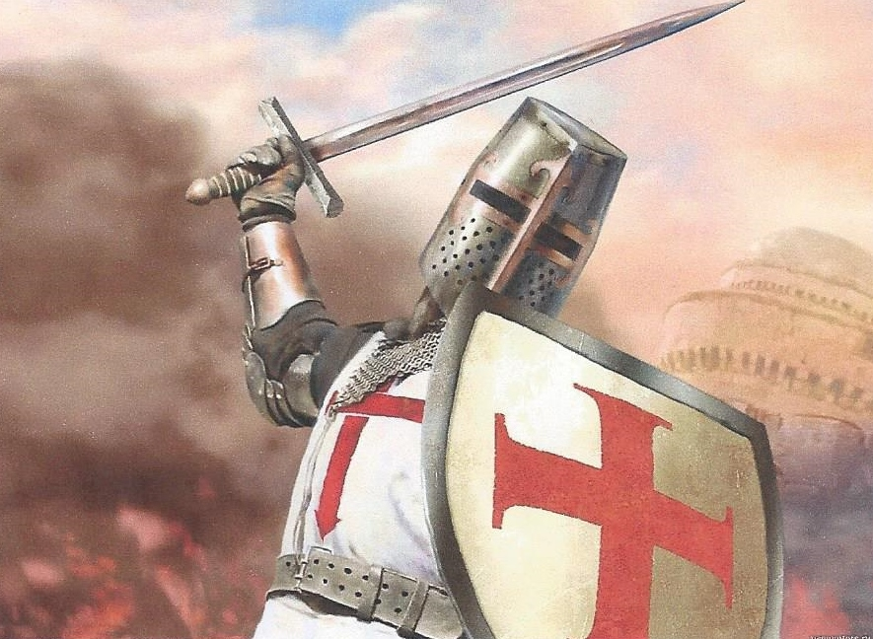
The Crusades (1095 – 1291) During this time, there were three crusades of Europeans against Muslims.
The First Crusade was preached in 1095 by Pope Urban II over what he called a disgrace to Christianity from Muslims controlling pilgrimage to Jerusalem by Christians.
He called for western leaders to stop infighting among themselves and take the battle to the oppressors of the Holy Land instead.
He also promised that if you died crusading for Christianity, you were guaranteed to go to heaven and all of your sins forgiven.
The first wave of Crusaders were peasants, and they were annihilated.
By late summer of 1096, the army of knights did organize, but since Henry IV of Germany and Phillip I of France were at the time excommunicated, neither participated. Eventually, the Crusaders reached Jerusalem and controlled it from 1099 to 1118.

Slide 16
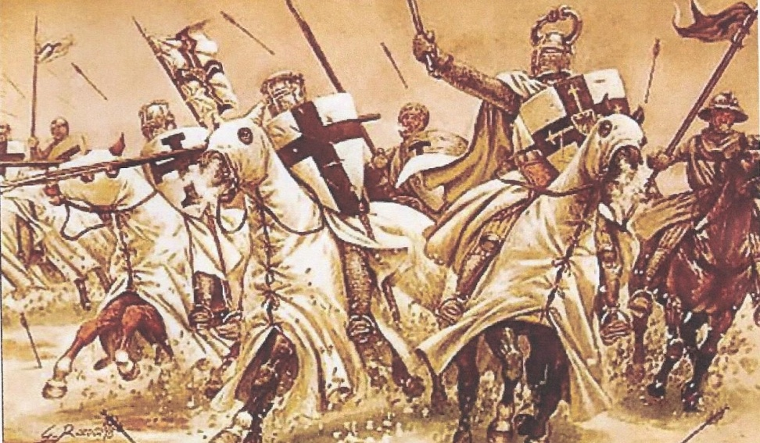
1140 - Muslims rose up to regain control, prompting the Pope to preach for the Second Crusade.
Conrad III of Germany was convinced to join the fight along with Louis VII of France and Roger II of Sicily.
1187 - Muslims once again rose up and this time they were under a powerful leader who already controlled Egypt and Syria.
A Third Crusade was preached, this time resulting in the support of the Kings of France, England and Germany.
This time only Frederick I, the Holy Roman Emperor (1152 – 1190) was available to set out in 1189. He proved to be quite the adversary until his drowning the following year. Richard the Lionheart of England and Phillip II Augustus of France eventually negotiated a truce allowing the free access of Christians to Jerusalem.

Slide 17
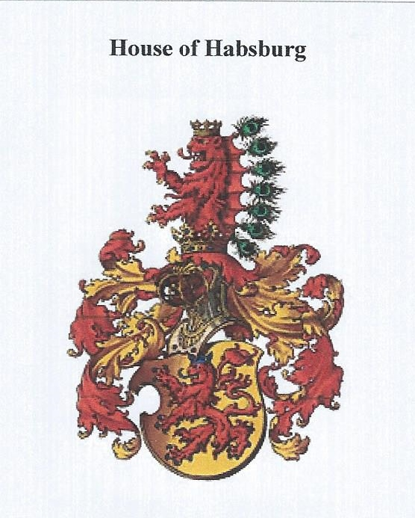
Hapsburg Monarchy/Austrian Monarchy (1273 – 1804 AD)
The roots of this powerful family started in Switzerland, but in 1276 AD was moved to Austria. This family used intermarriage and the untimely death of other rulers to expand their territory and power.
A Hapsburg held the title of Emperor of the Holy Roman Empire from 1438 to 1740.
Under the Hapsburgs, the first German universities were created in Prague, Cologne, Erfurt, Heidelberg and Vienna.
A study of 3000 descendants over 16 generations led to the hypothesis that inbreeding was the ultimate downfall of the family.

Slide 18
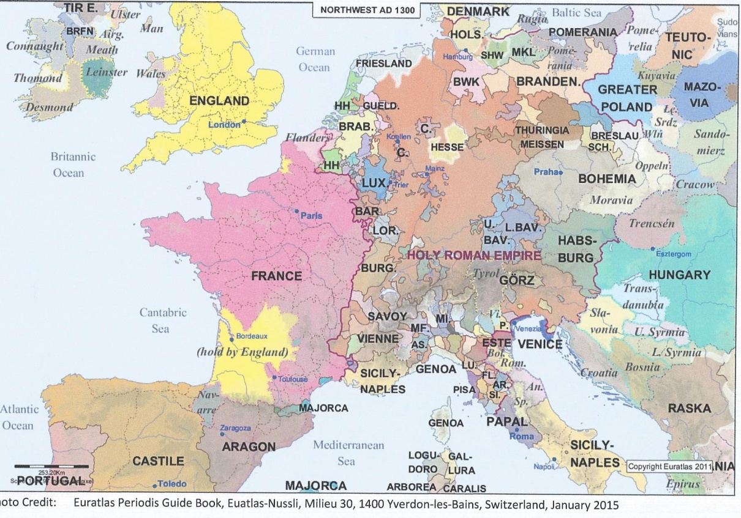
The Black Death (Bubonic Plague) started in Sicily and Italy in 1347 and spread to Switzerland, Germany and Eastern Europe within months. By 1348 it had also spread to France, Spain, and England. Because of the thousands if not millions of deaths, it caused a decline in the economy and the decline in serfdom, since resulting labor shortages forced landowners to make concessions to the peasants.
14th Century (1300 AD) show vast changes in European borders.

Slide 19
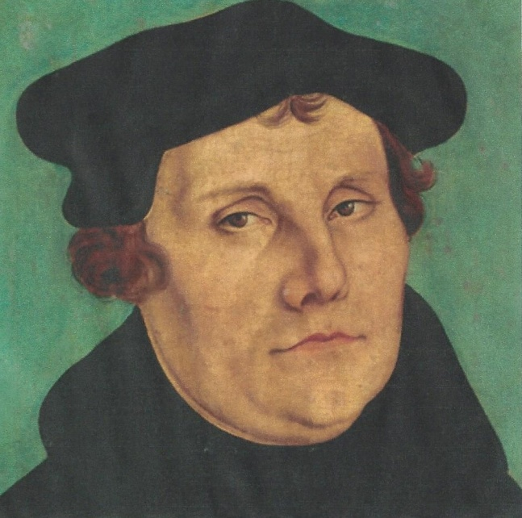
Martin Luther and the Protestant Reformation - Martin Luther believed the only path to salvation was faith in the goodness and mercy of Jesus Christ. This conflicted with the Catholic Church’s doctrine of earning your way into heaven by living a pious life, but that only Jesus could grant salvation. (“Justification by faith alone” vs. “Justification by faith”).
In 1517 a Dominican friar started selling “indulgences” This money was used to help pay for the construction of St. Peter’s basilica in Rome.
Luther questioned the doctrine of indulgences, and in October 1517 he posted his 95 Theses to the door of the castle church in Wittenberg.
in 1520 Pope Leo X issued a bull (basically a document) of excommunication. Luther responded by burning it.
Although he urged reform and felt there were inequities and bad laws, he also felt that laws should be followed, just or otherwise. In 1524 peasants revolted (The Peasants War), but little came of it.

Slide 20
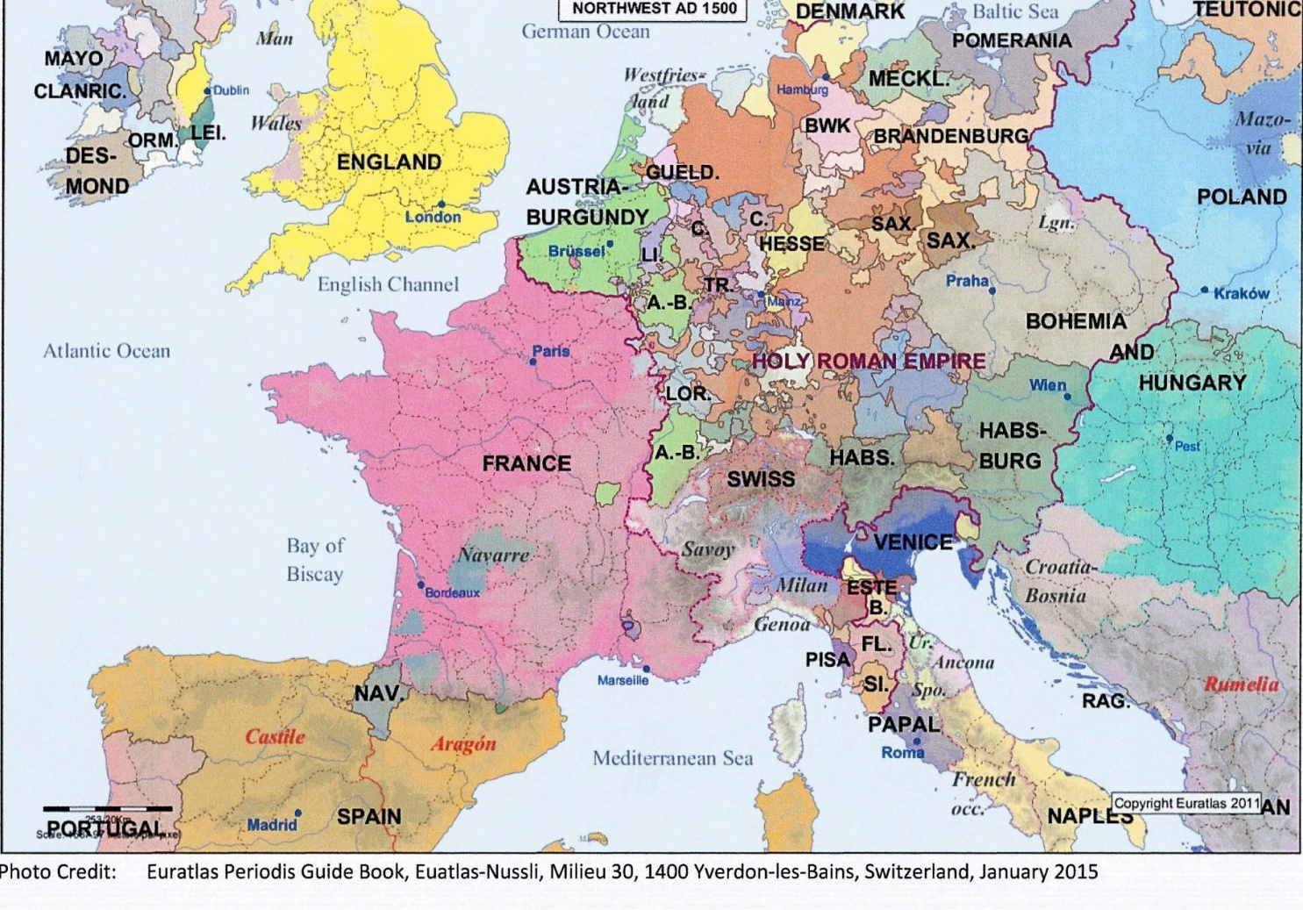
16th Century Europe (1500 AD)
From 1546 to 1555, Germany was torn by a religious civil war between Lutherans and Catholics. The Peace of Augsburg treaty allowed German princes to determine the religion of their own state.

Slide 21
An interesting personal note relating to my own genealogical research into the Stadelbauer family is this posting from a family member in Germany on a Facebook page:
“Unsere Familiengeschichte: Der Anfang meiner Familie beginnt auf einem Hof in Österreich. Erzählungen zu Folge wurden auf diesem Hof 3 Söhne gebohren, die angeblich wegen ihrer neuen Religion (evangelisch) nach Deutschland flüchten mussten.
Einer ist in den Norden Deutschlands und hat im Laufe der Zeit teilweise sein e verloren.
Zwei von den Brüdern gingen ins Fränkische und liesen sich dort nieder. Nach einigen Überlieferungen ging jedoch einer wieder zurück an den Hof.
So zu welchem der 3 gehört Ihr? Oder habt Ihr weitere Wurzeln?
The start of my family knowledge begins on a farm in Austria. Stories passed down that the family on this farm had 3 sons, who had to flee allegedly because of their new religion (protestant) to Germany.
One went the north of Germany and in the course of the time became partly lost.
Two of the brothers went to Franken in Bavaria and settled down, but one of them went back to Austria.
To whom do you think you belong? Or do you have another line?”
To me, this is provided a tangible tether to the past and history itself.

Slide 22
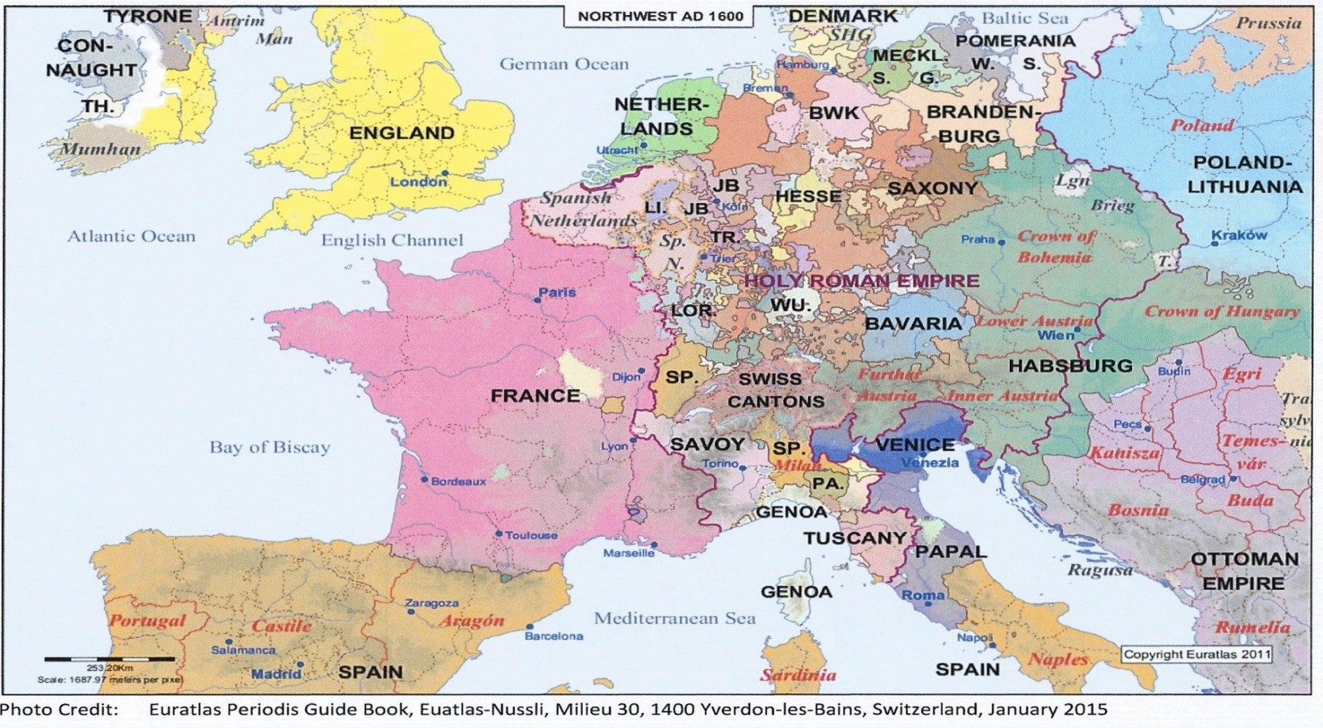
Thirty Year War (1618 – 1648) Fought mostly within German borders. Was actually a series of religious wars, but there were political motivations as well. It was an effort to reduce power of the Hapsburgs. An estimated one third of the population (about 7 million people) died. It was finally settled with the Peace of Westphalia which stipulated that Lutheranism would be given parity with Catholicism.

Slide 23
In the 18th century the Marquisate of Brandenburg was owned by the House of Hollenzollern and was located on the southern shores of the Baltic and west of Prussia. The Marquis of Brandenburg convinced the Emperor of Germany to combine the two provinces into the Kingdom of Prussia.
The Marquis’ son, Frederick (1713 – 1740) was crowned the King of Prussia, taking the title of Frederick I and chose Konigsberg (Prussia) as his capital. Known as the Soldier King because his focus was on building a great army. He led a very austere lifestyle.
Frederick Wilhelm (Frederick II) – Suffered greatly under his father and his austerity, but essentially became just like his father, focusing on having a strong army. However, unlike his father, who never started any wars, he started a war when he decided to take Salesia, a province belonging to the Hapsburgs of Austria. This war involved almost all of Europe. After 2 years, a treaty signed in Breslau gave him Silesia. But his actions had caused repercussions for the rest of Europe, as they continued fighting each other.
The Seven Year War (1757 – 1763) Maria Teresa of Austria (and a Hapsburg) aligned herself with Elizabeth, Empress of Russia, Augustus III of Poland, and the Marchioness of Pompadour, who ruled France.

Slide 24
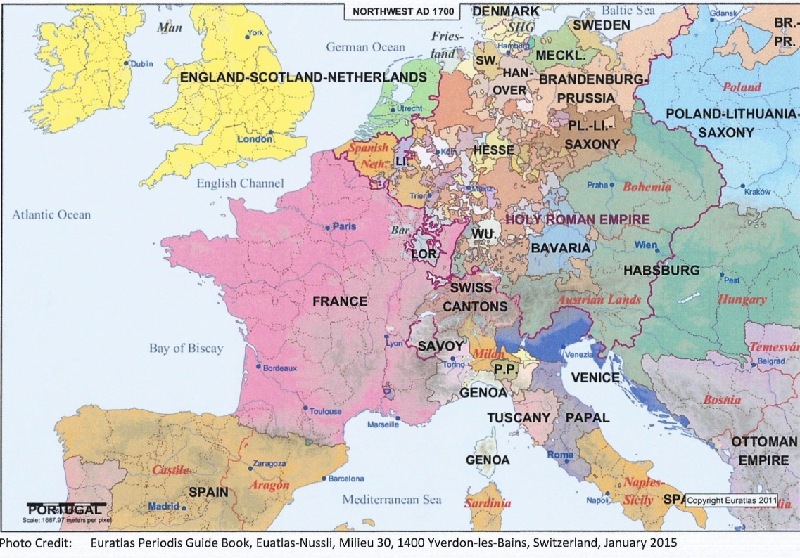
The three women ruled most of the continent and all disliked Frederick. Maria Teresa was intent on getting Silesia back. They formed a plan to attack Frederick, but Frederick found out and planned to strike first.
France had troops formed and ready to attack Prussia from the west; Sweden and Russia were prepared to attack from the north, and Austria would attack from the south. Frederick amassed 100,000 troops and attacked Saxony. Thus started a war that would last seven years, claim almost a million troops, countless civilians and deflate Prussia’s population by 500,000. In the 1763, a treaty was signed and Frederick kept Silesia.

Slide 25
Annexation of Poland (1772) – A few years after the end of the Seven Year War, talks began between Russia, Austria and Prussia about partitioning a section of Poland among themselves. Although Maria Teresa of Austria continued to harbor ill feelings toward Frederick, her son, now Emperor of Holy Roman Empire upon his father’s death, actually looked up to Frederick, so was more than willing to go along with the plan. Using a combination of bribery and force, they split much of Poland up among themselves.
French Revolution (1789 – 1815) – Came to Germany in 1792 when France invaded them. By 1794 France gained control over the Rhineland, and occupied it for over 20 years.
Treaty of Basel (1795) - Prussian and northern German states ceased fighting the French. Austria left alone to suffer at the hands of the French.
1805 Austrian troops, along with their Russian ally, suffered another defeat at Austerlitz. This defeat ultimately led to the demise of the Holy Roman Empire the following year (Napoleon abolished it).
1806, Prussia started pushing back again, but it too was defeated, and Russian abandoned them as an ally. In 1807, Prussia lost territory under the Treaty at Tilsit.

Slide 26
1813 - Prussia had reorganized and retrained their troops. Along with Austria and Russia, they finally defeated Napoleon at the Battle of Leipzig and drove him out of Germany.
Prussian troops were on hand to help with Napoleon’s final defeat at Waterloo in 1815.
Napoleon was responsible for some good changes for Germany. Public administration was improved, (births, marriages, and deaths became part of civil registrations in 1798), and feudalism was weakened, and Napoleonic Code replaced traditional legal codes in many areas. This new legal code remained in place in some places until 1900.
Congress of Vienna (1815) – reorganization of Europe after the defeat of Napoleon. Four major powers (Austria, Prussia, Russia and Great Britain). The political boundaries agreed to by the congress lasted over 40 years.

Slide 27
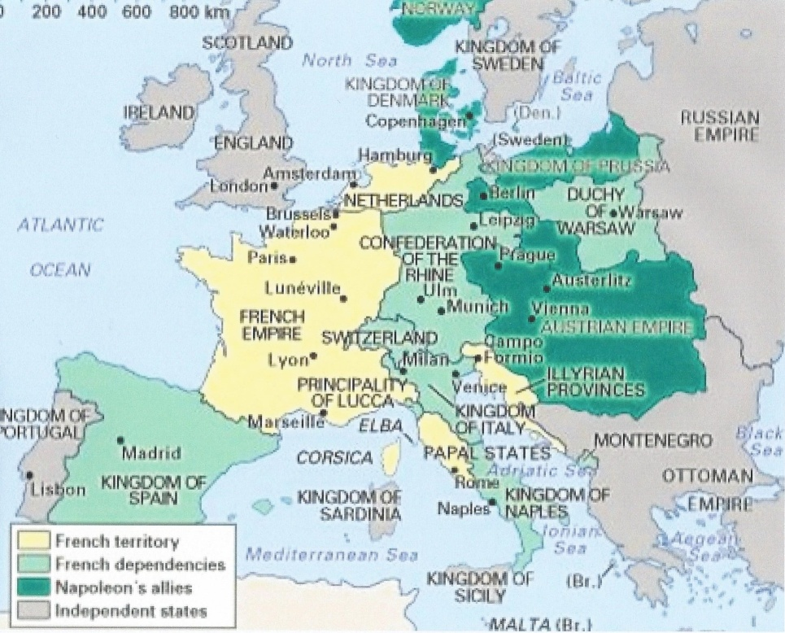
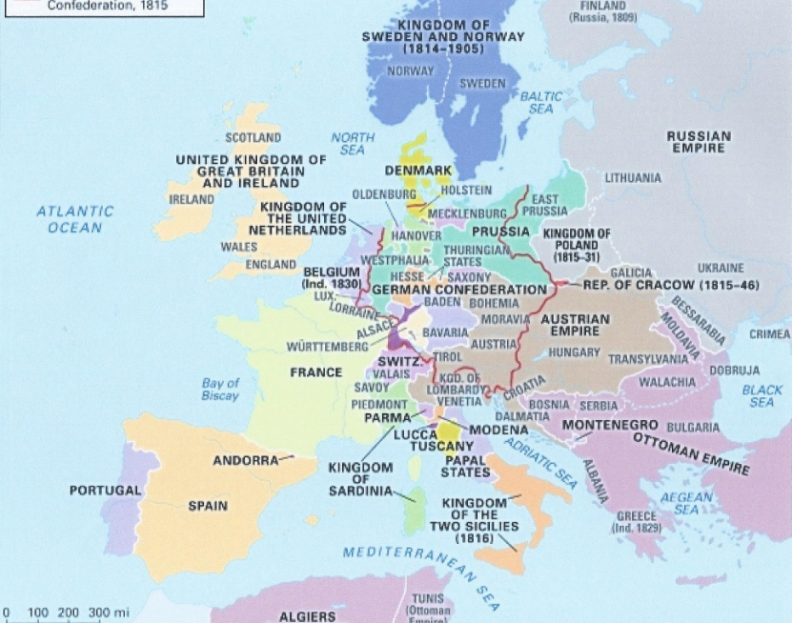
Europe in 1812
Europe after the Congress of Vienna 1815
Photo credit www.britannica.com

Slide 28
Germanic Confederation (1815) – 39 states of Germany formed at the Congress of Vienna. It wasn’t a very strong organization, in part due to a lack of consensus among its members. It ultimately completely fell apart in 1866 after the Seven Weeks War between the two dominant states of the Confederation (Prussia and Austria), which Prussia won and reorganized as the North German Confederation, which eventually included some of the southern states and became the German Empire.

Slide 29
Bibliography
Bemont, Charles; Monod, Gabriel (2012). Medieval Europe, 395-1270. Lecturable (Kindle Edition).
Euratlas Periodis Guide Book (2015), Euatlas-Nussli, Milieu 30,1400 Yverdon-les-Bains, Switzerland.
Hansen, Kevan M (1999). Finding You German Ancestors: A Beginners Guide. The Generations Network, Inc.
Henderson, Ernest F. (2012). A Short History of Germany from the Earliest Times to the Peace of Westphalia. Lecturable (Kindle Edition)
Henderson, Ernest F. (2012). A History of Germany in the Middle Ages. Lecturable (Kindle Edition).
Nelson, Rebecca Editor (2005). The Handy History Answer Book. Visible Ink Press.
Viault, Birdsall S. (1990). Modern European History. McGraw-Hill, Inc.
www. History-world.org/an_overview_of_European_history.htm
www.mapsofworld.com
www.sparknotes.com

