Slide 1
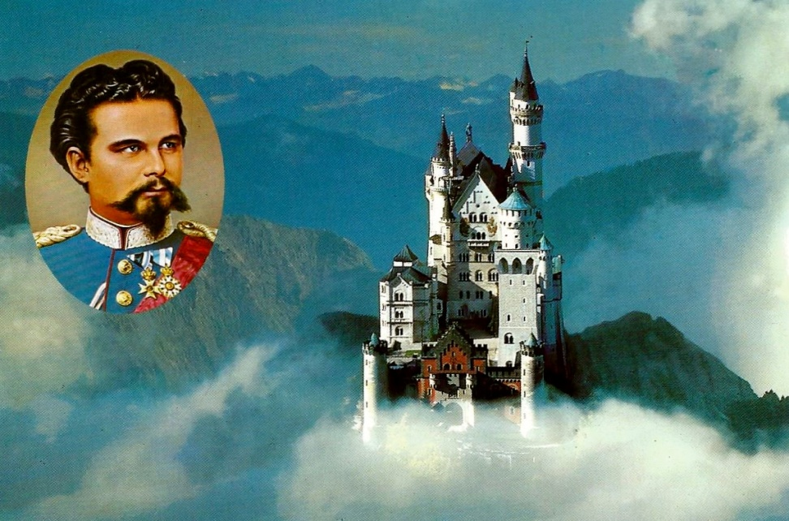
King Ludwig II of Bavaria
Photo Credit: Königsschloß Neuschwanstein Kalender 1998
Diane Stadelbauer (aka Silke)
Elementary German 102
Frau Panaccione 28 April 2017

Slide 2
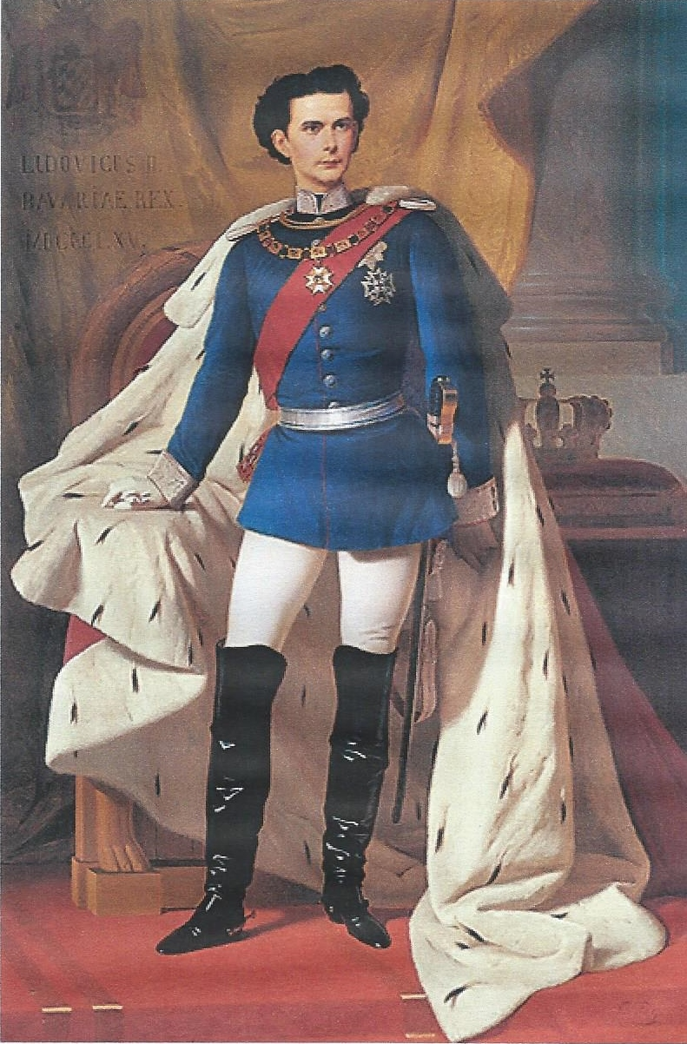
King Ludwig II of Bavaria
Known as “The Mad King”, “The Swan King”, “The Dream King” “The Lunatic King” “The Virgin King”
Born: Ludwig Otto Friedrich Wilhelm. Heir to the Wittlesbach dynastry. 25 August 1845 at Nymphenburg Palace, Munich, Bavaria.
Supposedly he was born on the same date and the exact same hour as his grandfather had been born.
Parents: Maximilian II of Bavaria and Princess Marie of Prussia.
Grandparents: King Ludwig I of Bavaria and Princess Therese von Sachsen-Hildburghausen.
Photo Credit: Ferdinand von Piloty, Munich, 1865

Slide 3
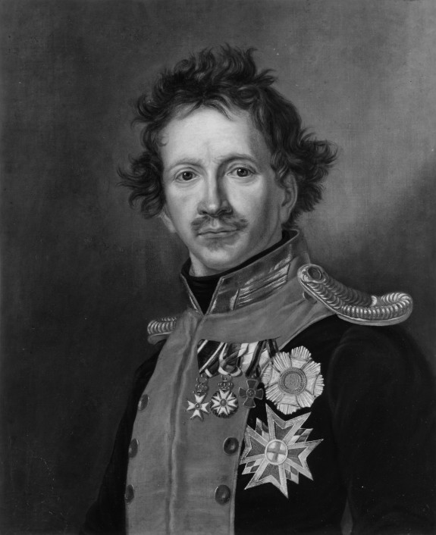
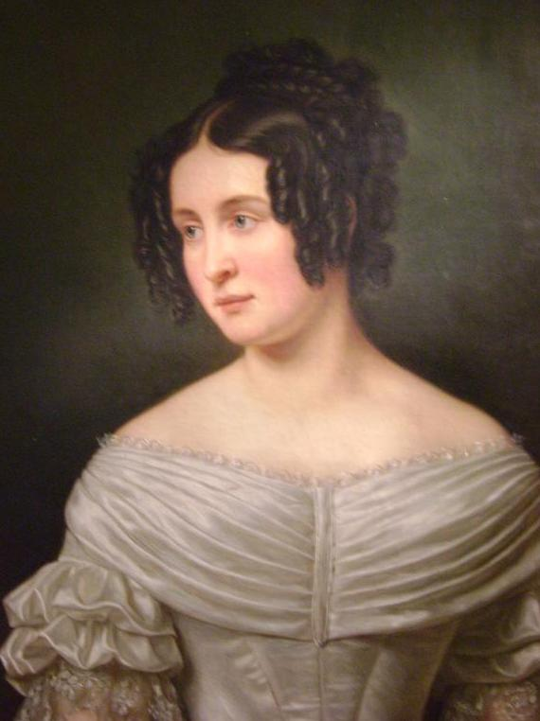
Grandparents: King Ludwig I (1786-1868) Son of Maximilian I, and only the second King of Bavaria. Godson of Louis XVI of France (Ludwig being German form of Louis) and Princess Therese von Sachsen-Hildburghausen.
Ludwig I loved art and architecture, a characteristic that apparently passed onto his grandson Ludwig II.
Abdicated his throne to his son Maximilian II on 21 March 1848 because of an alleged affair with a dancer who was 32 years his junior. He lived another 20 years.
Photo Credit: Joseph Karl Stieler
Photo Credit: Joseph Karl Stieler

Slide 4
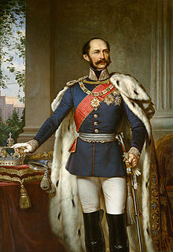
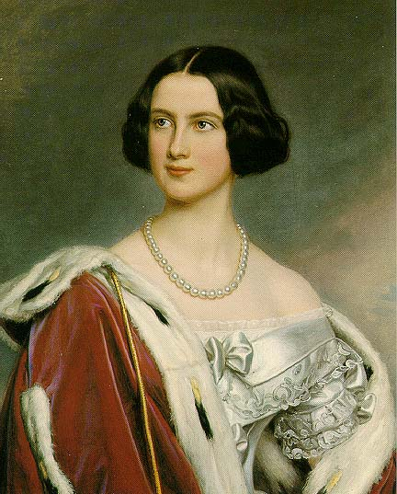
Parents: Maximilian II and Princess Maria of Prussia were cousins and she was a niece of King Friederich Wilhelm III of Prussia.
At the time of their marriage he was 34 years old and she was 17 years old. Ludwig was born 2 years after they married and his brother Otto was born 2 years later.
Maximilian II was not particularly close to his sons, but their mother was.
Maximilian was more scholarly and intellectual and his wife was more physical and physically active. He was said to have declared that if he weren’t King, he would have liked to have been a university professor.
Photo Credit: Joseph Bernhardt
Photo Credit: Joseph Karl Stieler

Slide 5
Prince Ludwig II of Bavaria (1845-1882)
Much speculation about whether he suffered from mental illness or not (specifically schizophrenia).
Speculation about his sexual orientation. He had few real friends growing up, and the nature of his relationships with other males, along with his hesitation, and even apparent aversion to marriage later in life fueled suspicions about his sexuality and the nature of the relationships (i.e. whether they were just close friendships or sexual)
He was very naïve, especially about sex.
Idiosyncratic (somewhat peculiar). Didn’t like unattractive people.
Seemed to prefer his fantasy to reality.
Devoted to his brother, and loved art and architecture like his grandfather
Enjoyed the outdoors, hiking and riding, like his mother

Slide 6
Education of Ludwig II
Started at about 8 years old, but became more formal by age 12.
By 12 years old, his governess was replaced by Major General Theodor Basselet de la Rosée, a former Cavalry soldier and other tutors. MG de la Rosée established the practice for those around Ludwig to treat him with the decorum usually reserved until a future monarch reached adulthood. This sometimes led to bad behavior on Ludwig’s part.
He studies days a week and attended mass on Sunday mornings, so he only had half a day a week off.
By age 10 he was given an allowance, but required to keep records of how he spent it. He proved to be very charitable and enjoy giving gifts to family and even everyday people that he came in contact with.

Slide 7
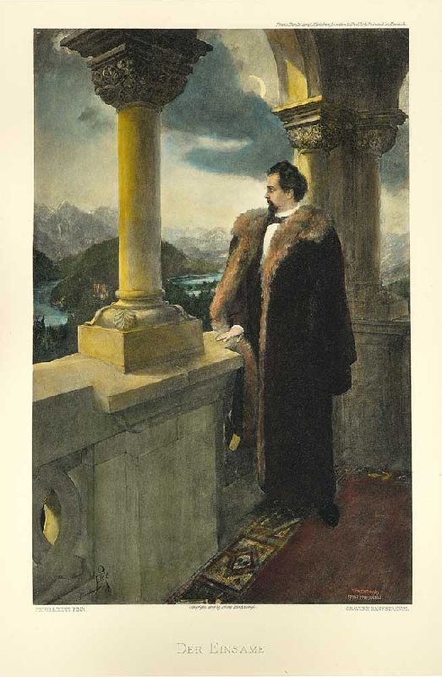
Questions of Ludwig’s Sexuality
Facet of Ludwig’s life that had come under scrutiny and was to play a role in his ultimate demise.
Homosexuality was quite common in Europe, not only in the 19th century, however, officially it was illegal.
Historically, during the time Ludwig lived, it was also common for members of the same gender to have very close, non-sexual friendships.
Photo Credit: Ferdinand Leeke

Slide 8
The Women in Ludwig II’s life:
Ludwig’s mother, Princess Maria – Ludwig was closer to his mother than his father, and apparently grew close to her again toward the end of his life, but at one time referred to her as his “successor’s consort”.
Ludwig’s Governess Fräulein Sibylle Meilhaus – perhaps closer to him than his mother. Influential over him, but replaced by the time he turned 12 so he could focus on his formal education.
Two cousins: Anna von Hessen-Darmstadt, daughter of his maternal aunt and sister-in-law to Queen Victoria’s daughter Alice, who was married to Prince Louis of Hessen-Darmstadt; and Elisabeth, daughter of Ludwig’s uncle Duke Max of Bayern. She was 8 years his senior and married to Austrian Emperor Franz Josef.
Women from the arts and theater field
Cousin Sophie, younger sister of Elisabeth, and briefly, Ludwig’s fiancé.

Slide 9
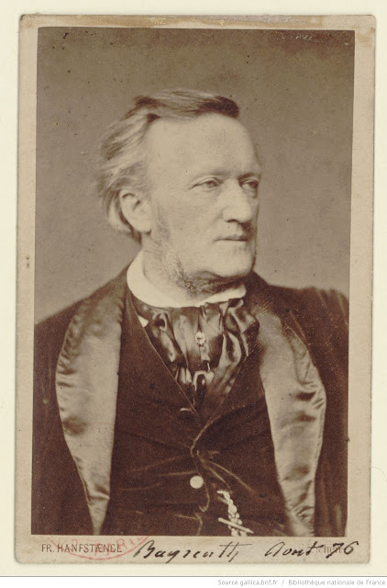
Ludwig II and Richard Wagner
Richard Wagner (1813-1883) Composer, theater director, conductor.
Ludwig first saw Lohengrin, one of Wagner’s operas when he was 12 years old.
Wagner spent much of his life in debt, until he met Ludwig.
Married Christine Wilhelmine “Minna” Planer at age 23, and although they lived apart for many years, he remained married to her until her death in 1866. In 1865 he started an affair with Cosima von Bülow, a married woman 24 years his junior.
Met Ludwig in 1864 shortly after Ludwig became King. His life was to change drastically. He was not well liked by many of Ludwig’s government because of his influence over Ludwig.
Photo Credit: Franz Seraph Hanfstaengl

Slide 10
Government System in Bavaria
King Ludwig had ministers who administered the country, but he communicated with them through two groups of advisors and aids.
Cabinet Secretariat: Dealt primarily with matters of state. This group included a Council of Ministers, similar to our what we would consider a Cabinet.
Court Secretariat: Dealt with the private purse of the King and with his theatrical and architectural projects, and other personal matters.
Bavaria after Napoleon
Deutscher Bund (the German Confederation) Established by the Congress of Vienna in 1815. Consisted of 39 German states, with Prussia and Austria being two of the most powerful and rivals.
Bavaria had only been a kingdom for 9 years at that time.
1863 – Prussia and Austria had different goals for Germany. King Maximilian was not well, and didn’t want to take sides, but was forced to attend a conference of the states that ultimately led to his demise. 10 March 1864 Ludwig became King.

Slide 11
Austro-Prussian Conflict of 1866 (aka the Seven Week War)
Austro-Prussian annexation of Schleswig-Holstein
Prussian Prime Minister Bismarck’s ambitions for a united Germany and the exclusion of Austria
Ludwig wanted to stay neutral, and considered abdicating to his brother and moving to Switzerland. Richard Wagner urged him not to abdicate, and Ludwig eventually joined Austria and her allies against Prussia.
Prussia was militarily superior and quickly won the war. Through the Treaty of Prague, Bavaria lost territory, paid a nominal fine to Prussia, but most importantly, agreed to support Prussia militarily in any future conflicts.

Slide 12
1866 – 1872
April 1867 France announced that it intended to acquire Luxembourg and Bismarck and Prussia opposed the move. Ludwig chose to honor his word to Prussia and announced that if war ensued, he would support Prussia. War was averted for the time.
First Vatican Council (1868 – 1870) Pope Pius IX curtailed freedom and democracy in the Church and formally declared the doctrine of papal infallibility. This resulted in more fractioning between liberal and conservatives in the Church and ultimately in all of Europe.
May 1869 – in Bavaria, conservatives formed the Patriot Party who advocated Bavarian independence.
Franco-Prussian War (19 Jul 1870 – 10 May 1871) – Prussia succeeded in provoking France into war, and making it look like France started it. Bavarian troops were instrumental in Prussian victories in Weissenburg and Worth.
Treaty of Frankfurt (10 May 1871) gave Germany most of Alsace and parts of Lorraine, which became the Imperial Territory of Alsace-Lorraine.

Slide 13
1872 – 1882
Ludwig started to become more and more reclusive and less interested in matters of government.
1872 – Doctors convinced Ludwig to have his brother Otto confined under doctor’s supervision due to his increasingly unstable mind. By 1876 Otto was discharged from the Army, and by 1878 he was declared insane.
During this time Ludwig’s behavior began fluctuating as well. He could be very friendly, generous, charming, or he could be devious, scheming, brutal.
His behavior toward his servants became sometimes cruel. It was forbidden to cough, sneeze clear your throat, or speak in a Bavarian accent in his presence.
He spent less in Munich and more time in his castles and hunting lodges away from the bustle of the city and eyes of his subjects and more secluded. He became more interested in playing the roles of his fantasies and his building phase started.

Slide 14
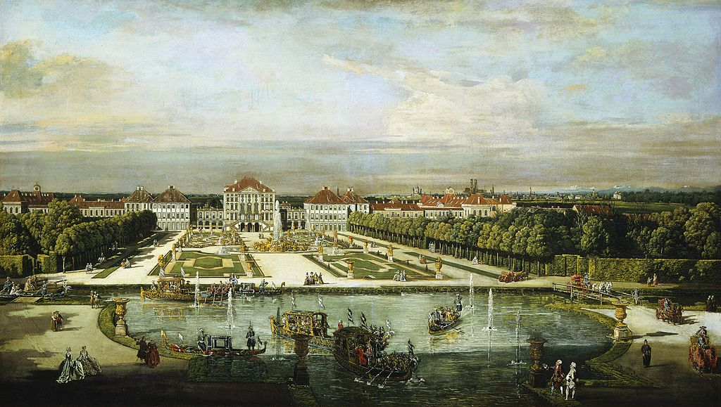
Ludwig’s Castles
Castles associated with Ludwig which he did not build
Nymphenburg Palace Ludwig was born in this castle. Located in what is now suburban Munich. Building started in 1664 and added to by successors and continued for 100 years. Owned by Ludwig’s grandfather Ludwig I.
Nymphenburg Palace around 1760 as painted by Bernardo Bellotto

Slide 15
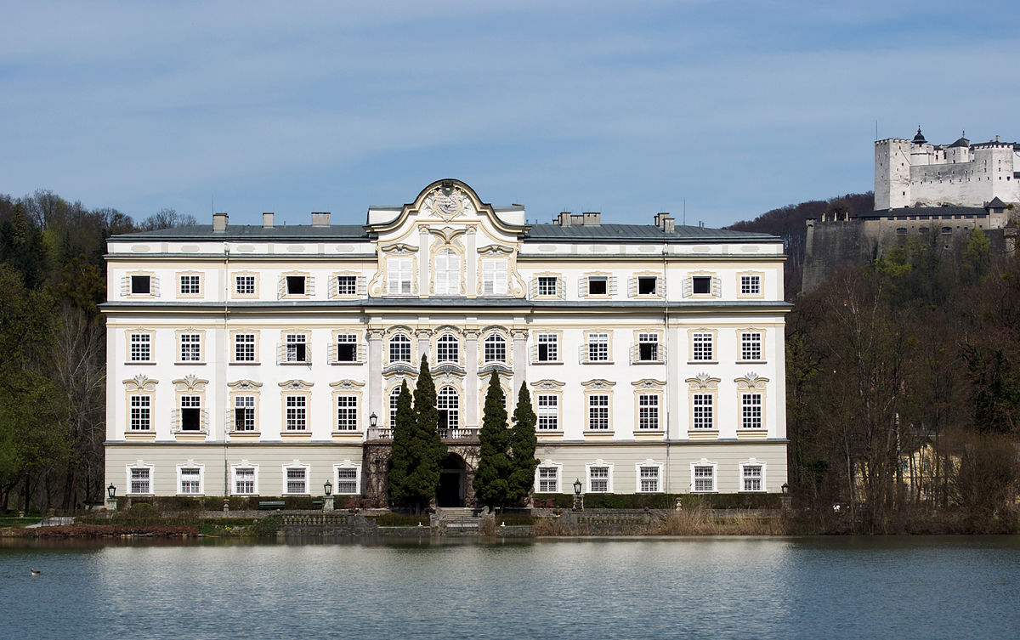
Leopoldskron Castle Located in the hills above Salzburg. Acquired and lived in by his grandfather Ludwig I in the last 20 years of his life. Scenes from outside of this castle were used in “The Sound of Music”.
By Simon1976 - Own work, CC BY-SA 3.0, https://commons.wikimedia.org/w/index.php?curid=16363747

Slide 16
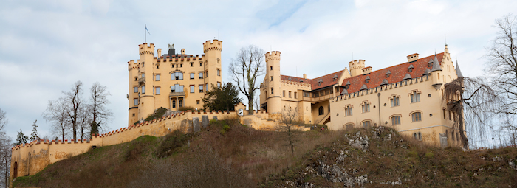
Article Source: http://www.articlesbase.com/travel-articles/the-actual-occupants-of-hohenschwangau-castle-4495644.html
Article Source: http://www.articlesbase.com/travel-articles/the-actual-occupants-of-hohenschwangau-castle-4495644.html
Hohenschwangau (High country of the Swan) Located on a mountain across from Neuschwanstein. Built by Ludwig’s father on top of a medieval ruin.
Peter Nowacki, http://www.articlesbase.com/travel-articles/the-actual-occupants-of-Hohenschwangau-castle-4495644.html

Slide 17
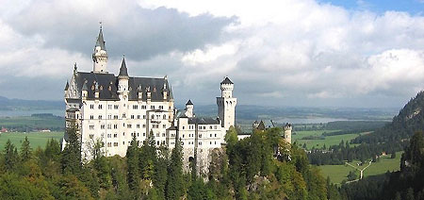
Castles built or planned by Ludwig II
Heinrich Kreisel, in his book on Ludwig’s castles, divides the buildings into 3 groups: the Grail, the Sun and the Moon.
The Grail
Neuschwanstein – Perhaps the best known castle of Ludwig. Used as a model for Sleeping Beauty’s castle by Walt Disney. First castle built by Ludwig; opened on Christmas Day 1881.
Photo from http://www.neuschwanstein.de/

Slide 18
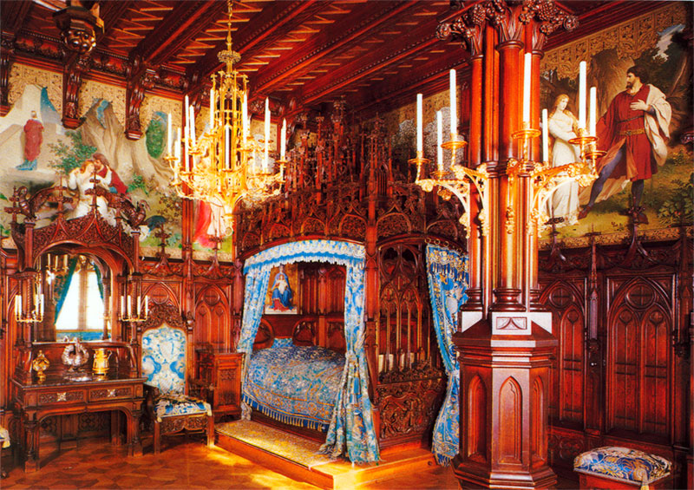
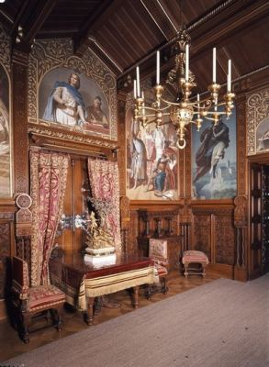
King Ludwig’s bedroom - the bed is a single bed and, like the rest of the castle, swans reign.
Dining Room – equipped with an electric bell system so Ludwig could summon staff

Slide 19
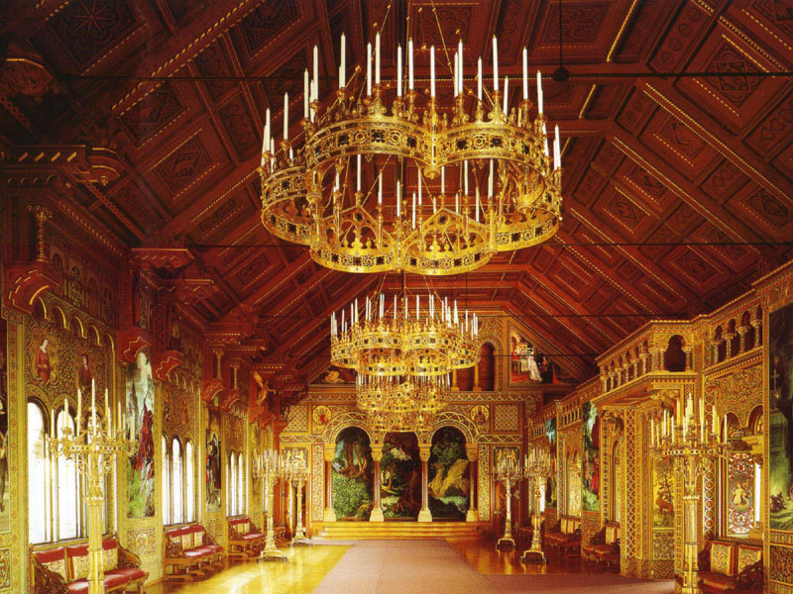
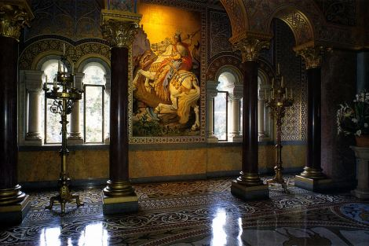
SIMPLY GRAND: The Singers’ Hall takes up the topmost floor of the castle.
It’s one of the castle’s most important rooms and was to be used for large banquets and musical performances.
HALL OF MAJESTY: The Thronsaal, the Throne Room. Oddly enough, the most important thing for a throne room – the throne itself – is missing. It was on order when Ludwig died and delivery was cancelled when the Bavarian parliament ordered work on the castle to stop.

Slide 20
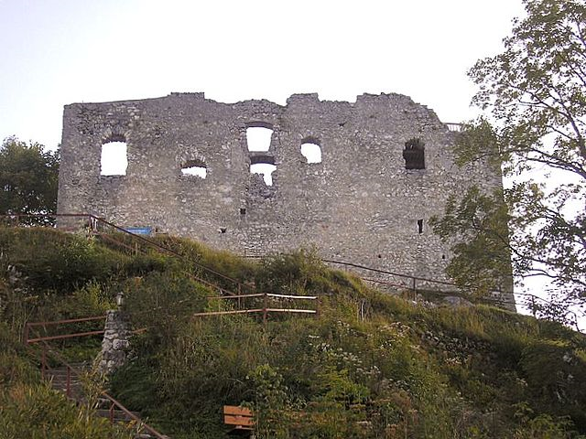
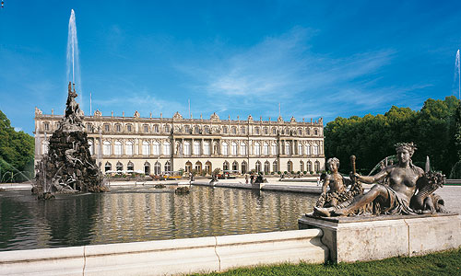
Falkenstein Castle
The Sun Castles
Herrenchiemsee – Third castle built by Ludwig. Designed after Versailles.
What remain of Falkenstein Castle.
https://commons.wikimedia.org/w/index.php?curid=1210646
http://www.herren-chiemsee.de/deutsch/n_schloss/index.htm

Slide 21
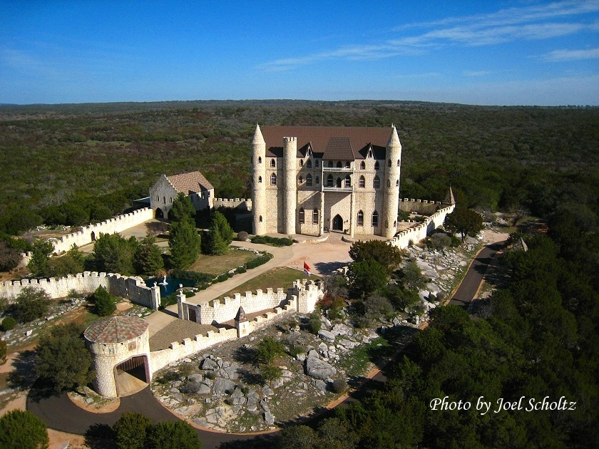

Slide 22
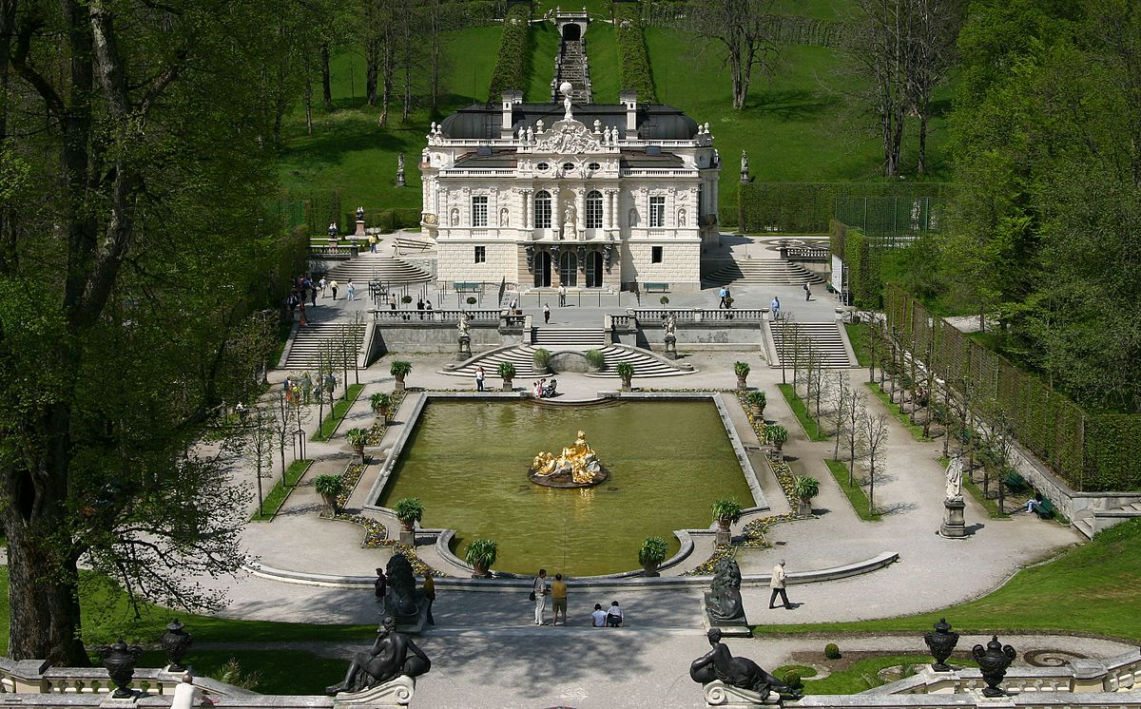
Linderhof – On the other side of the mountain from Neuschwanstein at the bottom of a valley. Smallest of 3 castles built by Ludwig and the only one he completed. Fashioned after Versailles.
By Softeis - Own work, CC BY-SA 3.0, https://commons.wikimedia. org/w/index.php?curid=161243

Slide 23
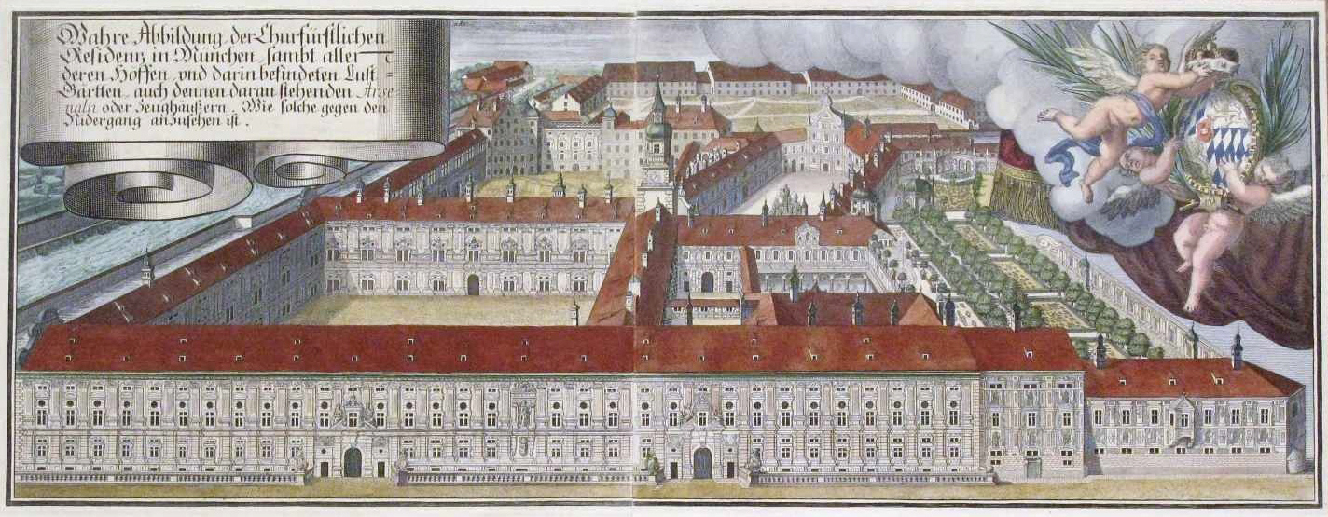
Munich residence is the 1800s
The Royal Apartments in the Munich Residencz. The Residencz is the largest
city palace in Germany. The complex of buildings contains ten courtyards and displays 130 rooms. The three main parts are the Königsbau (near the Max-Joseph-Platz), the Alte Residenz (Old Residenz; towards the Residenzstraße) and the Festsaalbau (towards the Hofgarten).

Slide 24
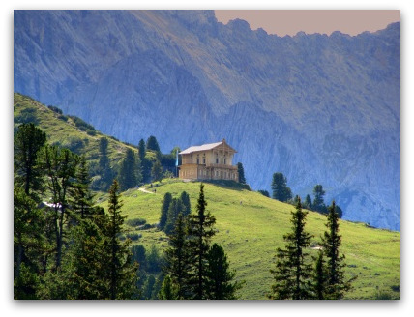
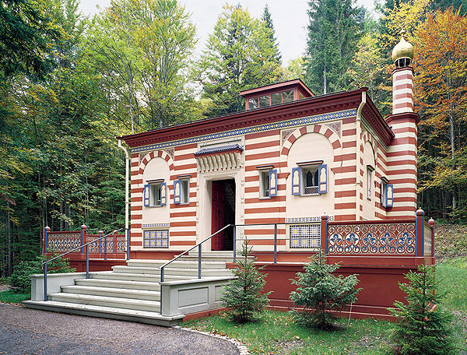
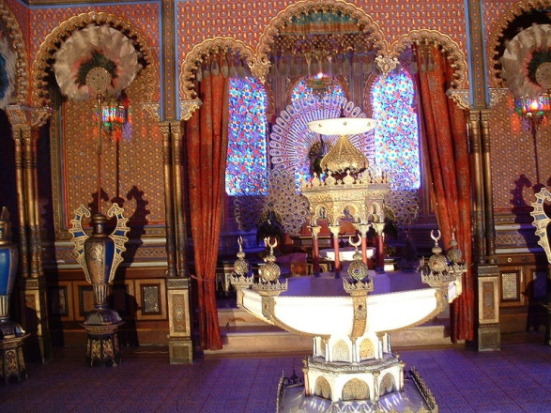
The Moon Castles
Schachen hunting lodge (aka Königshaus (King’s House)) is a wooden two-story cottage high up on Mount Schachen in the Bavarian Alps.
The Morrocco House – built on the grounds of Linderhof.
The Moorish Kiosk at Linderhof – Ludwig fell in love with it in July 1867 when he visited the World’s Fair in Paris. He bought it and had it disassembled and shipped to Linderhof and reassembled in the park

Slide 25
Ludwig’s Final Days 1883 – 1886
Following Richard Wagner’s death in February 1883 Ludwig seemed, for a short time to take interest in being King again.
Because of his building frenzy, Ludwig started having financial problems .
Rumors of payments from Bismarck in exhange for Kaiserbrief signed and sent by Ludwig inviting Prussia’s King Wilhelm to become the Emperor of Germany in 1871 at the end of the Franco-Prussian War.
1884 – Ludwig in debt in the amount of 7.5 million marks. Able to get a loan from a group of southern German banks.
December 1884 – sold a title for an additional 400,000 marks
Summer 1885 – Ludwig now in debt an additional 6 million marks (total debt 14 million marks)
May 1886 – Company that supplied gas and water to Ludwig’s castles went to court to get the 100,000 marks Ludwig owed them.

Slide 26
The End
23 March 1886 – Prime Minister Johann von Lutz meets with Dr. Bernhard von Gudden (Professor of Psychiatry at University of Munich and director of the District Mental Hospital of Upper Bavaria) about Ludwig’s mental condition.
9 June 1886 – Contingent including Dr. von Gudden go to Hohenschwangau in preparation to notify Ludwig who was at Neuschwanstein and take him into custody.
10 June 1886 – Ludwig forewarned and the group was denied entry, and even imprisoned for a few hours. They were released after Prince Luitpold sent word to let them go. During this time Ludwig spoke of suicide.
12 June 1886- Ludwig finally allows himself to be taken into custody. He is taken to Berg (on the east shore of Lake Starnberg in the village of Berg in Upper Bavaria).

Slide 27
13 June 1886 – Ludwig allowed to go for a walk with Dr. von Gudden and an orderly. He and Dr. von Gudden go for a second, unaccompanied walk again at 6:45 pm, with intentions to return at 8 pm. Their bodies were found after 10 pm.
Persisting Questions
Did Ludwig commit suicide? Was it murder? Was he actually insane? Or just an embarrassment?
Der Spiegel and The Telegraph publish articles in 2014 citing a study published in the journal “History of Psychiatry” questioning von Gudden’s diagnosis of Ludwig and the evidence he accepted.
Dr. Christoph Biermann – “Leiden eines Königs” Suggests that if in fact Ludwig was insane it may be because schizophrenia ran in the family, as evidenced by Ludwig’s brother Otto.
Syphillis also a possible cause. Ludwig’s sexuality comes into question again as a possible cause (though there is no evidence Ludwig was ever diagnosed with it). If he did have it, it is also possible he contracted it congenitally from his father, or even early in life from his wet nurse, as she died supposedly from typhoid fever when he was 7 months old.

Slide 28
Bibliography
McIntosh, Christopher (1982). The Swan King, Ludwig of Bavaria. Tauris Parke Paperbacks.
Stone, Humphrey (1978). Designs for the Dream King. Debrett’s Peerage Ltd.
Blunt, Wilfred (1970). The Dream King,Ludwig of Bavaria. The Viking Press, Inc.
Thadeusz, Frank (2014). Study Claims Bavarian Monarch Was Sane, Der Spiegel Online.
The Telegraph (2014)
Desing, Julius; Klenberger, Wilhelm (1992). Royal Castle Neuschwanstein, The King and His Castle. Wilhelm Klenberger GmbH.
Königsschloß Neuschwanstein Kalender 1998, Fotoverlag Huber
Fotoverlag Huber (1997). Neuschwanstein Hohenschwangau Guide.
www.wikipedia

