Slide 1
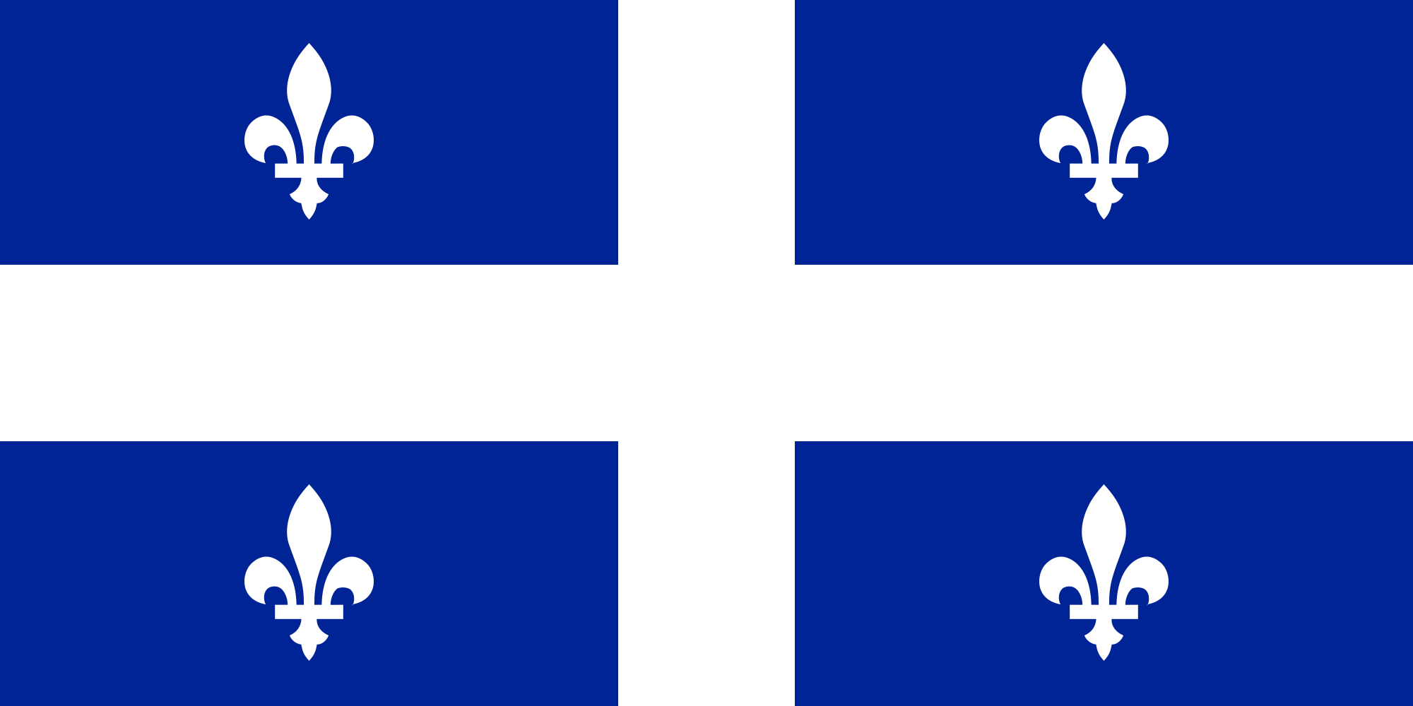
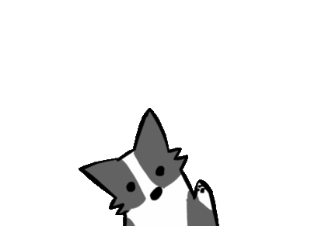
Travel Guide to:
Québec
Gabrielle Guitard
Culture Project
December 5 2018

Slide 2
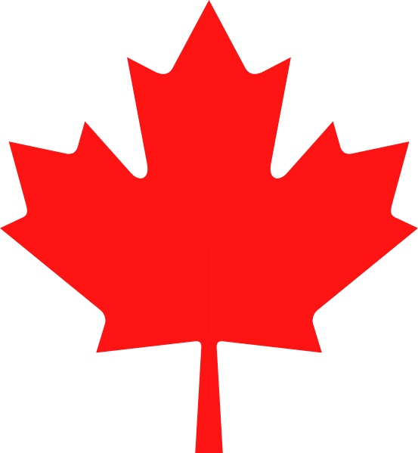
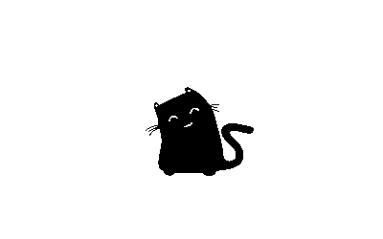
Music
Agenda
Currency
Activities
Food
Cities
History

Slide 3
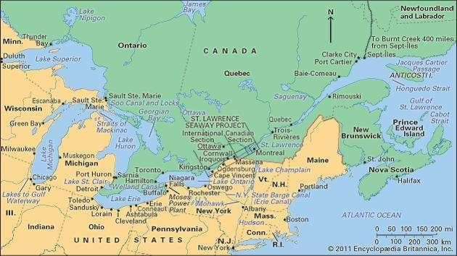
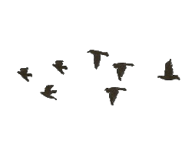
Instructions for use
History
Quebec became part of canada in 1840.
Quebec was part of the first four provinces.
Quebec os the largest canadian province
Quebec is also the oldest city in canada as well
Quebec means where the river marrows
*St.Lawrence river is import to many since water and ice sports are people favorite thing to do
Quebec Speaks french but also teaches english in school.
Most know broken english
Quebec for a long time has been trying to separate themselves from canada

Slide 4
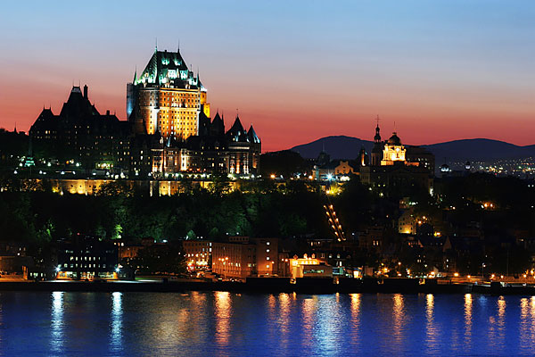
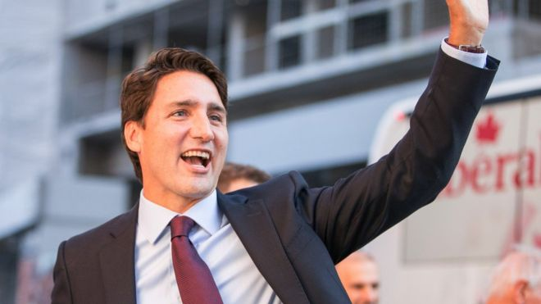
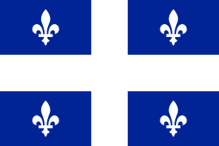

In two or three columns
Capital
Is Quebec
History
Prime Minister
Justin Trudeau
Population
Is 8.4696 million as of 2018
The Quebec Flag
has a white fleurs-de-lis witch is a symbols of purity and
blue field symbolizing Heaven come from a banner honouring
the Virgin Mary. One such was reputedly carried by French
Canadian militia at General Louis-Joseph de Montcalm's
victory at Carillon.

Slide 5
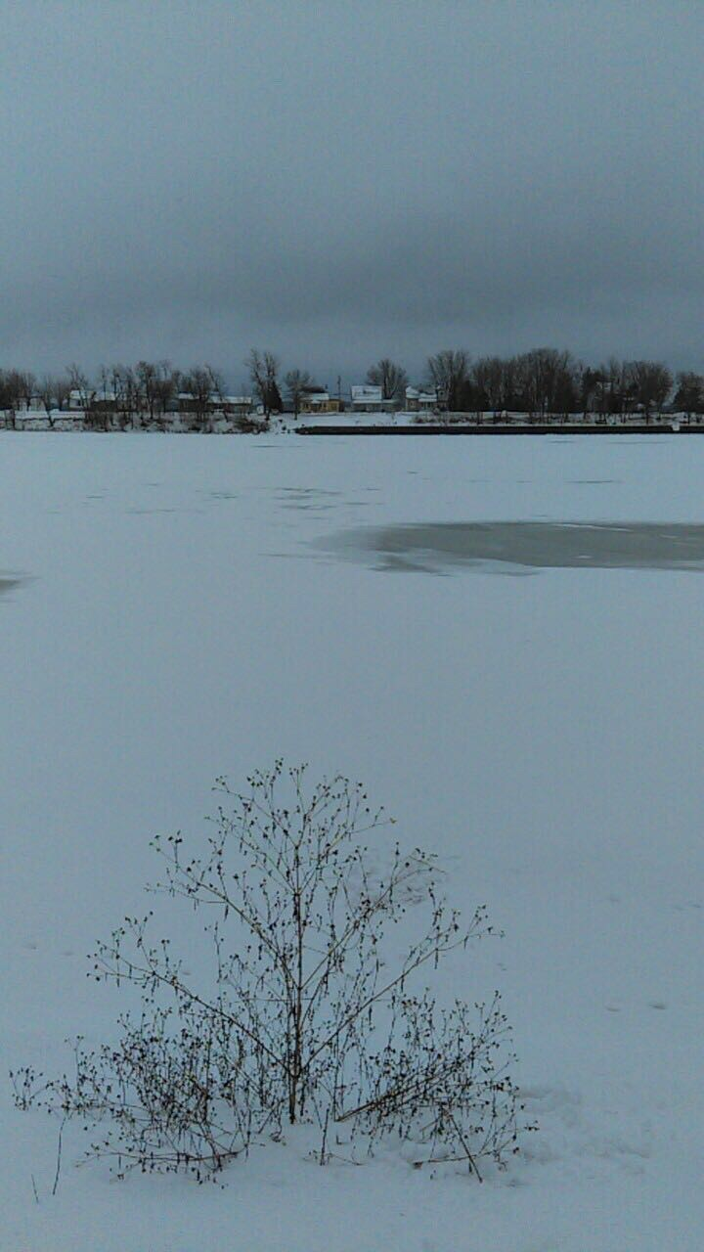
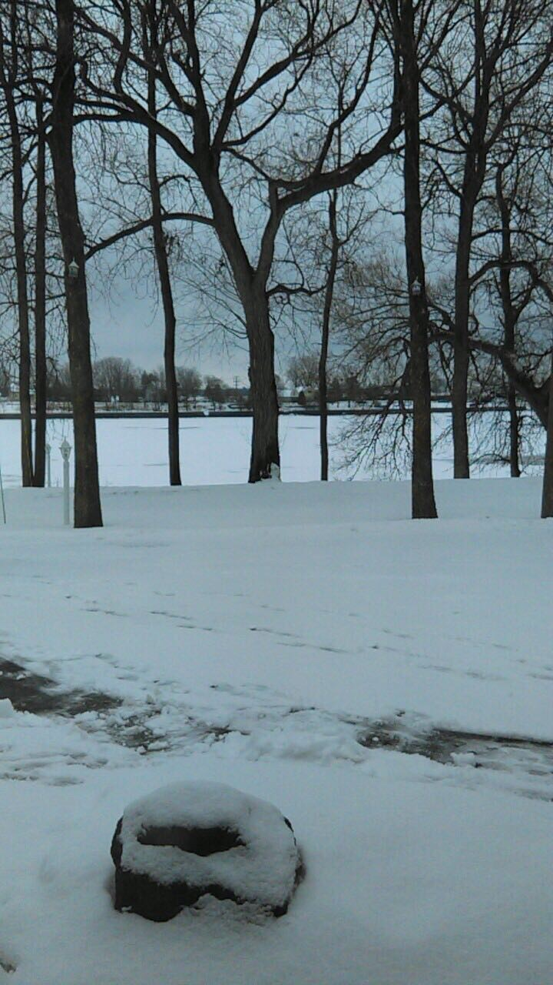
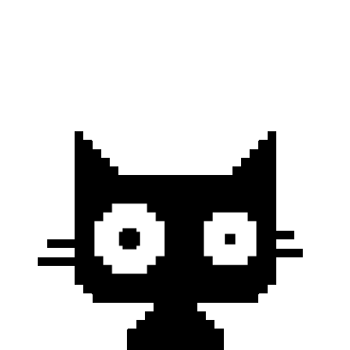
Cities
Cites
In Quebec there is
145 parishes
227 towns
42 Townships
2 United townships
44 villages
There are no longer cities they are called municipalities
My aunt lives: St.Mar reshru

Slide 6
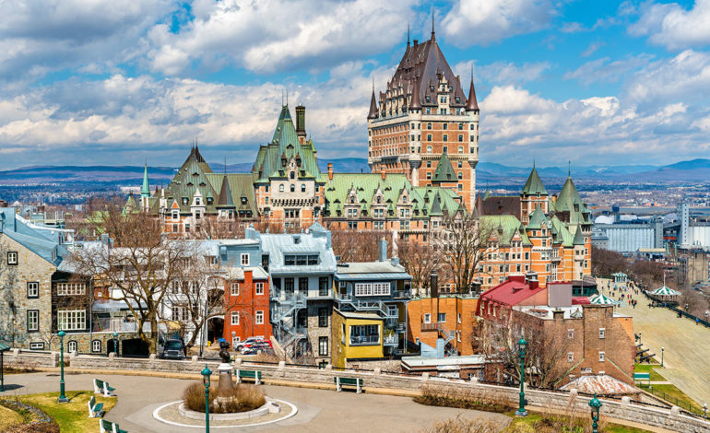

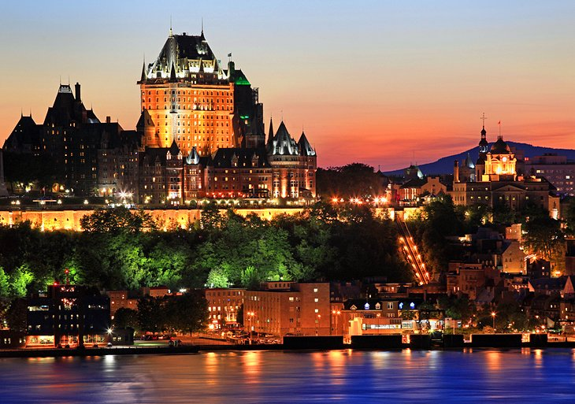
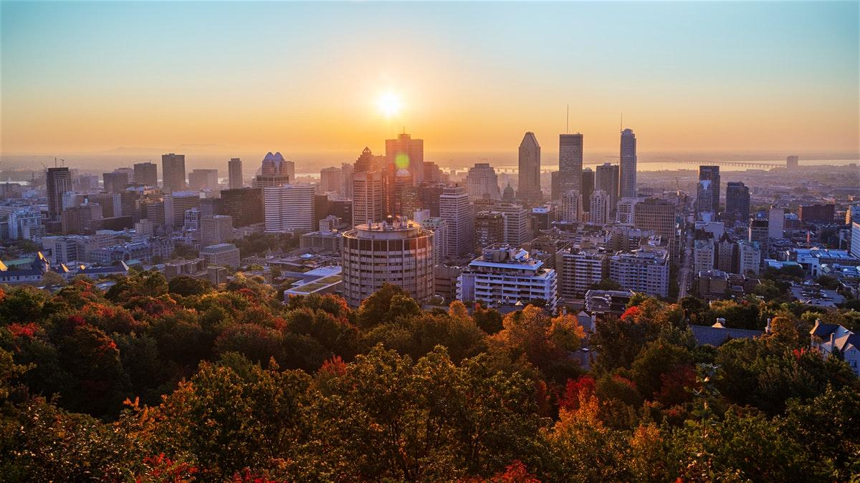
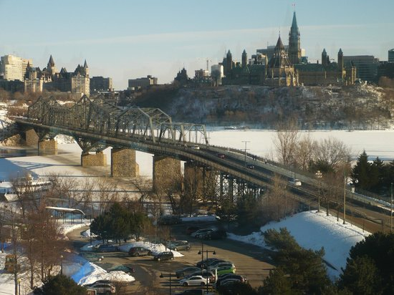
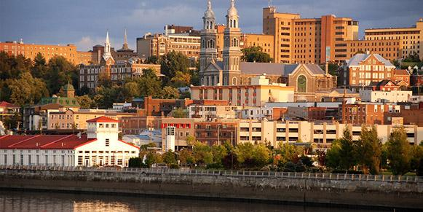
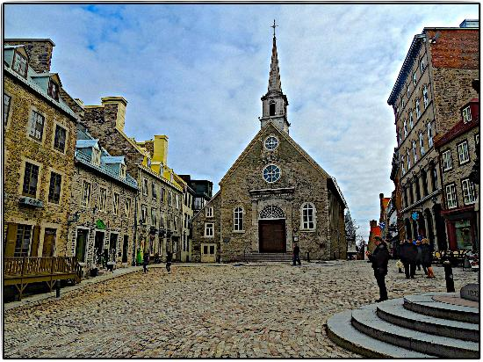
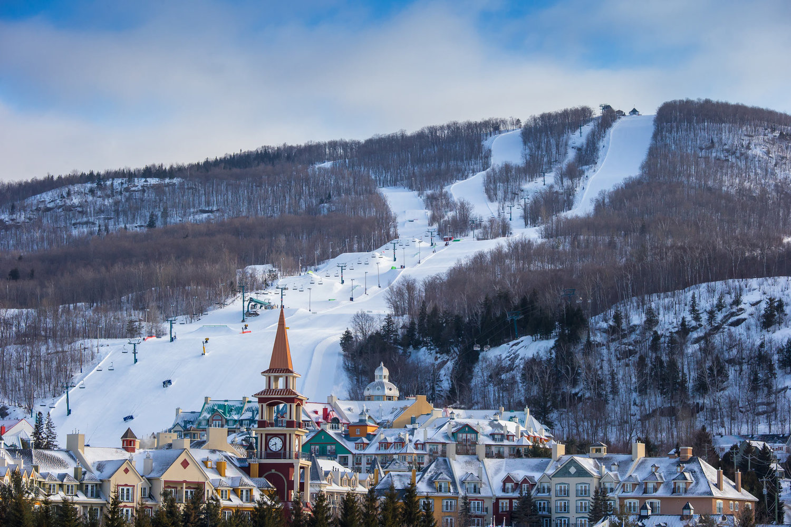
Let’s review some concepts
6 most
Populare
“cities”
Quebec City
Quebec city is the most popular and known by most and has the most tourist spots.
Pop: 530,000
Montreal
Its largest municipality in quebec providence. Was also known as the ville-marie (city of marie).
Gatineau
Is the fourth biggest provinces. It is located on the northern bank of ottawa river across from ottawa river. Has the byWard market and canadian museum of history.
Trois-Rivieres
Means 3 rivers since the saint maurice river has 3 mouths out the saint lawrence river.
Saguenay
There's urban life,great outdoor and cruises. There are also good museums and aquariums.
Mont-Tremblant
Is located in the laurentian mountains northwest of the montreal. Has an all year round four season ski resort

Slide 7
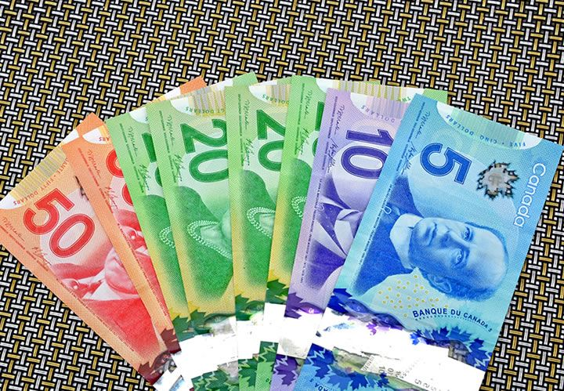
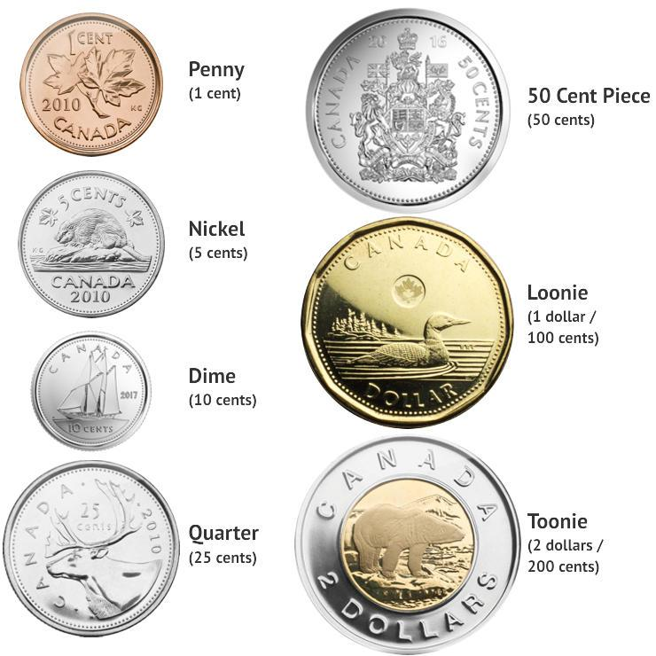
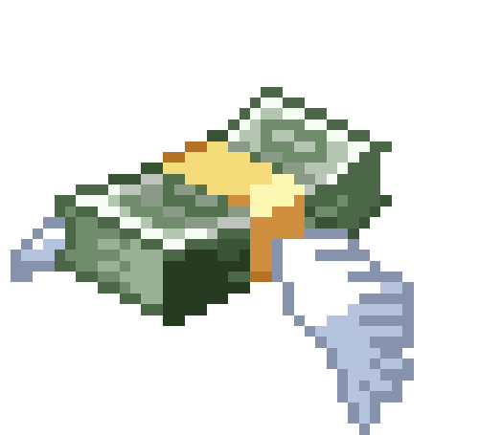
Cities
Currency
Symbol‎: ‎$‎ or Can$ or C$ or CAD
Cent‎: ‎¢
Rarely used‎: ‎1¢‎, ‎50¢
Code‎: ‎CAD
USD
$ 1 USD
$ 5 USD
$ 10 USD
$ 50 USD
CAD
C$ 1.29 CAD
C$ 6.47 CAD
C$ 12.94 CAD
C$ 64.70 CAD

Slide 8
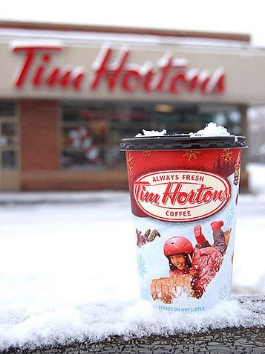
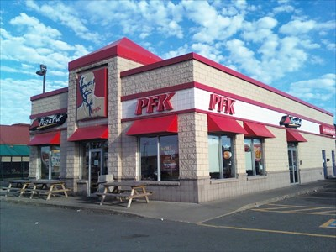
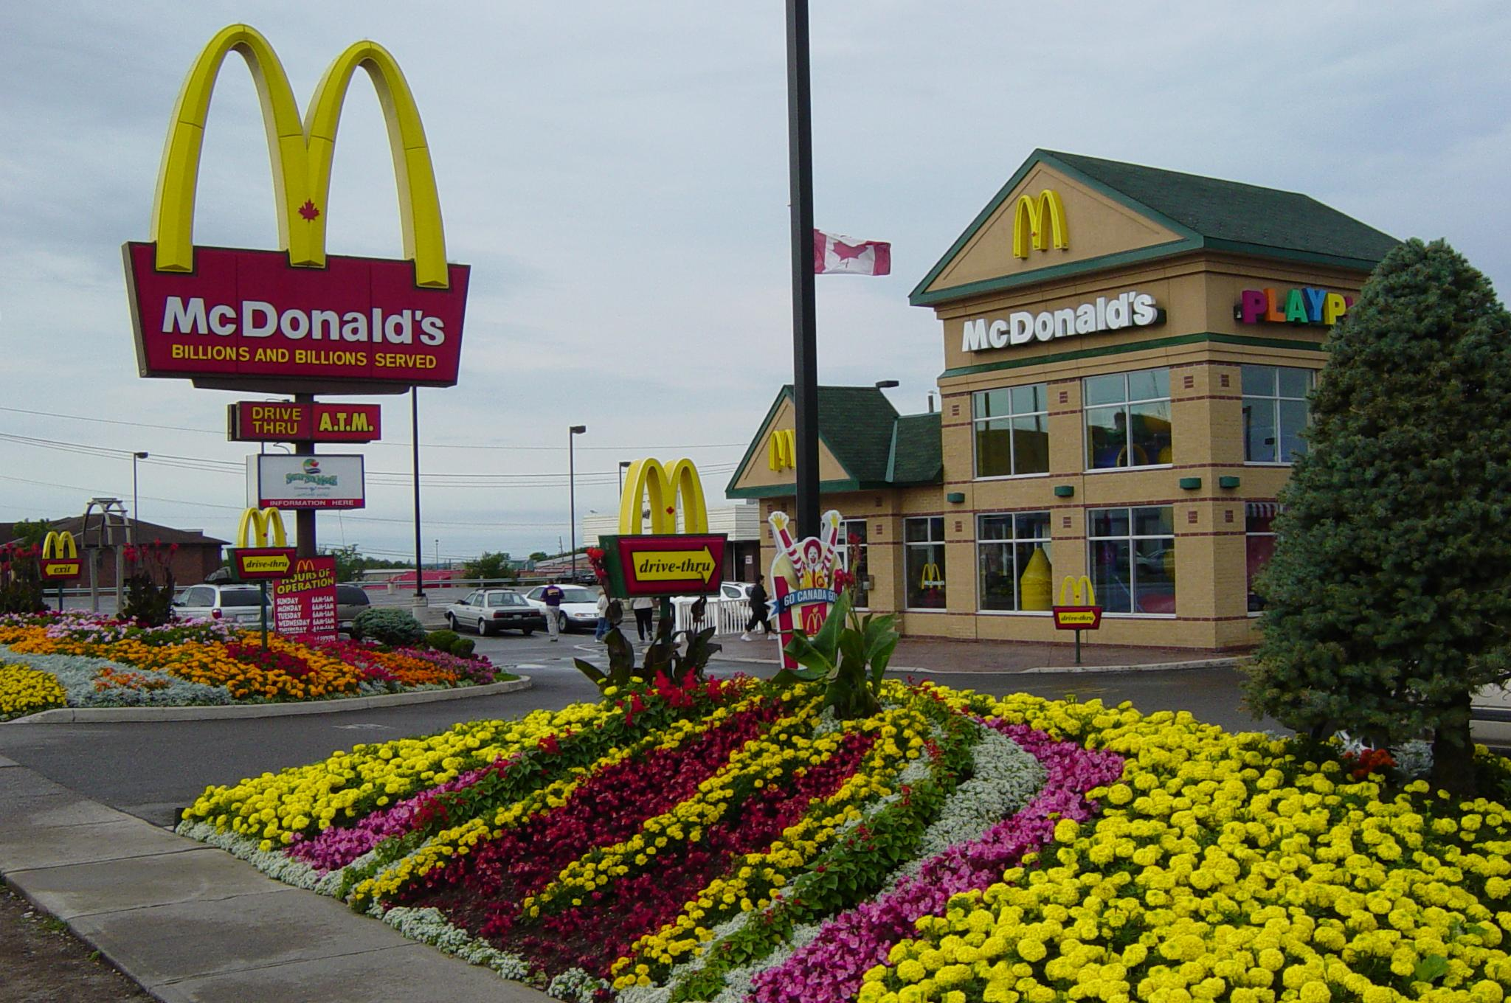
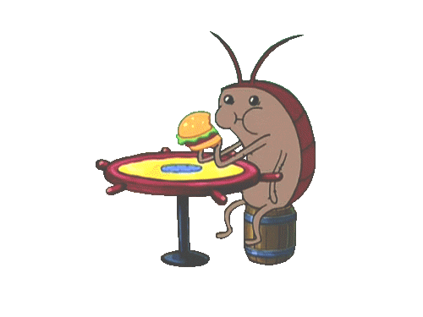
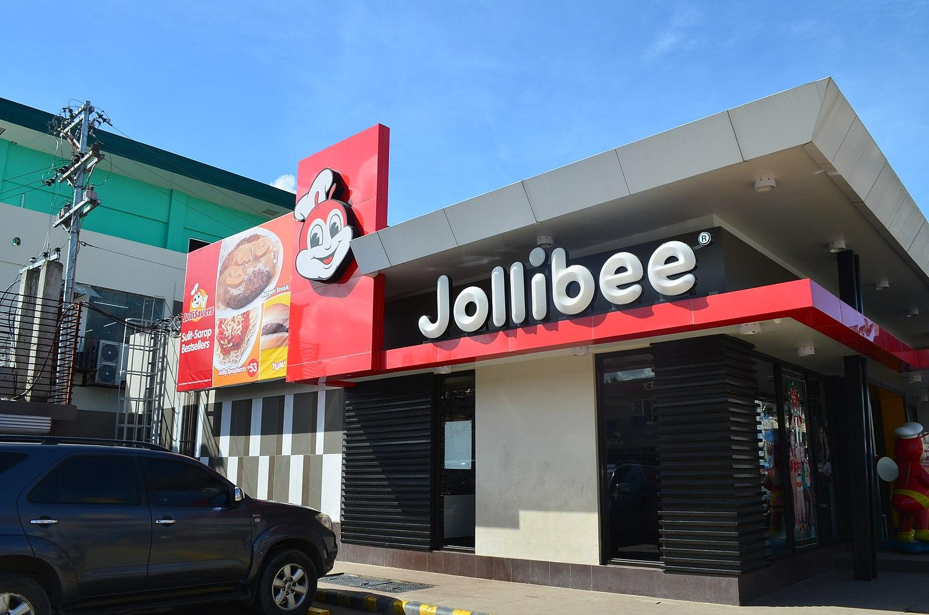
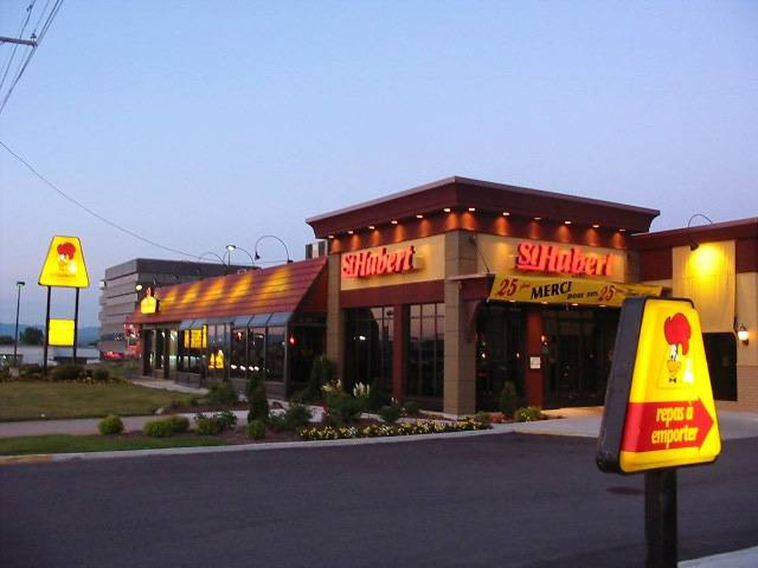
Cities
Tim
Hortons
Also known as
timmy’s is a
coffee shop.
It is like the
dunkin donuts
of Canada.
.
McDonalds
It's just like are
McDonald's
in the US
but they have
some candian
dishes like
poutine.
PFK
It's the
Canadian
version of
KFC.
Chicken in
French is Poulet.
Food
Jollibee
Is like all fast
food restaurants
combined.
They have fried
chicken, rice,
burgers, and pasta even boba tea. They
have Jollibee in
new york and mass
StHubert
It's like an
Applebees. It's a
sit in restaurant
that sell many
different food dishes. Also have they best gravy.
Caetine/farmer market
Open in the summers they sell Pongo, poutine, burgers.All kinds of fruit and veggies. Also maple syrup ,honeys, and homemade dessert.

Slide 9
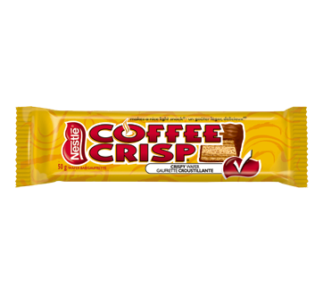
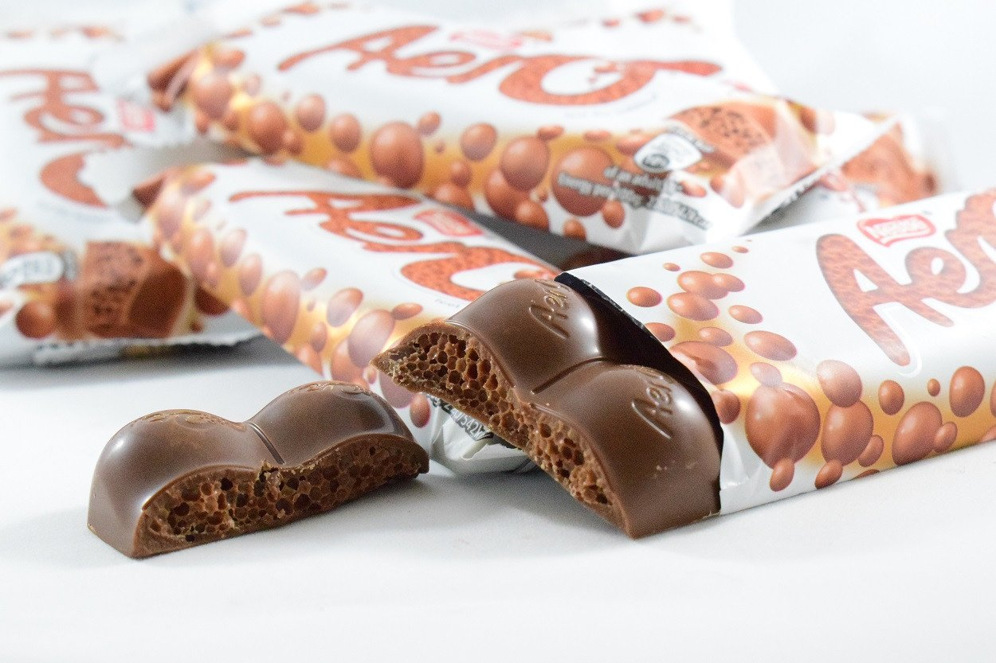
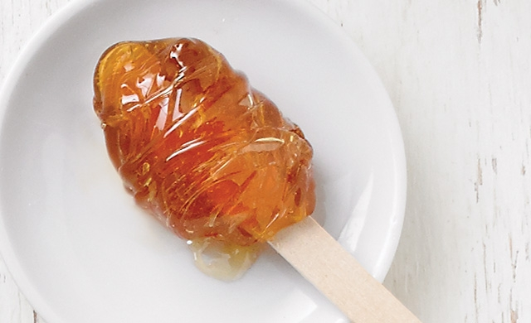
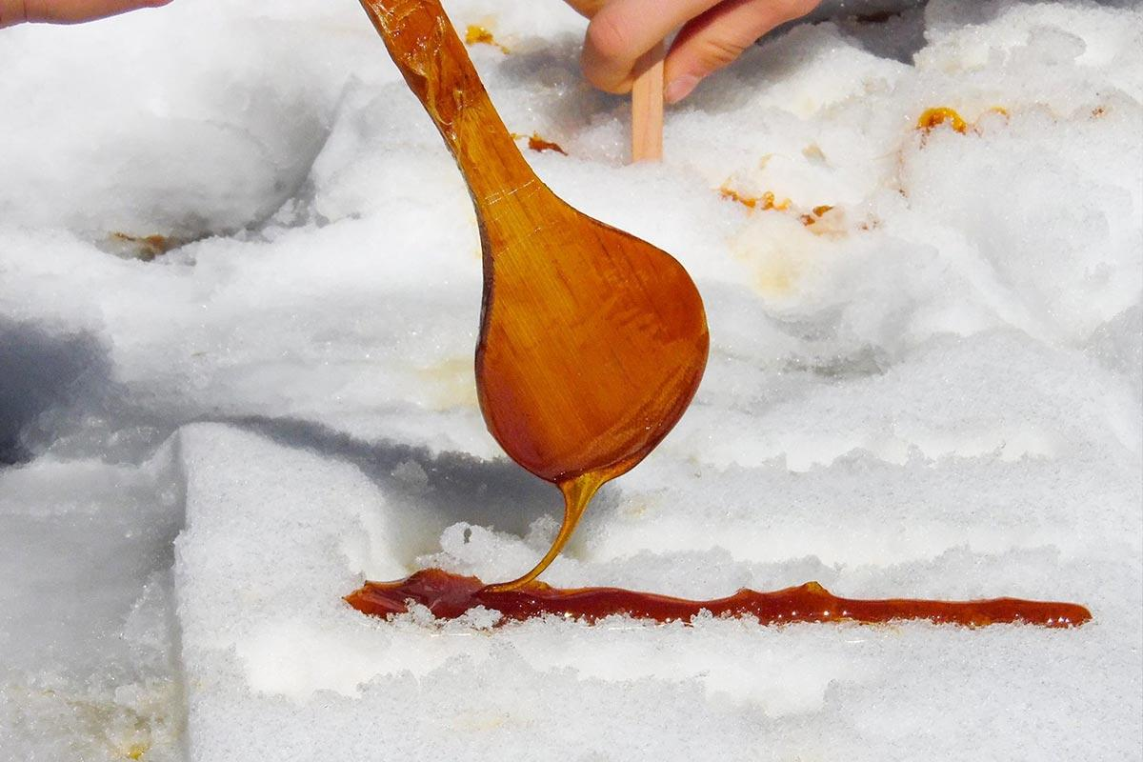
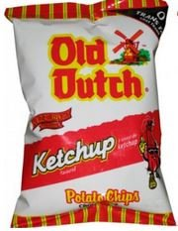
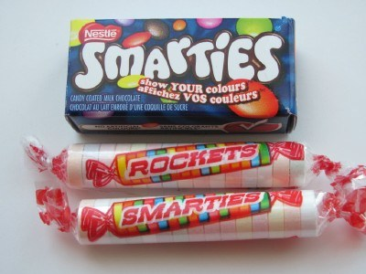
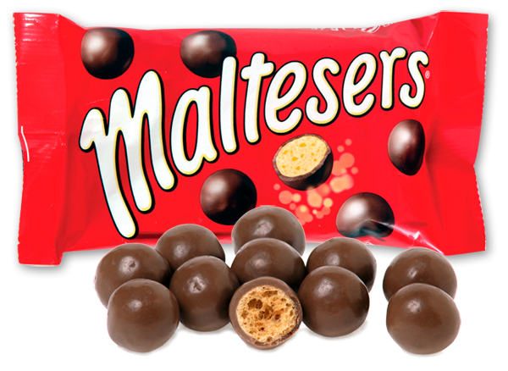
Cities
Coffee Crisp
It's like a coffee version of kit-kats just bigger.
Aero
It's a milk chocolate bar with lot of little air holes.
Maple Taffy
Is not like american taffy. When fresh snow falls canadians go outside and pours maple syrup in the now and roles it ione a stick. They do this at home and in festivals.
Food
Smarties/rockets
Smarties are like M&M with better chocolate.
Rockets are US smarties.
Ketchup Chips
Chips that have ketchup flavour on it .it very popular and good.
Maltesers
Are whoppers renamed to Maltesers

Slide 10
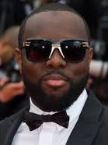
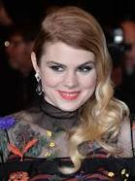
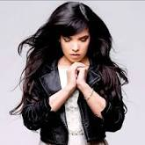
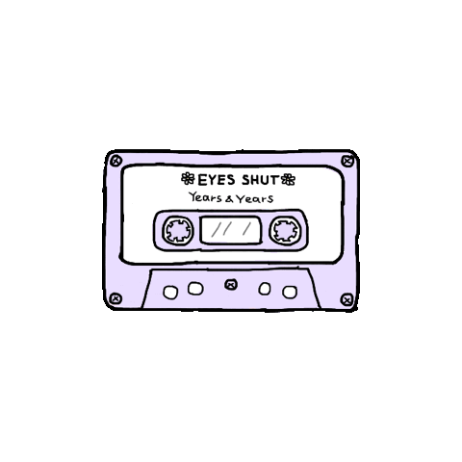
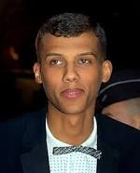
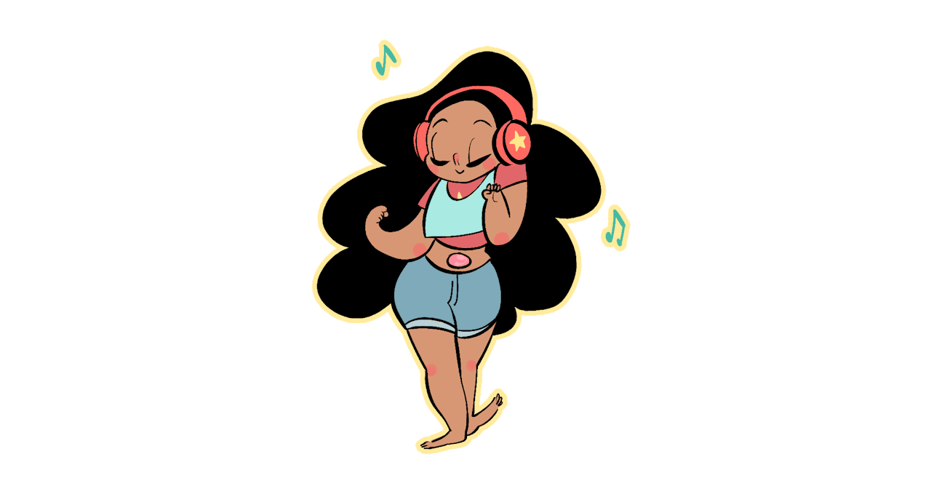
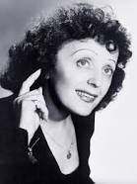
Let’s review some concepts
Music
Maitre Gims
His real name is Gandhi. He is a french rapper and singer.
Coeur De Pirate
She is a canadian singer and songwriter. She is from montreal her name is beatrice martin.
Indila
Her real name is adila.She french singer and songwriter.
Stromae
His real name is Paul her is a Belgian musician, He is also a rapper and singer-songwriter.
Radio
You will hear some french radio stations but mostly you will her 2000’s hit songs
Edith Piaf
She was a french vocalist, songwriter, cabaret performer and film actress.

Slide 11
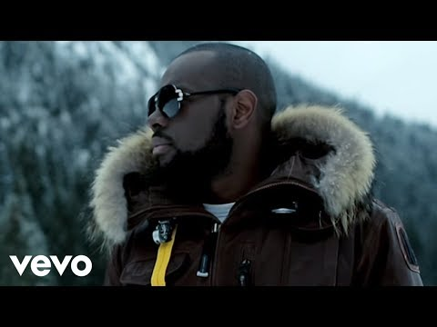
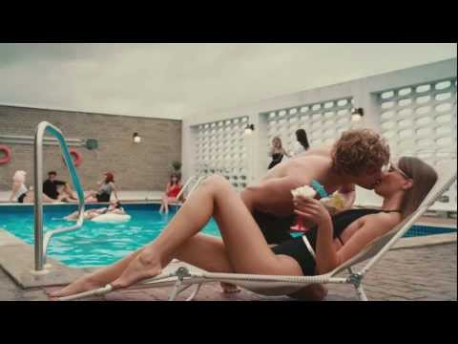

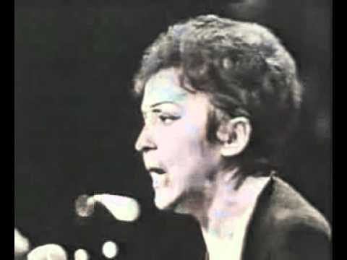
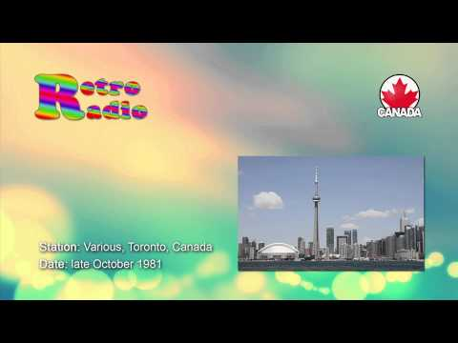
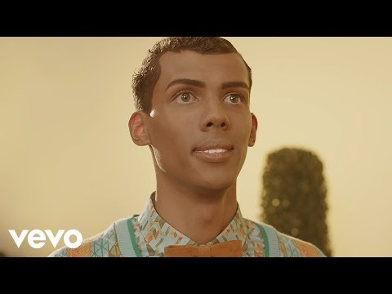
Music I listen to

Slide 12
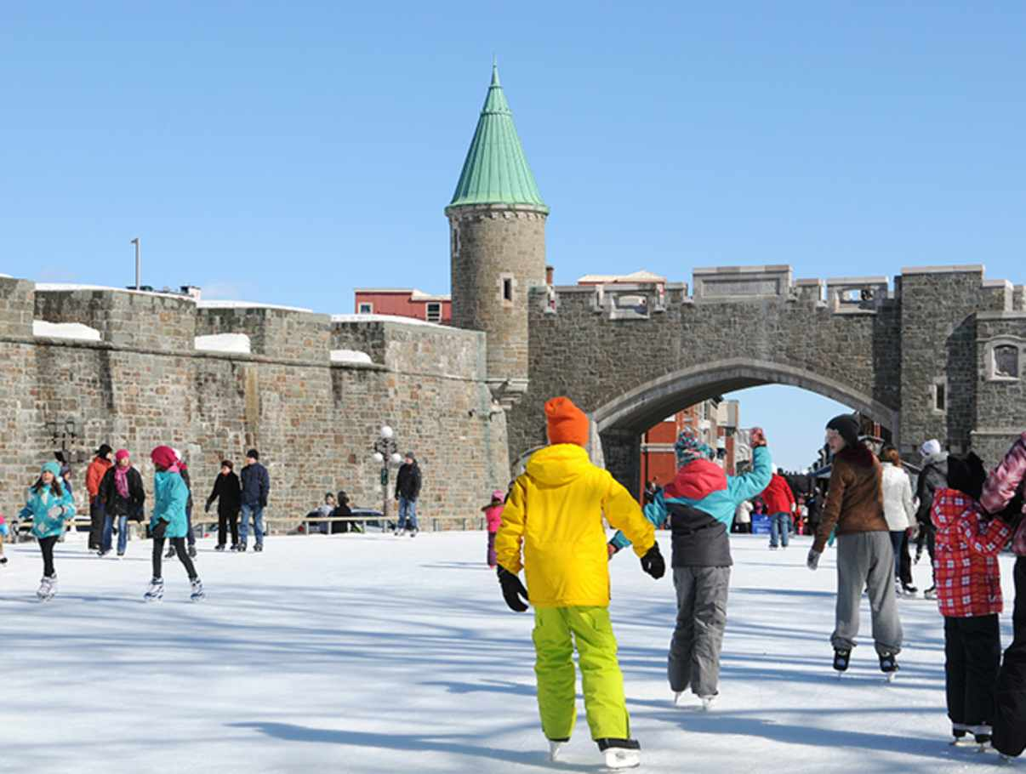
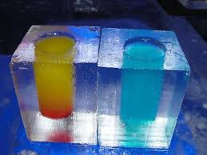
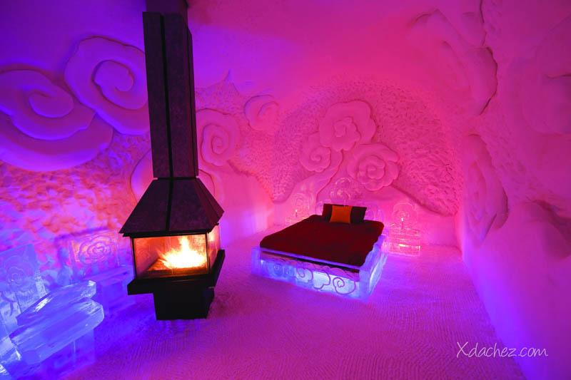





Let’s review some concepts
Hotel de glace
Ice Hotel where everything is made out of ice you are allowed to stay for one night only.
Act vitys
(winter)
Hockey
Hockey is really big in candia. Once the river
has frozen over or the rinks tons of people play hockey. on.
Ice skating
Another very popular thing to do in canada
Ice canoeing
Just like normal canoeing just with ice and colder weather,
Skiing and snowboarding
A Lot of outside snow sports.
Shopping
Alots are great places to shop and malls are really big. Most things have french and english writing

Slide 13
Wikipedia
https://en.wikipedia.org/wiki/List_of_village_municipalities_in_Quebec
https://en.wikipedia.org/wiki/List_of_fast-food_chains_in_Canada
https://en.wikipedia.org/wiki/Canadian_dollar
The Canadian Encyclopedia
https://www.thecanadianencyclopedia.ca/en/article/quebec
Google images
https://www.google.com/search?q=canda&rlz=1C1CHBF_enUS759US759&source=lnms&tbm=isch&sa=X&ved=0ahUKEwj62_30-IffAhXGpFkKHfbpBREQ_AUIDygC&biw=1022&bih=880
Youtube
https://www.youtube.com/watch?v=0fg1dk-j6P8
Trip advisor
https://www.tripadvisor.com/Attraction_Products-g155033-zfg11869-Quebec_City_Quebec.html
Family
Work cited

Slide 14

Thank you!
Any questions?

